Slide 1

Current and Future Directions in
Health Systems Research
Presented November 29, 2023, Updated January 29, 2024
Amy M. Kilbourne, PhD, MPH, Acting Director
Health Systems Research, Office of Research and Development
U.S. Dept. of Veterans Affairs
Amy.Kilbourne@va.gov

Slide 2
Many thanks to the HSR Team!
Liza Catucci
Eric Enone
Bonnie BootsMiller
Mary Walsh
Melissa Braganza (QUERI)
Kara Beck (QUERI)
Stefanie Gidmark (QUERI)
Slava Butkovich (QUERI/VBA)
Christine Nguyen
Veronica Gittens
Judy McMaster
Diane Murphy (FINANCE)
Amelia Schlak (AAAS)
Maren Loe (AAAS)
Alex Meredith (AAAS)
Tiffin Ross-Shepard
Cathie Plouzek
Crystal Henderson
Amanda Borsky
Robert O'Brien
Amy Kilbourne

Slide 3
HSRD is now Health Systems Research (HSR)
ORD Reorganization: HSRD, RRD, BLRD, and CSRD → “broad portfolios” (BP)
  In mid-2023, HSRD transitioned to the “Health Systems Research” BP
  To better align with VA priorities, some BP funding moved from the BPs to “actively managed portfolios (AMPs)”
  Each BP has a purview statement of scientific goals that informs their funding decisions
HSR priorities expanded as strategic methodology areas
  Reflect VA/VHA priority goals and NAM Quintuple Aim goals
  Previously described in our HSR RFAs, so familiar to SMRBs and investigators
  Do not replace but expand on the current topic areas
Using cutting-edge science that informs how treatments, programs and policies work for Veterans and their providers, HSR/QUERI investigators are poised to inform VA strategic goals as national learning health system thought leaders

Slide 4
Office of Research and Development Reorganization
Updated November 29, 2023
Office of Research and Development
Veterans Health Administration

Slide 5
ORD Reorganization
More efficient use of resources to enable more impactful research investments (“big studies”, Veteran access to latest treatments)
  Centralized HR, IRB, IT/data analytics, and contracting support
  Make it easier for external organizations to partner with VA research
New organizational units: Strategy, Informatics, and Enterprise Optimization
Funding more aligned with Congressional priorities, focus on requirements
  Precision oncology/cancer clinical trials actively managed portfolio (AMP) (2022)
  Pain and Opioid Management, Suicide Prevention, TBI AMPs (2023)
  Health Systems Research (includes QUERI) broad portfolio-BP (2023)
  Brain, Behavioral Health, and Mental Health BP (2024)
  BPs: Medical Health & Aging, Functional Rehabilitation, Emerging Infections, Military Exposures (2024)
Current challenge: lower than expected VA research appropriation

Slide 6
VHA Organizational Chart
Office of the Under Secretary for Health
Chief of Staff
Finance
Risk Management
Health Informatics
Office of the Deputy Under Secretary for Health
PATIENT ADVOCACY
Human Capital Management
READJUSTMENT COUNSELING
Strategy
HEALTHCARE TRANSFORMATION
WOMEN’S HEALTH
Discovery, Education and Affiliate Networks
Integrated Veteran Care
Clinical Services
Operations
Patient Care Services
Quality and Patient Safety
Support Services
Office of Academic Affiliations
Office of Healthcare Innovation and Learning
Office of Research and Development
National Center for Healthcare Advancement and Partnership
Office of Research and Development
HSR/QUERI

Slide 7


VA: Nation’s Largest Embedded Research Program
Over 9 million Veterans enrolled
Over 1,250 facilities (>170 hospitals)
Global budget, salaried providers, national EHR
Integrated system: social, educational, housing and disability services
Dedicated appropriation to research funding across the translation spectrum
HSR emphasizes embedded research opportunities
HSR’s national research-embedded QI program (QUERI) ensures effective practices are more rapidly translated to Veterans

Slide 8
Current ORD Organizational Chart
DCRADO ISRM
ISRM Special Assistant
Deputy Director ISRM
Director Research Integration (12/23-7/24)
Executive Director of Brain, Behavioral, and Mental Health BP
Executive Director of Medical Health & Aging BP
Executive Director of Functional Rehabilitation BP
Executive Director of Health Systems Research
Director of ISRM Operations
ISRM Budget Management Team
Application Review Team
Director of Pain/Opioid Use AMP
Director of Precision Oncology AMP
BBMH SPMs
MHA SPMs
FR SPMs
HSR SPMs
COINs
Director of QUERI
Project Management Team
HR Management Team
Director of Suicide Prevention AMP
Director of Traumatic Brain Injury AMP
RFA Management Team
Investigator Workforce Development Team
QUERI
SPMs
Director of Gulf War Illness
Director of Military Exposure AMP
Data Analytics Team
Clinical Trials Operations Team
Key
Records Management Team
Pre-Award Management Team
Associate CRADO of Epidemiology & Public Health
Key ISRM Leads will be valuable in establishing the reorganization without disrupting ongoing research
Pilot Portfolios
***Note: Operations sub-units are still in development and not final***
SOPs & Quality Management Team

Slide 9
Where we were: Research on areas of Veteran need was divided up by research discipline
Investigators, Scientific Review, and Management
…
Basic Science
Clinical Science
Health Services
Rehab
Projects
TBI
SP
POU
TBI
SP
POU
TBI
SP
POU
TBI
SP
POU
For the last 20+ years, ORD’s scientific funding unit has been organized by scientific discipline (e.g., basic science, etc.). While this has some advantages, it contributes to siloing of activities focused on the same health condition. In some cases, each service has supported projects associated with a single focus area, resulting in fragmentation of and duplication of efforts.
Please note: This is only a partial drawing of ORD’s structure for illustration purposes
TBI
SP
Suicide Prevention
Traumatic Brain Injury
POU
Pain / Opioid Use

Slide 10
Where we are going: Research will be organized into portfolios focused on areas of Veteran need
Investigators, Scientific Review, and Management
…
Brain, Behavioral and Mental Health
Medical Health and Aging
Functional Rehabilitation, Restoration & Reintegration
Health Systems Improvement
…
Traumatic Brain Injury
Suicide Prevention
Pain/Opioid Use
Through the organizational redesign, we have proposed several Broad and Actively Managed Portfolios focused on Veteran need that will drive cross-cutting collaborative research. This will encompass work across scientific disciplines (e.g. pre-clinical and health services).
Please note: This is only a partial drawing of ORD’s proposed structure for illustration purposes

Slide 11
ORD Mission and Goals
Mission
Improve Veterans' health and well-being via basic, translational, clinical, health services, and rehabilitative research
Apply scientific knowledge to develop effective individualized care solutions for Veterans
Attract, train, and retain the highest-caliber investigators, and nurture their development as leaders in their fields
Assure a culture of professionalism, collaboration, accountability, and the highest regard for research volunteers' safety and privacy
Goals
Increase Veteran access to high-quality clinical trials
Increase the real-world impact of research
Put VA data to work for Veterans
Actively promote DEI
Build community through VA research

Slide 12




ORD is Funded through a Separate Congressional Appropriation
VHACO ORD primary roles are funding and policy related to research
113 Active VAMC research sites nationwide
18,475 Active research projects
6,687 Active principal investigators
10,249 Published research articles
ORD 2023 Budget: ~$916 Million, HSR budget ~$125 Million
Source: VAIRRS 11/17/23
Notes:
HSR has over 520 active projects led by over 840 investigators in partnership with over 40 VA national program offices.

Slide 13
Health Systems Research (HSR)
HSR funds investigators who focus on innovative strategies that lead to accessible, high-quality, personalized, effective care for Veterans and the nation
  Learning Health System approach that drives embedded, partnered research
  Funding for investigator-initiated projects, career development awards and Centers
  Cutting-edge research on organization, implementation, and delivery of clinical services informed improvements in health care quality, equity, safety, experience, value, and outcomes for Veterans over the past 3 decades
HSR’s QUERI (Quality Enhancement Research Initiative) is a unique research-clinical partnership that is funded separately by the VA clinical appropriation with the goal of improving Veteran health by more rapidly implementing research into practice at the national level

Slide 14
HSR Centers of Innovation (COINs)
Provide infrastructure to support collaborative, multi-site research, QUERI
Multi-level engagement (Program offices, VAMCs, clinicians, Veterans)
Host Veteran engagement panels
Methods Cores (Data, Implementation, etc.)
Advised by partnership engagement panels including VISN and VAMC, academic affiliate and program offices, providers, and Veterans
Compete for funding every 5 years based on current priorities and impacts

Slide 15
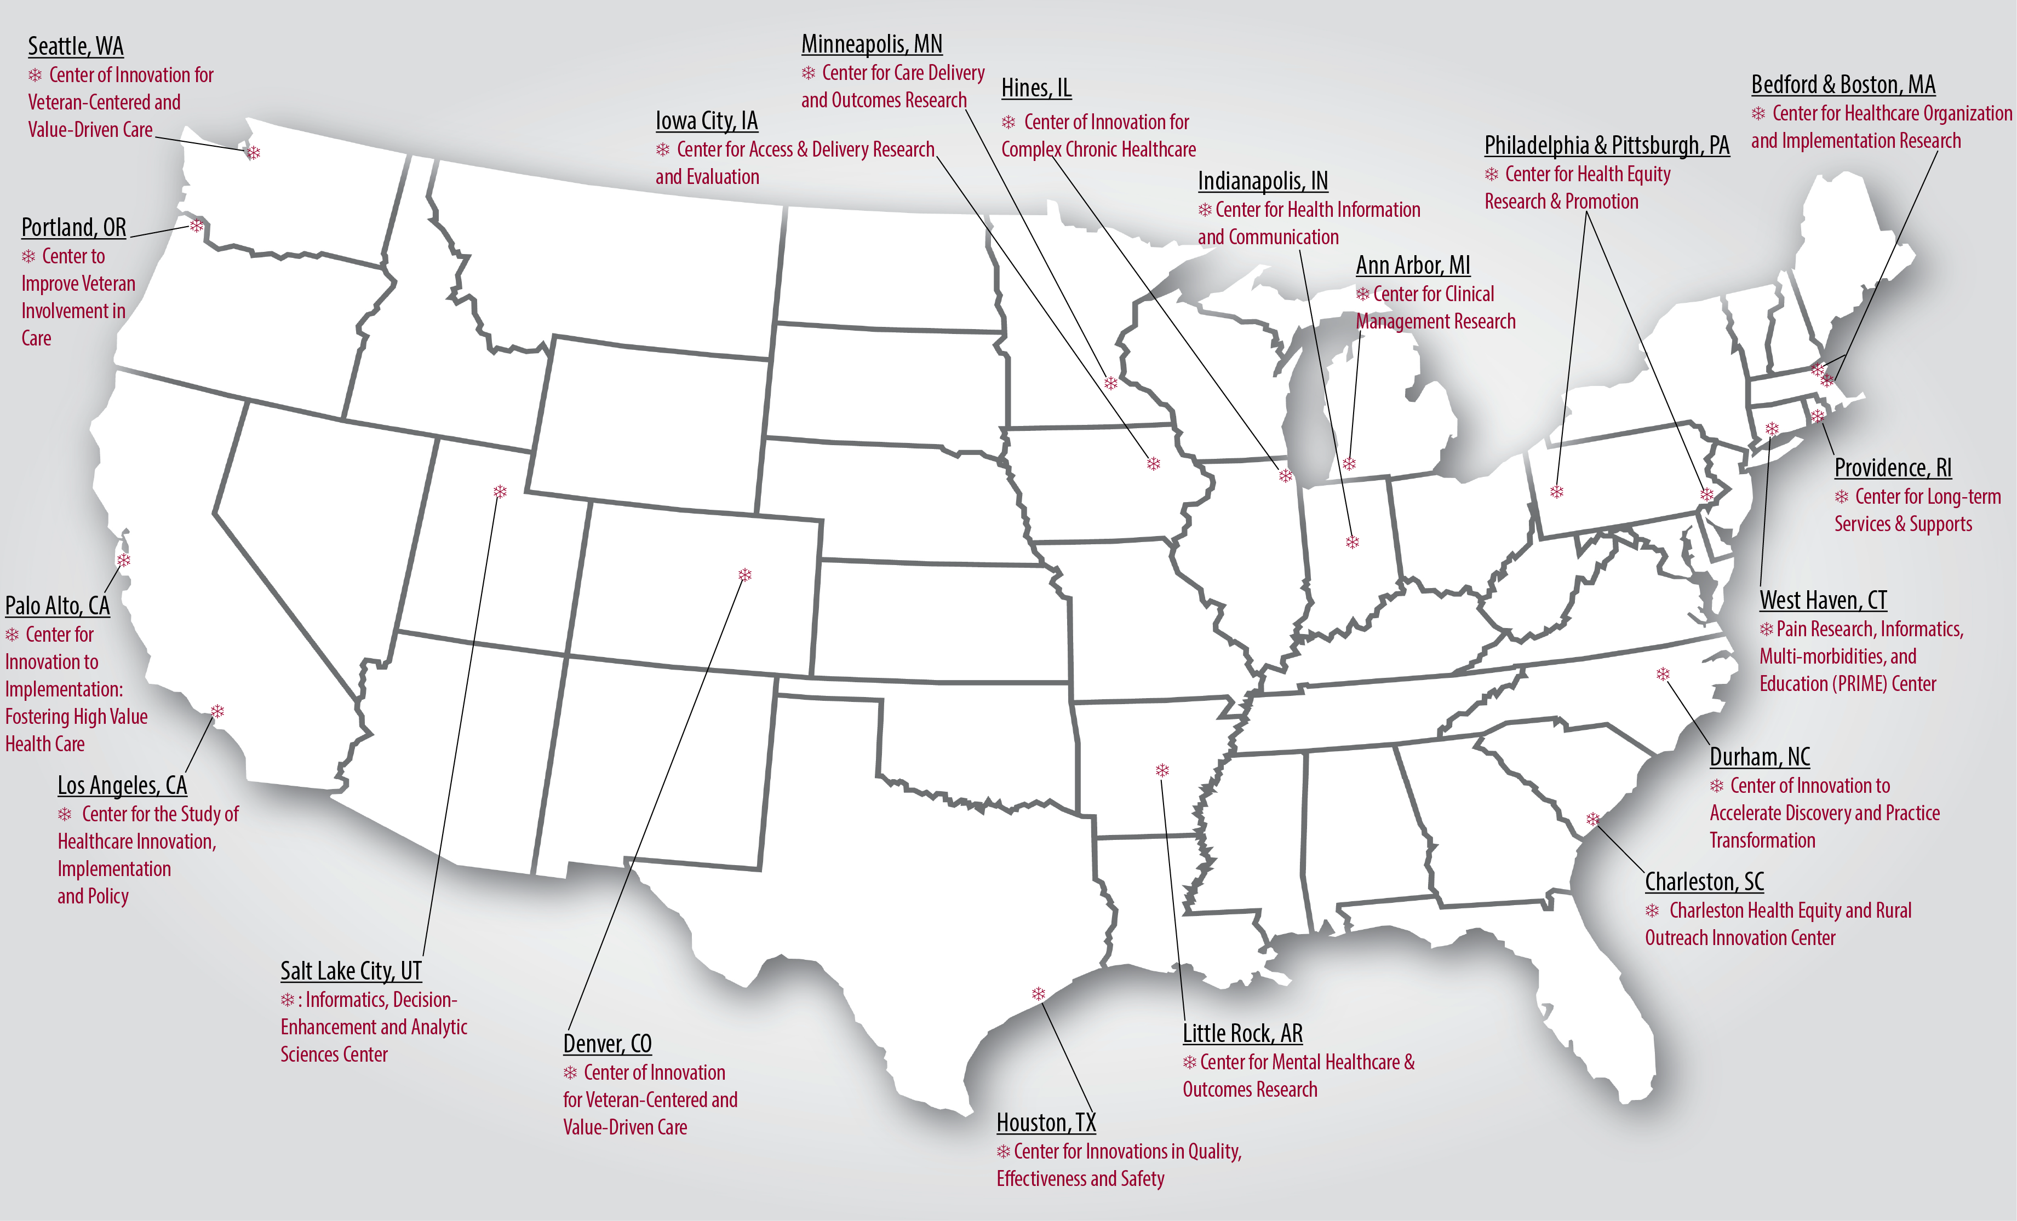
HSR Centers of Innovation Across the U.S.

Slide 16
Updated HSR Priorities
November 29, 2023
Health Systems Research
Office of Research and Development
Veterans Health Administration

Slide 17
Our Goal: Improve Veteran Outcomes Through
Cutting-edge Health Systems Research
How we measure success: Are Veterans getting better? (Quintuple Aim)
  Increase Access Ensure Equity Support Workforce
  Improve Outcomes Improve Value
Research priorities reflect VA Strategic Plan, Agency Priority Goals, Performance Plans
HSR is uniquely positioned to contribute to the science through Learning Health Systems:
  Implementation Science
  Data Science
  Science of End-User Engagement
  Systems Science
  Policy Analysis
Going forward: HSR / QUERI to inform VA’s next Strategic Planning Process

Slide 18
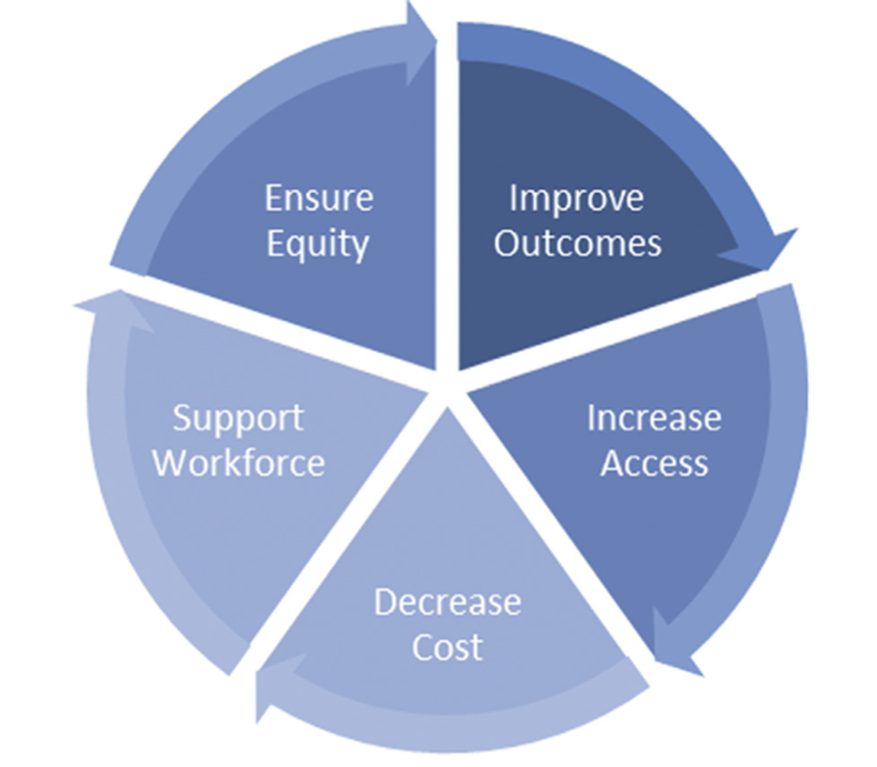
HSR Project Outcomes Informed by Quintuple Aim
Inter-disciplinary assessment of Veteran and VA outcomes
Organizational, provider, and patient care processes (e.g., access, quality, equity), value (cost), and end-user lived experiences (e.g., Veterans, providers, communities)
Refs; Matheny M, et al: National Academy of Medicine, 2019; Nundy S, Cooper LA, Nate KS. JAMA 2022; Cahan EM, 2020

Slide 19

NAM Future of Health Services Research
More system-focused research on practical topics and priorities faced by health care providers that includes end-user input
More investment in technology and data infrastructure including community and population data
Continued focus on disparities and solutions to quality gaps especially beyond the clinic walls
Timely studies focused on dissemination and implementation
Reward system, policy, and population impacts
Ref: https://nam.edu/the-future-of-health-services-research-special-publication/

Slide 20
VA Training and Funding Ecosystem
Learning Hubs
QUERI QI Collaboratives
Diffusion of Excellence
Post-doctoral Fellowships
Investigator-initiated Research
Data to Knowledge
Examine performance gaps
Identify best practices
Patient/provider experiences
Knowledge to Performance
Implement, tailor best practices
Implementation or QI playbooks
Measure impacts
Advancing Diversity in Implementation Leadership
Researchers in Residence
Learning Community
(e.g., Research Centers, National Program Offices, Regional Health System Leaders)
Performance to Data
Data on new discoveries
Change processes
Actively involve interested parties
Infrastructure: Funding, Informatics, Governance, Methods
e.g., HSR National Network of Research Centers; VA national EHR and population health databases; ORD research/QI ethical standards, Methods Resource Centers
Kilbourne, Schmidt, Edmunds, Vega, Bowersox, Atkins, 2022

Slide 21
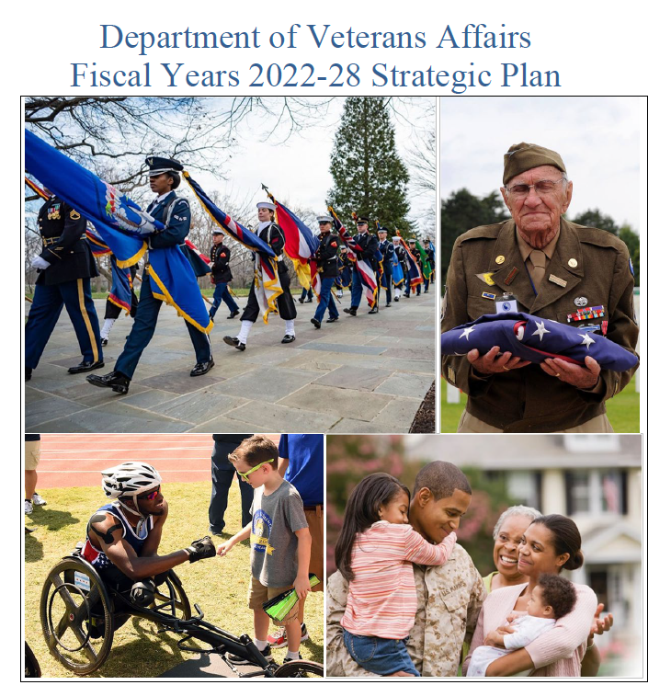
VA 2022-2028 Strategic Plan
Developed in 2018-20; updated 2021-22
Emphasis on underserved, at-risk Veteran populations and understanding lived experiences
“VA will leverage research studies, innovation and partnerships to enhance understanding of Veteran needs and eliminate disparities and barriers to health, improve service delivery and opportunities to enhance Veterans’ outcomes, experiences and quality of life.”
“VHA researchers, statisticians and evaluators have a well-earned reputation as thought leaders in health care and have a distinguished history in contributing both to Veteran well-being and that of all those seeking health services.”
(HSR and QUERI) are “VA’s principal sources of high-quality, independent, peer-reviewed evaluations”
Ref: https://department.va.gov/wp-content/uploads/2022/09/va-strategic-plan-2022-2028.pdf

Slide 22
HSR Strategic Methodology Areas
Implementation Science
Systems Science
Engagement Science
Data Science
Policy Analysis
Strategic methodology areas are based on the National Academy of Medicine Quintuple Aim goals, AHRQ Learning Health System Core Competencies, PCORI Methodology Standards, and VA Strategic Plan priorities.
Quintuple Aim Outcomes: Increase Access, Ensure Equity, Support Workforce, Improve Outcomes, Improve Value
More information on HSR Priorities: https://www.hsrd.research.va.gov/funding/PriorityDomains.pdf

Slide 23
HSR Priorities Encompass Core Strategic Methodology
Implementation Science. Discover and optimize strategies to get effective treatments to Veterans faster and sustain their use in real-world practice
Data Science. Design, validate, and apply data science and knowledge management tools that improve Veteran health and health care
Engagement Science. Create and test novel approaches for engaging end-users (e.g., Veterans, providers, communities, etc.) that support improved outcomes
Systems Science. Design and apply new systems science methods to improve Veteran provider workforce effectiveness, satisfaction, diversity, and retention
Policy Analysis/Evaluation. Develop, assess, and improve VA and national policies to improve Veteran outcomes, with a focus on underserved populations

Slide 24
HSR Strategic Methodology Areas Benefit Veterans, VA Care
Area of Scientific Inquiry | Benefit to Veterans | Key VA Priority Alignment
Implementation Science | Ensures “what we know is what we do” on a routine basis and that effective innovations get to Veterans more quickly | ORD Goal: Real-world Impact Congressional priority
Data Science | VA has extensive data that can be better leveraged to help improve Veteran care, outcomes, and experience in a way that ensures Veterans’ privacy and equity | ORD Goal: Making VA Data work for Veterans Evidence Act (US PL 115-435)
Engagement Science | Involving Veterans, providers, and other partners ensures treatments, programs, and policies work for Veterans, and that their lived experiences are considered | VA Strategic Plan: Support Underserved, At-Risk, Marginalized Veteran Populations ORD: Build Community through Research
Systems Science | Health care and health go beyond condition and disease labels; it takes a wider lens to understand the moving parts of the enterprise to improve them to ensure safe and effective care | VHA Long-Range Goals (e.g., Connect Veterans to the Soonest and Best Care; Workforce, High-reliability)
Policy Analysis | Many health problems have determinants outside the clinic walls, need to improve alignment and effectiveness of programs, benefits, and policies to ensure optimal Veteran outcomes | VA Legislative Mandates, e.g., Evidence Act MISSION Act PACT Act, Hannon Act, STRONG Veterans Act
Notes:
Benefits to Veterans:
Implementation science: VA supports innovation in health and health care; implementation science ensures what we know is what we do on a routine basis
Science of engagement: Involving Veterans, providers, and other interested parties ensures treatments, programs, and policies work for Veterans and that they are provided equitably (and some of the best research ideas come from our Veterans, providers, etc.)
Systems science: Health care and health go beyond condition and disease labels- it takes a wider lens to understand the moving parts of the enterprise to improve it
Data science: VA has extensive data that can be better leveraged to help Veteran care, outcomes, and experience; in a way that ensures privacy and security
Policy: some health problems have determinants outside the clinic walls; how can we better align our programs, benefits, and policies to ensure optimal Veteran outcomes?
Alignment with priorities: Implementation science: addresses ORD goal to increase substantial real-world impact through studies on how to more rapidly translate treatments into real-world settings
Data science: Aligns with ORD priority of making data work for Veterans, via conduct of emerging research on application of new technologies such as AI in health systems
Engagement science: Systematic ascertainment and use of end-user lived experiences, e.g., underserved, marginalized, and at-risk Veteran populations is in VA Strategic Plan
Systems science/workforce: U.S. Government national priority, systems science (e.g., high-reliability organization) identified as an emerging area (NAM Future of HSR report)
Policy analysis: increased partnerships with VBA, VA, HSR's role in Evidence Act implementation, to address barriers to optimize Veteran health “beyond the clinic walls”

Slide 25
HSR Strategic Methodology Areas Are Foundational to Current HSR Topics, Quintuple Aim Goals, and VA National Priorities
HSR
Topic Areas
Health Care System Organization and Delivery
Health Care and Clinical Management
Long-Term Care, Aging & Support Services
Behavioral, Social & Cultural Determinants of Health
Quality, Safety & Value
ORD BPs*
Brain, Behavior, MH (Suicide*‡, TBI*)
Functional Rehabilitation
Medical/Aging
Quality & Safety of Health Care
Access/Virtual Care
Primary Care Practice and Complex Chronic Disease Care
Long-term Care & Aging
Health Equity & Social Determinants of Health
Emergency Medicine
Health Care Value
Women’s Health
Alzheimer's & Related Dementias*
Ending Veteran Homelessness & Housing Insecurity‡
Rural Health
Military Exposures*‡
Gulf War*‡
Pandemic Responses & Infectious Diseases*
Community Care
Chronic Pain & Opioid Use Disorders*
Whole Health & Population Health
Strategic Methodology
Areas
Implementation Science
Systems Science
Engagement
Science
Data
Science (EHR)
Policy
Analysis
VA Priority Goals‡: Workforce, Connect Veterans to soonest/best care, Promote culture of safety/learning
Veteran Quintuple Aim Goals: improve outcomes, increase access, ensure equity, decrease cost, support workforce
*New or Planned Actively Managed Portfolios, BP = New ORD Broad Portfolios, MH= Mental Health; ‡VA National Priority Goals

Slide 26
HSR Strategic Methodology Areas Enhance HSR Topics
HSR topics can encompass more than one strategic methodology area
Health Care System Organization and Delivery (Access, Emergency Medicine, Women’s Health)
Mental and Behavioral Health, including Suicide Prevention
Health Care and Clinical Management (Primary Care Practice and Complex Chronic Disease Management, Disabilities and Military Exposures, Opioid/Pain)
Long-Term Care, Aging & Support Services
Behavioral, Social & Cultural Determinants (Health Equity, Whole Health)
Quality, Safety & Value
Strategic methodology areas, VA priorities also inform expanded HSR topics
Homelessness, housing and economic security (Reduce Veteran homelessness)
Workforce (Hire faster and more competitively, practitioner experience and well-being)
High reliability (Culture of safety, learning, and knowledge translation)
Policy, e.g., Veterans benefits and impact on health and social determinants (VA Strategic Plan focus)

Slide 27
Veteran Quintuple Aim Goals & HSR Strategic Methodology Encompass Current HSR Topics
Veteran-focused Quintuple Aim Goals
HSR Strategic Methodology
Improve
Outcomes
Policy Analysis
Systems Science
Increase Access
HSR Topic Areas
Health Care System Organization and Delivery (e.g., Access, Virtual Care, ED, Women’s Health, Community Care)
Mental Health, including Suicide Prevention
Health Care and Clinical Management (Primary Care Practice & Complex Chronic Disease, Military Exposures, Opioid/Pain)
Long-Term Care, Aging & Support Services
Behavioral, Social & Cultural Determinants of Health, Homelessness; Workforce, Quality, Safety & Value; Policy (e.g., Veterans Benefits)
Engagement
Science
Implementation Science
Support
Workforce
Ensure Equity
Data Science
Increase Value
Notes:
VA Strategic Priorities:
Hire Faster & More Competitively
Connect Veterans to Soonest, Best Care
Culture of Safety, Knowledge Translation
Prevent Veteran Suicide
Military, Environmental Exposures
Reduce Veteran Homelessness
Hire faster and more competitively: improve workforce recruitment, onboarding, and retention of VA employees and trainees
Connect Veterans to the soonest and best care: reduce direct care wait times and community care appointment scheduling times by improving clinical availability and scheduling
Promote a culture of safety, learning, and knowledge translation: implement and evaluate programs focused on innovation, psychological safety, zero harm, and manager/leader training
Prevent Veteran suicide: prevent Veteran suicide using a public health approach (e.g., outside the clinic walls, partnerships with community service organizations)
Serve Veterans with military and environmental exposures: improve quality of care, including the identification and management of symptoms among Veterans with military and environmental exposures
Reduce Veteran homelessness: ensure more at-risk and underserved Veterans receive early interventions, partnerships and supportive services to avoid homelessness

Slide 28
HSR Strategic Methodology Areas Foundational to Responding to Agency-wide Priorities (Source: Evidence Act Priority Survey Results)
Hire faster and more competitively. Improve workforce recruitment, onboarding, and retention of VA employees and trainees
Connect Veterans to the soonest and best care. Reduce direct care wait times and community care appointment scheduling times by improving clinical availability and scheduling
Promote a culture of safety, learning, and knowledge translation. Implement and evaluate programs focused on innovation, psychological safety, zero harm, and manager/leader training
Prevent Veteran suicide. Prevent Veteran suicide using a public health approach (e.g., outside the clinic walls, partnerships with community service organizations)
Serve Veterans with military and environmental exposures. Improve quality of care, including the identification and management of symptoms among Veterans with military and environmental exposures
Reduce Veteran homelessness. Ensure more at-risk and underserved Veterans receive early interventions, partnerships and supportive services to avoid homelessness

Slide 29
Strategic Methodology Areas Ensure Alignment with Emerging Veteran, VA Priorities
National Priorities: VA Strategic Plan, VHA/VA Leadership
VA National Program Offices, VHA Long-range Goals
Veterans Integrated Service Network and VA Medical Center Performance Goals
Service Lines, Frontline providers, Clinical Managers
HSR Strategic Methodology
Implementation Science
Data Science
Science of Engagement
Systems Science
Policy Analysis/Evaluation
Multi-Level VA Priorities
Legislative, Executive, and Veteran Priorities
Research Priorities
Veterans’ and their caregivers’ needs
Veterans Service Organizations
Congressional Priorities
  Megabus/NDAA
  VA Maintaining Internal Systems and Strengthening Integrated Outside Networks Act of 2018 (MISSION Act)
  Foundations for Evidence-based Policymaking Act of 2018
  Comprehensive Addiction and Recovery Act (CARA)
  21st Century Cures Act
  Hannon Act
  STRONG Veterans Act
  PACT Act, etc.
Presidential Executive Orders and memoranda
VA Office of Research and Development
National Research Advisory Council
QUERI
Other Federal Partners and Organizations (e.g., NAM, AHRQ, PCORI, NIH, etc.)
Philanthropic Foundations and Professional Societies
National Health and Quintuple Aim Goals:
  Increase Access
  Ensure Equity
  Support Workforce
  Improve Veteran Outcomes
  Improve Value

Slide 30

HSR/QUERI Systematic Priority-Setting Process in VA Strategic Plan
QUERI also facilitates VA fulfillment of the Evidence Act, which requires VA to justify budgets using evidence
  Evidence Act is Law (US PL 115-435)
  Influences agency budgets
  Requires annual evaluation plans on top priorities that inform policies and resource allocations
  Evaluation plans can be HSR or QUERI projects and are made public
  Help leverage other legislative mandates and funding sources
Priorities will inform VA, ORD, HSR and QUERI Initiatives:
Evidence Act National Evaluations
QUERI Rapid Response Teams
Advancing Diversity in Implementation Leadership (ADIL)
HSR Merit and QUERI Partnered Evaluation Centers
ORD AMPs/BPs
VA Strategic Plan
Local, regional, and national VA leaders identify priorities via qualitative discussions, national survey
2
1
National leaders
vote and concur on
top priorities,
informing QUERI
Requests for
Applications
QUERI reports progress to VA leaders, benchmarking on QUERI Impact Framework metrics, eRA commons
3
5
VA investigators,
in partnership with
health system
leaders, submit
applications that
undergo peer
review
VA investigators,
in partnership with health system leaders, submit applications that undergo peer review
QUERI peer-reviews and funds teams with the highest quality applications that address priorities
4
Braganza, Kilbourne et al., HSR 2022

Slide 31
HSR Priorities Inform ORD’s Learning Health System Components
1. Systems of leadership
2. Governance and management
A set of methods to encourage a network to perform as a system (Learning Community)
The way policies, processes, norms, and actions of a network are structured, sustained, regulated, and held accountable
6. Research
3. Quality improvement
Drive the generation of new knowledge related to the network's clinical focus and knowledge related to improvement of the network itself (e.g., HSR, ORD)
Systematic, continuous actions that lead to measurable improvement in outcomes of health care services and the health status of the network's targeted patient groups (e.g., QUERI)
5. Data and analytics
4. Community-building and engagement
Activities (SOPs) to collect, validate, organize, and standardize data relevant to a network's mission and making these data available to all network stakeholders for clinical care, improvement, research and learning
Governance, structures and processes that enable all stakeholders to act on their inherent motivations and become involved in the network
Lannon et al - A maturity grid assessment tool for learning networks - Learning Health Systems - June 2020;
Updated: R. Ramoni, 2023

Slide 32



How ORD Envisions Using LHS Components in its AMPs
ORD Research
VHA Clinical Program Offices
Lung Precision Oncology Program
    Executive Steering Committee
    Workgroups
    Veteran Engagement
    Lung Cancer Screening Outcomes
    Sub-workgroups
    LCS Scientific Radiomics
    LCS Clinician & Scientific Outcomes
An example of AMP functionality in practice
Notes:
Talking Points
Precision Oncology was selected as the first AMP to be stood up because one of the programs within it – the Lung Precision Oncology Program or LPOP – is already very much functioning as an AMP
LPOP was created to be a national network concentrating on:​
Lung cancer screening​
Smoking cessation​
Genomic testing​
Improved treatment modalities
The development and organization of LPOP, or Lung Precision Oncology Program was not by happenstance. It was methodical and informed by what researchers and clinicians needed to generate improved outcomes.​
Considerable time was taken to ensure that the collaboration was coordinated and supported with the necessary resources. The Office of Healthcare Transformation and Cooperative Studies Program were vital in providing resources to build out LPOP.
The Executive Steering Committee is comprised of key stakeholders from both the VHA and ORD who can provide oversight for the work being done and set performance standards and measures.​
Both workgroups and sub-workgroups are comprised of researchers and clinicians. Participants self-select which workgroups to join based on their areas of interest. ​
This self-selection enables LPOP to build communities of researchers and clinicians working together, generating ideas/concepts to improve clinical care as well as opportunities for clinical care to better inform research.​
The workgroups and sub-workgroups also identify short and long-term goals that the ESC reviews and provides input on.​
Ultimately, this shared decision making across all levels of the organization ensures that the work being undertaken is aligned around improving Veteran care.
Already, nearly 5,000 Veterans have received individualized care based on molecular testing thanks to LPOP.
This is the kind of impact ORD wants to build into the DNA of all AMPs.

Slide 33
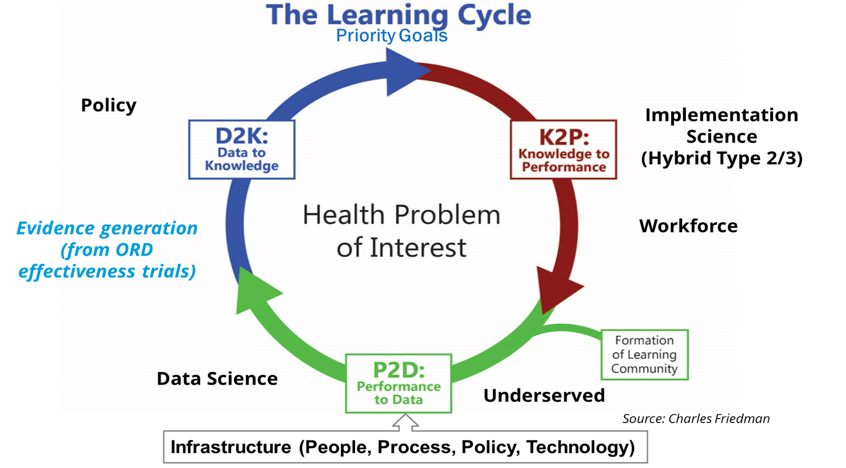
HSR Foundational Framework: Making LHSs work for Veterans
Systems Science
QUERI
Multi-level Engagement:
Veterans, Providers, Leaders
Engagement
Friedman et al, 2022

Slide 34
HSR Learning Health System Framework Informing
ORD Enterprise-Wide Initiatives (CSP Implementation Plan)
Provider and patient acceptance
Implementation costs
Intervention costs
Organizational and contextual factors
Fidelity to implementation of intervention or treatment
Use of intervention or treatment at the routine practice level
This is what we are trying to achieve
Kowalski et al, JCTS, 2022
34

Slide 35
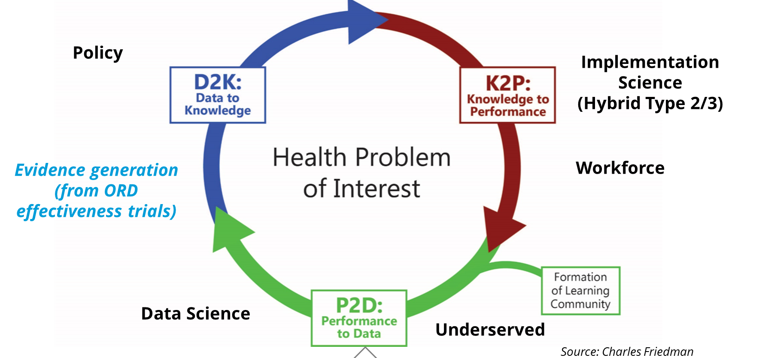
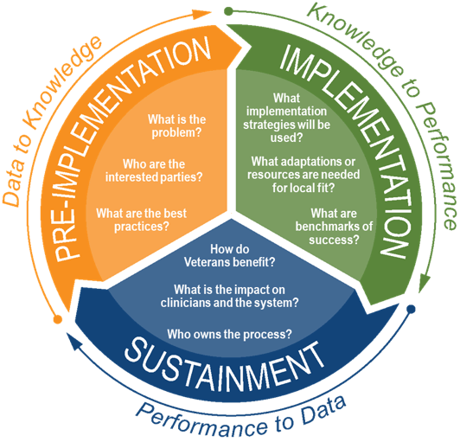
HSR LHS Cycle Supported by QUERI Roadmap
The Learning Cycle (Priority Goals)
Systems Science
QUERI
Engagement
(Friedman et al, 2022)
Infrastructure
(People, Process, Policy, Technology)

Slide 36

QUERI Implementation Roadmap
Problem-focused: Multi-level operations input, Learning Community
Infrastructure: Data, practice networks, peer-review
Agile: Projects on retainer to take on time-sensitive VA priority work
Research & QI protocols coexist
Investigator and staff implementation and evaluation training opportunities
Sustainment plan: business case, implementation playbooks
CyberSeminar on the QUERI Implementation Roadmap
Link for recording
  Link for slide deck
  Link for QUERI Implementation Roadmap Guide
Notes:
The Roadmap was informed by the Learning Health System Knowledge to Action Framework (12-13). This Framework operationalizes a continuous quality improvement approach for health care systems. Health care system data are used to identify priorities (data to knowledge), which in turn inform quality improvement efforts (knowledge to action- performance improvement), and lead to continuous monitoring of the health system for additional opportunities for improvement (performance to data or sometimes call practice-based knowledge).

Slide 37
Examples of HSR Research Topics Aligned with LHS and VA Priorities
Develop and test implementation or change strategies to improve scale-up and spread of effective treatments for Veterans (or de-implement low-value care), e.g., precision audit & feedback, credentialing, simulated learning
Develop, validate, and test novel data science methods that optimize application of Veteran-centered data in real-world settings, e.g., machine learning, AI (including ethical issues), social media, conversational analysis
Develop and validate systems science or engineering models to enhance the effectiveness, quality, safety, and efficiency of health care for Veterans in different settings (NAM HSR Report)
Assess impacts of health care workforce recruitment and retention initiatives, policies on Veteran access to care
Develop and test novel strategies to optimize the science of end-user engagement, e.g., Veterans, caregivers/families, providers, communities, etc., e.g., deliberative democracy, community research studios
Implement and assess impact of programs for underserved and at-risk Veteran populations (VA Strategic Plan)
Develop and evaluate programs or policies addressing health equity and social determinants of health, e.g., Veterans benefits, legislative mandates, national clinical standards of care, Veterans justice programs

Slide 38
Research That Does Not Fit in HSR
Clinical interventions that are still regarded as experimental (e.g., efficacy studies)
Studies involving interventions or treatments for a specific condition or disease that still require approval for use in VA routine clinical settings (these studies while not under the purview of HSR are encouraged to have an implementation feasibility secondary aim- See Cooperative Studies Program Implementation Planning Assessment Tool)
Epidemiology studies focused on describing the clinical course of disease and not processes of care
Research studies on the effectiveness of actual screening and treatments relating to prospective clinical trials
Data science studies that exclusively focus on molecular, physiologic, or genomic modeling
Computer software development efforts without a focus on their direct application in routine care settings
Efficacy or effectiveness studies where the primary outcomes focus exclusively on physiologic processes
Studies emphasizing specific functional outcomes related to individual disabilities
Studies where behavioral health interventions target specific mental health diagnoses such as anxiety disorder or depression in specialty mental health care
Studies requiring primary data collection of patient outcomes using specialized rather than general instruments

Slide 39
HSR Strategic Methodology: Summary
Enable HSR to better respond to emerging VA and Veteran priorities
Encompass current HSR topics while also expanding HSR’s reach across different operations partners to support VA national priorities related to Veteran care improvement
  HSR/QUERI to inform next VA Strategic Planning process
Reflected in current HSR RFAs (e.g., implementation, data science, engagement)
Differentiate HSR from newly created ORD Actively Managed Portfolios and Broad Portfolios
Ensure investment of cross-cutting Learning Health Systems research with a Veteran focus
Based on established scholarship and priorities from the HSR community, e.g.,
  Patient-Centered Outcomes Research Institute (PCORI) Methodology Standards
  Agency for Healthcare Research and Quality (AHRQ) Learning Health System Core Competencies
  National Academy of Medicine’s Future of Health Services Research report

Slide 40
HSR Impacts
November 29, 2023
Health Systems Research
Office of Research and Development
Veterans Health Administration

Slide 41






Congratulations to our Recent HSR Awardees!
2022 Under Secretary’s Award for Outstanding Achievement in Health Services Research
2022 Health System
Impact Award
2022 Best Research Paper Awardees
2022 Daniel Deykin Award
Outstanding Mentor
Kritee Gujral, PhD
Sanjay Saint, MD, MPH
Laura Damschroder, MS, MPH
John Piette, PhD
Dave Oslin, MD
Sarah Krein, PhD, RN

Slide 42
NEW! HSR Special Recognition Awards
Open to HSR staff and Investigators
Significant and longstanding contributions with key roles on research projects and/or within the research enterprise more broadly
Nominees are field-based staff or investigator with a role in an HSR, QUERI or operationally partnered initiative
Nominations due December 19, 2023
More information and nomination link here:
https://www.hsrd.research.va.gov/for_researchers/awards/staff-investigator-award.cfm

Slide 43
Health Systems Research Impacts
HSR and QUERI impacts were featured in the Government Accountability Office (GAO) 2020 report on VA’s Efforts to Prioritize and Translate Research into Clinical Practice
https://www.gao.gov/products/gao-20-211
Many thanks to our HSR investigators, staff, and our Veteran and provider partners for their work to improve the health and healthcare of the Veterans we serve!

Slide 44
Health Systems Research 2023 By the Numbers
$125 Million in funding
779 HSR investigators
426 active projects
69 newly funded projects
871 journal articles

Slide 45
Overall Assessment of HSR/QUERI Impacts (ACTION)
Essential in reporting impacts to VA and ORD Budget Justifications, Congress
Domain | Key Measures
Alignment | How is the initiative aligned with specific VA priority goals? What specific VA metrics is the study tracking?
Commitment | Is the study receiving financial or non-financial (e.g., FTE, data) support from the operations partner? Did the study develop new tools, software, products, etc., to be disseminated?
Tailoring to local context | Reach and Adoption (e.g., RE-AIM) Number of sites involved, patients/providers enrolled
Informing the field | Were leaders with policy and financial influence briefed on study impacts?
Observing healthcare change and generating New projects | To what extent did the study lead to or shape new VA programs or policies? Did Veterans get better?
Braganza et al. 2020

Slide 46
Examples of HSR and QUERI Impacts
In collaboration with VA operational partners
Suicide prevention national outreach programs
Opioid and pain care evidence-based practices (EBPs)
Medical home model for at-risk Veterans (patient-aligned care teams)
National health equity dashboard
Antibiotic stewardship
Veteran functioning and long-term care
Optimizing surgical care
Innovation

Slide 47
Examples of Recent Impacts
Suicide prevention
  Caring Contacts sends messages to Veterans at high risk of suicide → implemented in over 22 VA sites
  Caring letters reached over 200,000 Veterans
  QUERI national evaluation for Transitioning Servicemembers
National rollout of guideline-based opioid use prescribing
  Stepped Care for Opioid Use Disorder Train the Trainer (SCOUTT): >200% increase in patients with OUD receiving evidence-based treatment
  Stratification Tool for Opioid Risk Mitigation (STORM) medication safety dashboard resulted in over 20% reduction in mortality from opioid use disorder
  Consortium to Disseminate and Understand Implementation of Pain & Opioid Use Disorder Treatment (CONDUIT): 7 EBPs for pain implemented in >60 sites

Slide 48
Examples of Recent Impacts (cont’d)
Patient-aligned Care Teams Tailored for Homeless Veterans (H-PACT)
  Enrolled Veterans had fewer VA and non-VA hospitalizations
Health Equity Dashboard
  The VHA Primary Care Equity Dashboard has nearly 1,000 users at 119 VAMCs
Antibiotic Stewardship: Spread of Best Practices
  HSR has funded more than a dozen studies on curbing antibiotic over-prescribing, one study resulted in more than 8,000 fewer days of antibiotics

Slide 49
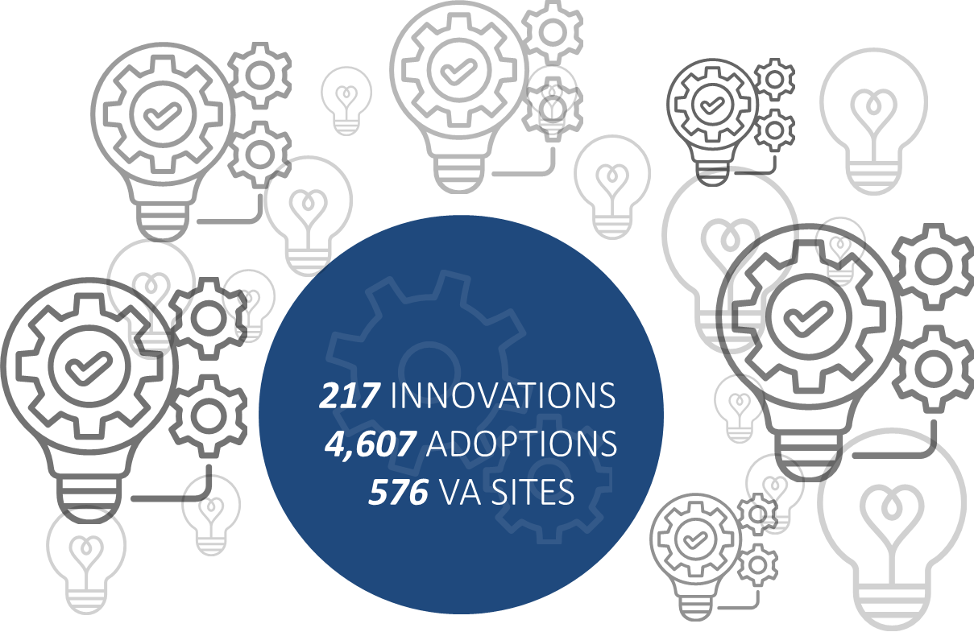
Diffusion of Excellence and HSR/QUERI Partnership Impacts
6-year partnership to scale-up, spread, and sustain evidence-informed practices, e.g., support for 6 National Diffusion Practices:
  TeleWound: Veterans saved an average of 303 miles in travel with a cost savings of $170
  FLOW3: 157 facilities; 30,000 complete prostheses or socket replacements for 17,621 Veterans
  VIONE:133 facilities; 15,895 providers; 694,826 Veterans
Rigorous evaluation of the Diffusion of Excellence and development of products to enhance the program impact, e.g., QuickView, Wishlist
  Shark Tank→ 99% VHA parent health systems/facilities submitted 3,281 applications; 88 Promising Practices: 1,440+ adoptions; 56% facilities sustaining
Diffusion Marketplace Impacts

Slide 50
HSR Strategic Methodology Impacts
Engagement Science
Surgical Pause (Diffusion of Excellence) optimizes care for frail Veterans before surgery
Strengthening Excellence in Research through Veteran Engagement (SERVE) Toolkit
Systems Science
Advancing Comprehensive Diabetes Care (with Diffusion of Excellence, Office or Rural Health)
Cooperative Pain Education and Self-Management (COPES) national CBT program for pain
Implementation Science
Change strategies adopted by VA national program offices, e.g., Implementation Facilitation and Leadership for Organizational Change and Implementation (LOCI)
STRIDE inpatient walking program: Over 40 medical centers impacting more than 7,000 Veterans
CSP Implementation Planning Assessment Tool

Slide 51
HSR Strategic Methodology Impacts (cont.)
Policy Analysis
Several HSR and QUERI investigators involved in Reduce Employee Burnout and Optimize Organizational Thriving (REBOOT) initiative to evaluate VA workforce well-being policies
National evaluations of recent legislative mandates related to women’s health, access to care for underserved communities, mental health, and Veterans benefits
Data Science
Machine learning to enhance detection of Veterans at risk of homelessness
Improving value and safety of cancer pharmaceutical use
Predictive modeling to better evaluate progression to liver cirrhosis among Veterans

Slide 52
HSR Future Directions
November 29, 2023
Health Systems Research
Office of Research and Development
Veterans Health Administration

Slide 53
Looking Ahead
HSR/QUERI to inform the next VA Strategic Planning process
Greater integration with QUERI, ORD, and VA to support priority-setting and interdisciplinary research and evaluation in a learning health system (LHS)
Expanded opportunities for LHS infrastructure support
Empower our investigator and staff workforce to leverage opportunities across VA operations (beyond the research appropriation)

Slide 54
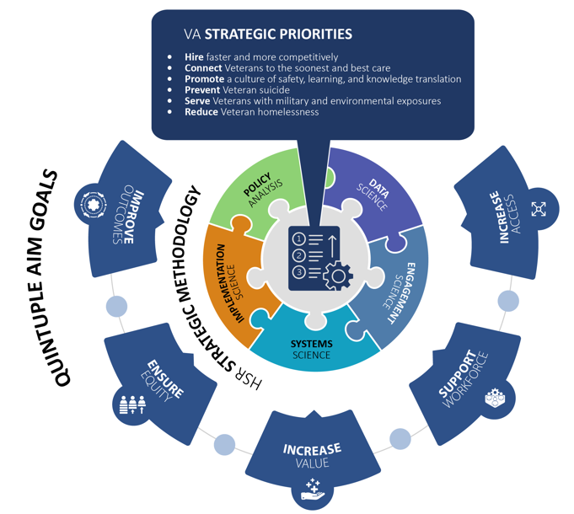
HSR & QUERI to Inform Next VA Strategic Plan
VA’s Strategic Plan informs its ~$1 trillion in spending, including VHA, ORD budgets and emerging areas for research and evaluation
HSR and QUERI to support VA’s Office of Enterprise Integration’s update to the VA Strategic Plan by informing priority areas based on multi-level input process

Slide 55
Rapid Approach to Identifying VA Strategic Plan Priorities
(Beck et al, QUERI Priority Setting process)
Candidate priorities for VA Strategic Plan
Measures of Impact
Ongoing Input
Phase I: Identify care gaps and unanswered questions (e.g., environmental scan, evidence inventories or reviews, VA program office strategic plans)
Phase II: Refine priorities using concurrent processes: national surveys/live voting & focus groups with Veteran, provider, leader, investigator groups
Phase III: Delphi consensus panel with interested party representatives rank priorities on urgency, impact, feasibility, identify impact metrics
Survey and focus group input inform Delphi panel discussion with representatives from different groups
Existing reviews inform focus group, survey questions
General principles:
Priorities should reflect the range of services provided to Veterans (total $1T)
In-depth feedback from focus groups to identify priorities not previously realized
Broad representation across interested parties via surveys, voting on top priorities
Emphasis on perspectives from the field
References:
Aligning quality improvement efforts and policy goals in a national integrated health system - Braganza - 2022 - Health Services Research - Wiley Online Library;
Health System Research Priorities for Children and Youth With Special Health Care Needs - PubMed (nih.gov),
Research Lifecycle to Increase the Substantial Real-world Im... : Medical Care (lww.com)

Slide 56
Detailed Steps to Identify Candidate VA Strategic Priorities
Stage | Steps
Identify Knowledge Gaps to inform Priorities from existing sources | Review current VA Strategic Plan, Evidence-based Policy Subcommittee, VA EBPWG Input from existing VA program office priorities and strategic plans (e.g., VBA, VEO, NCA, VHA Chief Strategy Office) Evidence inventory and review of other federal agencies affecting Veterans, literature, think tank reports
Electronic surveys and focus groups among interested parties who nominate specific research priorities and important research questions, to be further refined, collated by SPMs | Identify opportunities to hold focus groups via existing committees or organizations across interested parties to identify and further refine research priorities: Veterans (e.g., HSR COIN Veteran engagement councils), providers (e.g., facility Chiefs of Staff, VEO field representatives), leaders (e.g., VISN Chief Medical and Chief Nursing Officers, VEO, VBA, NCA), Veterans Service organizations, etc. Focus groups provided with initial priority list and high-level information on findings from Stage 1 to facilitate input Survey Veterans, providers, and clinical leaders or have focus group rank order VA Strategic Plan priority topics and questions for further input from interested parties. Identify groups using existing email lists of interested parties (e.g., CMO/QMO/CoS, VA researcher investigator email lists, Veterans Engagement Councils, National Program Office frontline provider lists, VEO representatives). Collate survey results, identify top priorities.
Delphi consensus panel of interested party representatives identifies top priorities via consensus | Hold a series of consensus meetings of representatives from participating focus groups to identify top priorities based on results from Stage 2. Delphi panel meets and develops consensus on top priorities (and measures of impact) by ranking on: Urgency (e.g., whether topic addresses gaps in Veteran outcome/experience and national priority) Impact (e.g., degree to which topic addresses the needs of a diverse array of Veteran groups over time) Feasibility (e.g., the topic represents potential actions under the purview of VA)
Summarize priorities and recommendations | Summarize final list of priorities with background information and recommendations for future directions Hand off to VA OEI for further vetting and information-gathering to inform VA Strategic Plan

Slide 57
HSR LHS Cycle Supported by QUERI Roadmap
The Learning Cycle (Priority Goals)
Systems Science
QUERI
Engagement
(Friedman et al, 2022)
Infrastructure
(People, Process, Policy, Technology)

Slide 58
At a Glance: HSR vs. QUERI
 | HSR | QUERI
Aims/Goals | Investigator-initiated research, hypothesis-driven, long-term, generalizable | Non-research driven by time-sensitive operations needs, implementation or evaluation of national-level initiatives
Operations Partner Involvement, Funding | Collaborative Research Appropriation | Directive Clinical Appropriation, Matched funding/resources often required
Study Design | Hypothesis-driven, pre-specified interventions or implementation strategies to inform national scale-up | Rigorous evaluations often within operations time constraints, national level, exploratory
Approach | Development of intervention, development or testing of implementation strategies, validation of methods, metrics, etc. | Implementation/evaluation of an evidence-based program addressing VA priorities and sponsored by a Program Office or VISN

Slide 59
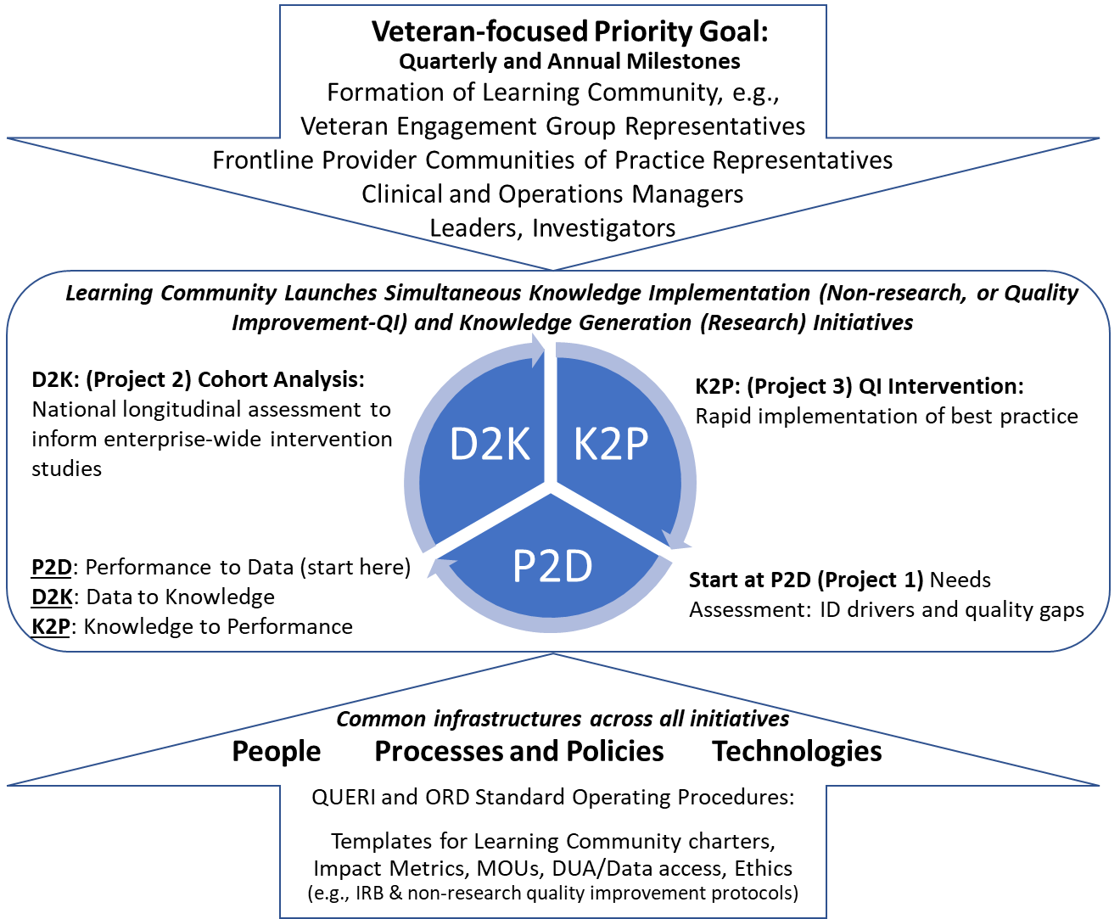
How HSR and QUERI Align to Address VA Priorities
Source: QUERI LHS RFA
The most recent QUERI RFA supports investigator-operational partner teams to deploy the data and governance infrastructure to launch research and non-research projects responsive to Veteran-centric goals

Slide 60
Summary of HSR and QUERI Funding Pathways
Capacity-Building
HSR Pilots
HSR Researchers in Residence
HSR & QUERI Career Development (ADIL)
QUERI Rapid Response Teams
Research & Evaluation
HSR Investigator Initiated Research
HSR Service-directed Research
QUERI Partnered Evaluation Initiatives
QUERI Evidence-based Policy Evaluation Centers
Scale-up, Sustain
QUERI Programs
QUERI-VISN Partnered Implementation Initiatives
List of current funded projects:
Current HSR studies
Quality Enhancement Research Initiative (QUERI) brochure
60

Slide 61
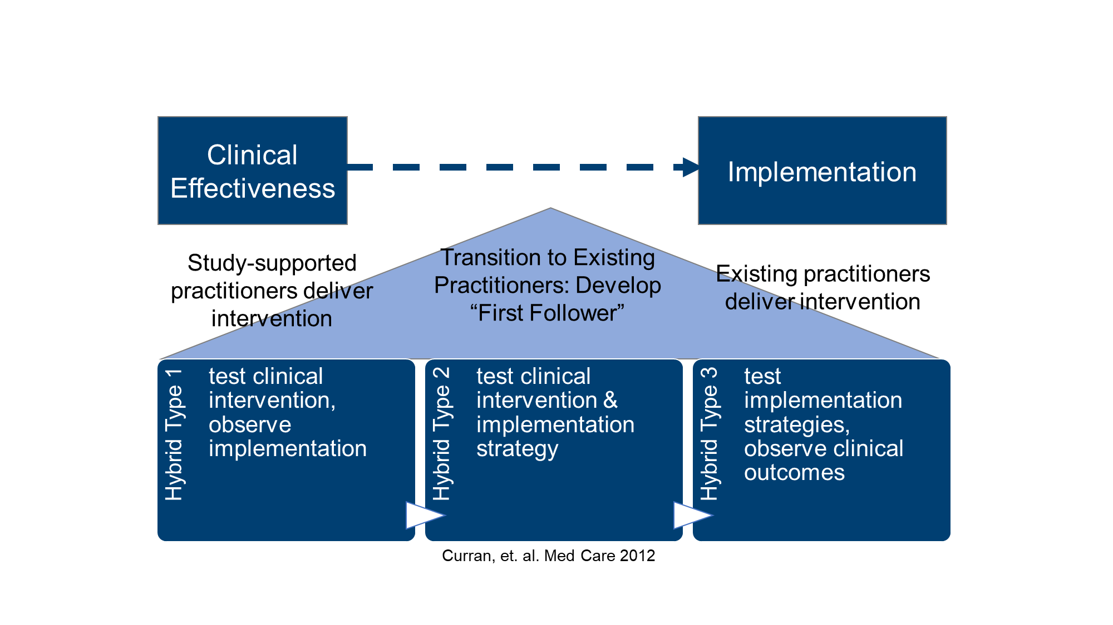
HSR Funds Implementation Research (Real-World Care)

Slide 62
QUERI Projects are Non-Research
QUERI projects are non-research because of the funding source (medical administration) and their focus on improvement within VA
Protocols involving data collection are non-research if the data are fed back to providers or operations leaders to directly improve care and/or other VA processes
Documentation of non-research QUERI projects by sponsoring program office lead in an MOU
In situations when a QUERI project wants to collect additional data above and beyond VA improvement efforts, obtain determination through the IRB (VAEDA)
CyberSeminar: Everything You Need to Know About VHA Non-research Protocols
Link to Recording
CyberSeminar: Everything You Need to Know About QUERI Non-research Protocols
Link to Recording

Slide 63
HSR Priorities and Future Directions: Bottom Line
HSR prioritizes research that addresses at least one of the strategic methodology areas
  Implementation Science Data Science Engagement Science
  Systems Science Policy Analysis
Research priorities also address impacts on Quintuple Aim goals
  Increase Access Ensure Equity Support Workforce
  Improve Outcomes Improve Value
Research priorities are aligned with VA national priorities
Hire Faster & More Competitively Connect Veterans to Soonest, Best Care
Promote a Culture of Safety, Knowledge Translation Prevent Veteran Suicide
Serve Veterans with Military & Environmental Exposures Reduce Veteran Homelessness
National thought leader in cutting-edge health systems research that is responsive to the changing needs of Veterans and the VA that serves them

Slide 64
Questions Received from the Field
How will CDA applications be impacted by the transition to broad portfolios?
  CDA applications will still be reviewed by HSR-specific panels, and the priorities related to career development align with those for HSR more broadly.
Will the transition benefit projects with multiple operations partners?
  Projects that bring together a coalition of operations partners will benefit from the updated crosscutting HSR priorities especially if they focus on VA priority goals, and where appropriate, the AMPs as well. One of the goals of the AMPs is to strengthen collaborations between research and operations partners for specific disease-focused areas of high priority to VA and Congress.
Can you clarify what types of software/algorithm studies fall under HSR priorities?
  Development of software or algorithms can still fit under the broader HSR strategic methodology priorities if the research involves ongoing partnerships with end-users, especially patients, providers, and clinical operations partners (e.g., use of engagement science), clinical processes (e.g., systems science) and/or aims that focus on feasibility and dissemination planning (implementation science).

Slide 65
Questions Received from the Field (cont.)
Does HSR plan to provide training opportunities to staff akin to QUERI?
  HSR strongly supports more training opportunities for staff especially in specific skills related to the LHS core competencies. One avenue is through AcademyHealth which has trainings in Communicating for Impact. We can also investigate leveraging QUERI training opportunities, and COINs also receive a set amount of funds annually to support professional development. Moreover, academic partners are increasingly offering training opportunities for staff professional development.
What is the vision to help support the field of HSR researchers- particularly early career investigators?
  In QUERI we have a saying that our investigators “triple-major:” as subject matter experts, methodologists, and scientific partners working with operations (see LHS core competencies). To this end it is important for early-career investigators to not only pursue a topic that they are passionate about, but to also grow expertise in a methodology that can be applied across areas of research, e.g., one of the five strategic methodology areas. It would also be important to take advantage of HSR and QUERI leadership training opportunities especially in how to work with operational partners (see Kilbourne, et al LHS, 2022).

Slide 66
HSR Priorities—Key Reference Documents
Patient-Centered Outcomes Research Institute (PCORI) Methodology Standards
Agency for Healthcare Research and Quality (AHRQ) Learning Health System Core Competencies
How the VA is training the Next‐Generation workforce for learning health systems - Learning Health Systems - Wiley Online Library
VA Quality Enhancement Research Initiative (QUERI) Roadmap
National Academy of Medicine’s Future of Health Services Research report
VA Strategic Plan (including Appendix D, highlighting HSR Priority-Setting)
VA Agency Priority Goals
Learning Health System Cycle (Friedman, 2022), Maturity model (Lannon et al, 2020)
VHA Medical Center and Network Director Performance Plan
HSR Priorities Document: https://www.hsrd.research.va.gov/funding/PriorityDomains.pdf

Slide 67


HSR and QUERI Funding Opportunities
HSR Investigator Initiated Research (IIR)
Research Career Development Program:
https://www.hsrd.research.va.gov/for_researchers/
https://www.hsrd.research.va.gov/cdp/
HSR Updated Priority Domains: https://www.hsrd.research.va.gov/funding/PriorityDomains.pdf
Quality Enhancement Research Initiative (QUERI) implementation training: https://www.queri.research.va.gov/training_hubs/
QUERI Advancing Diversity in Implementation Leadership (ADIL) Initiative queri.research.va.gov/QUERI-ADIL.pdf
HSR Funding:
QUERI Funding:
Notes:
Adobe Express
https://new.express.adobe.com/tools/generate-qr-code

