Slide 1
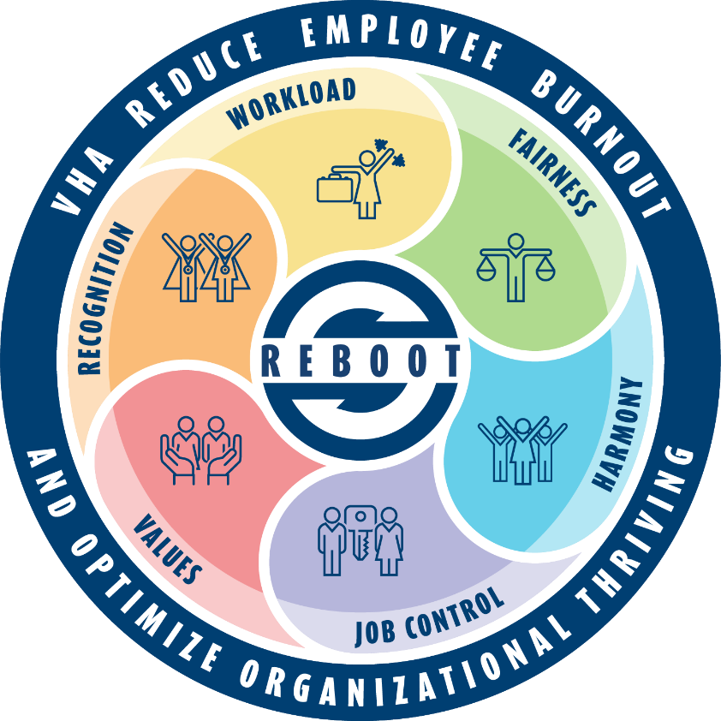
VHA Reduce Employee Burnout and Optimize Organizational Thriving (REBOOT) Initiative
Communications Plan
Informational
Name
Title
Session
Date

Slide 2
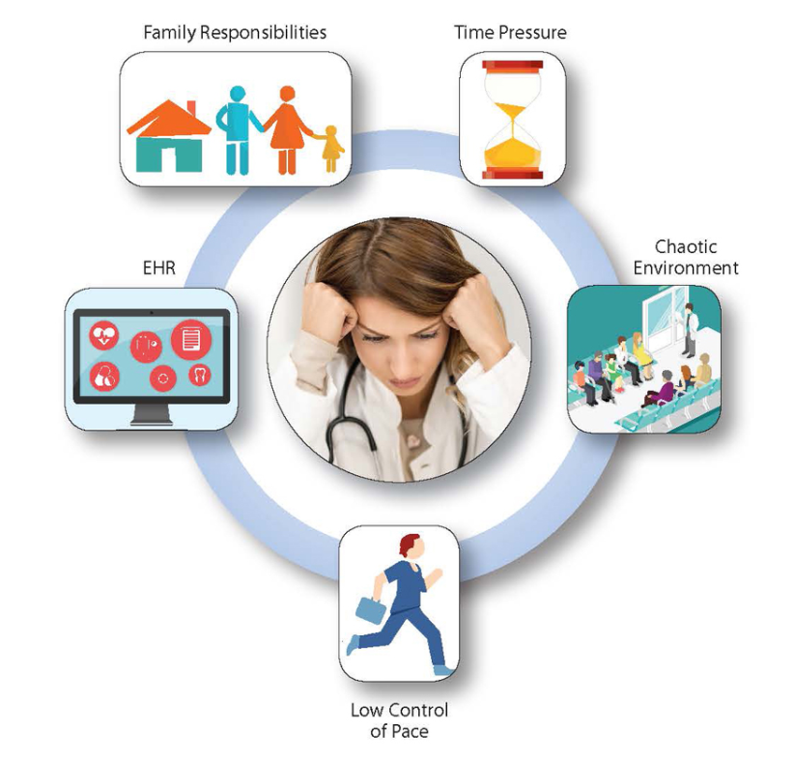
Burnout In Health Care: What Do We Know?
What is Burnout?
An occupational syndrome characterized by:
Emotional exhaustion
Depersonalization
Low sense of personal accomplishment at work
Burnout in health care was near ‘crisis’ levels before the COVID-19 pandemic
An estimated 35-54% of nurses and physicians and 45-60% of medical students and residents reported burnout
The cost of physician burnout is estimated at $2.6B to $6.3B annually
A link between burnout and preventable medical errors
Agency for Healthcare Research & Quality (AHRQ)
Text above boxes reads Family Responsibilities, Time Pressure, EHR (Electronic Health Record), Chaotic Environment, and Low Control of Pace
Sources: Addressing Health Worker Burnout (hhs.gov)
Estimating the Attributable Cost of Physician Burnout in the United States | Annals of Internal Medicine (acpjournals.org)
Physician Stress and Burnout - The American Journal of Medicine (amjmed.com)
Notes:
Talking Points/Additional Details
Graphic details
One AHRQ-funded project, the MEMO—Minimizing Error, Maximizing Outcome—Study (AHRQ grant HS11955), found that more than half of primary care physicians report feeling stressed because of time pressures and other work conditions.
Work conditions, such as time pressure, chaotic environments, low control over work pace, and unfavorable organizational culture, were strongly associated with physicians’ feelings of dissatisfaction, stress, burnout, and intent to leave the practice.
Source for graphic: https://www.ahrq.gov/prevention/clinician/ahrq-works/burnout/index.html

Slide 3
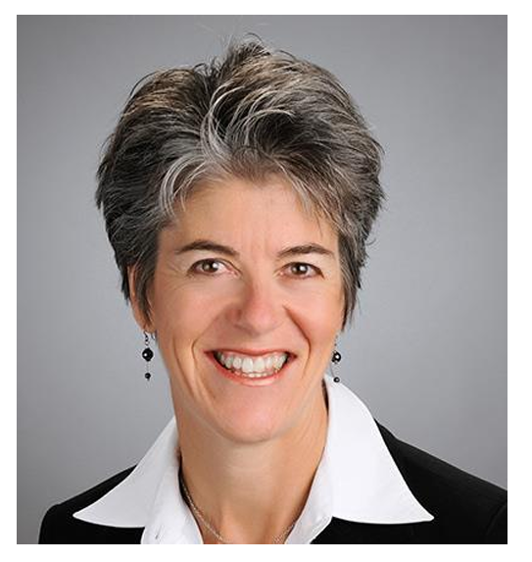
Burnout Originates in Systems
"While burnout manifests in individuals, it originates in systems. It’s important to move the focus toward fixing the workplace rather than fixing the worker.”
Christine Sinsky, MD
AMA Vice President of Professional Satisfaction

Slide 4
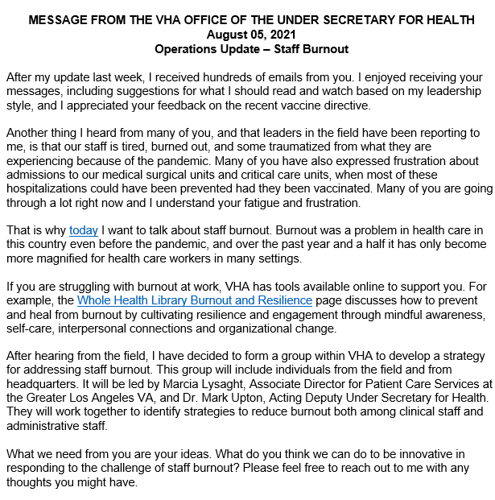
Beginning of Our Journey in VHA
The COVID-19 pandemic exacerbated burnout in health. It also created new ones.
In 2021, VHA leadership made a priority of addressing burnout with a well-coordinated, health care system-wide approach.
Where to start?
Began with acknowledgement of burnout, its impacts, and a national conversation with VHA’s workforce
Notes:
Talking Points
Dr. Lieberman sent an all-employee message in August 2021 acknowledging burnout and informing employees of the development of a workgroup being stood up to develop a plan for addressing burnout

Slide 5
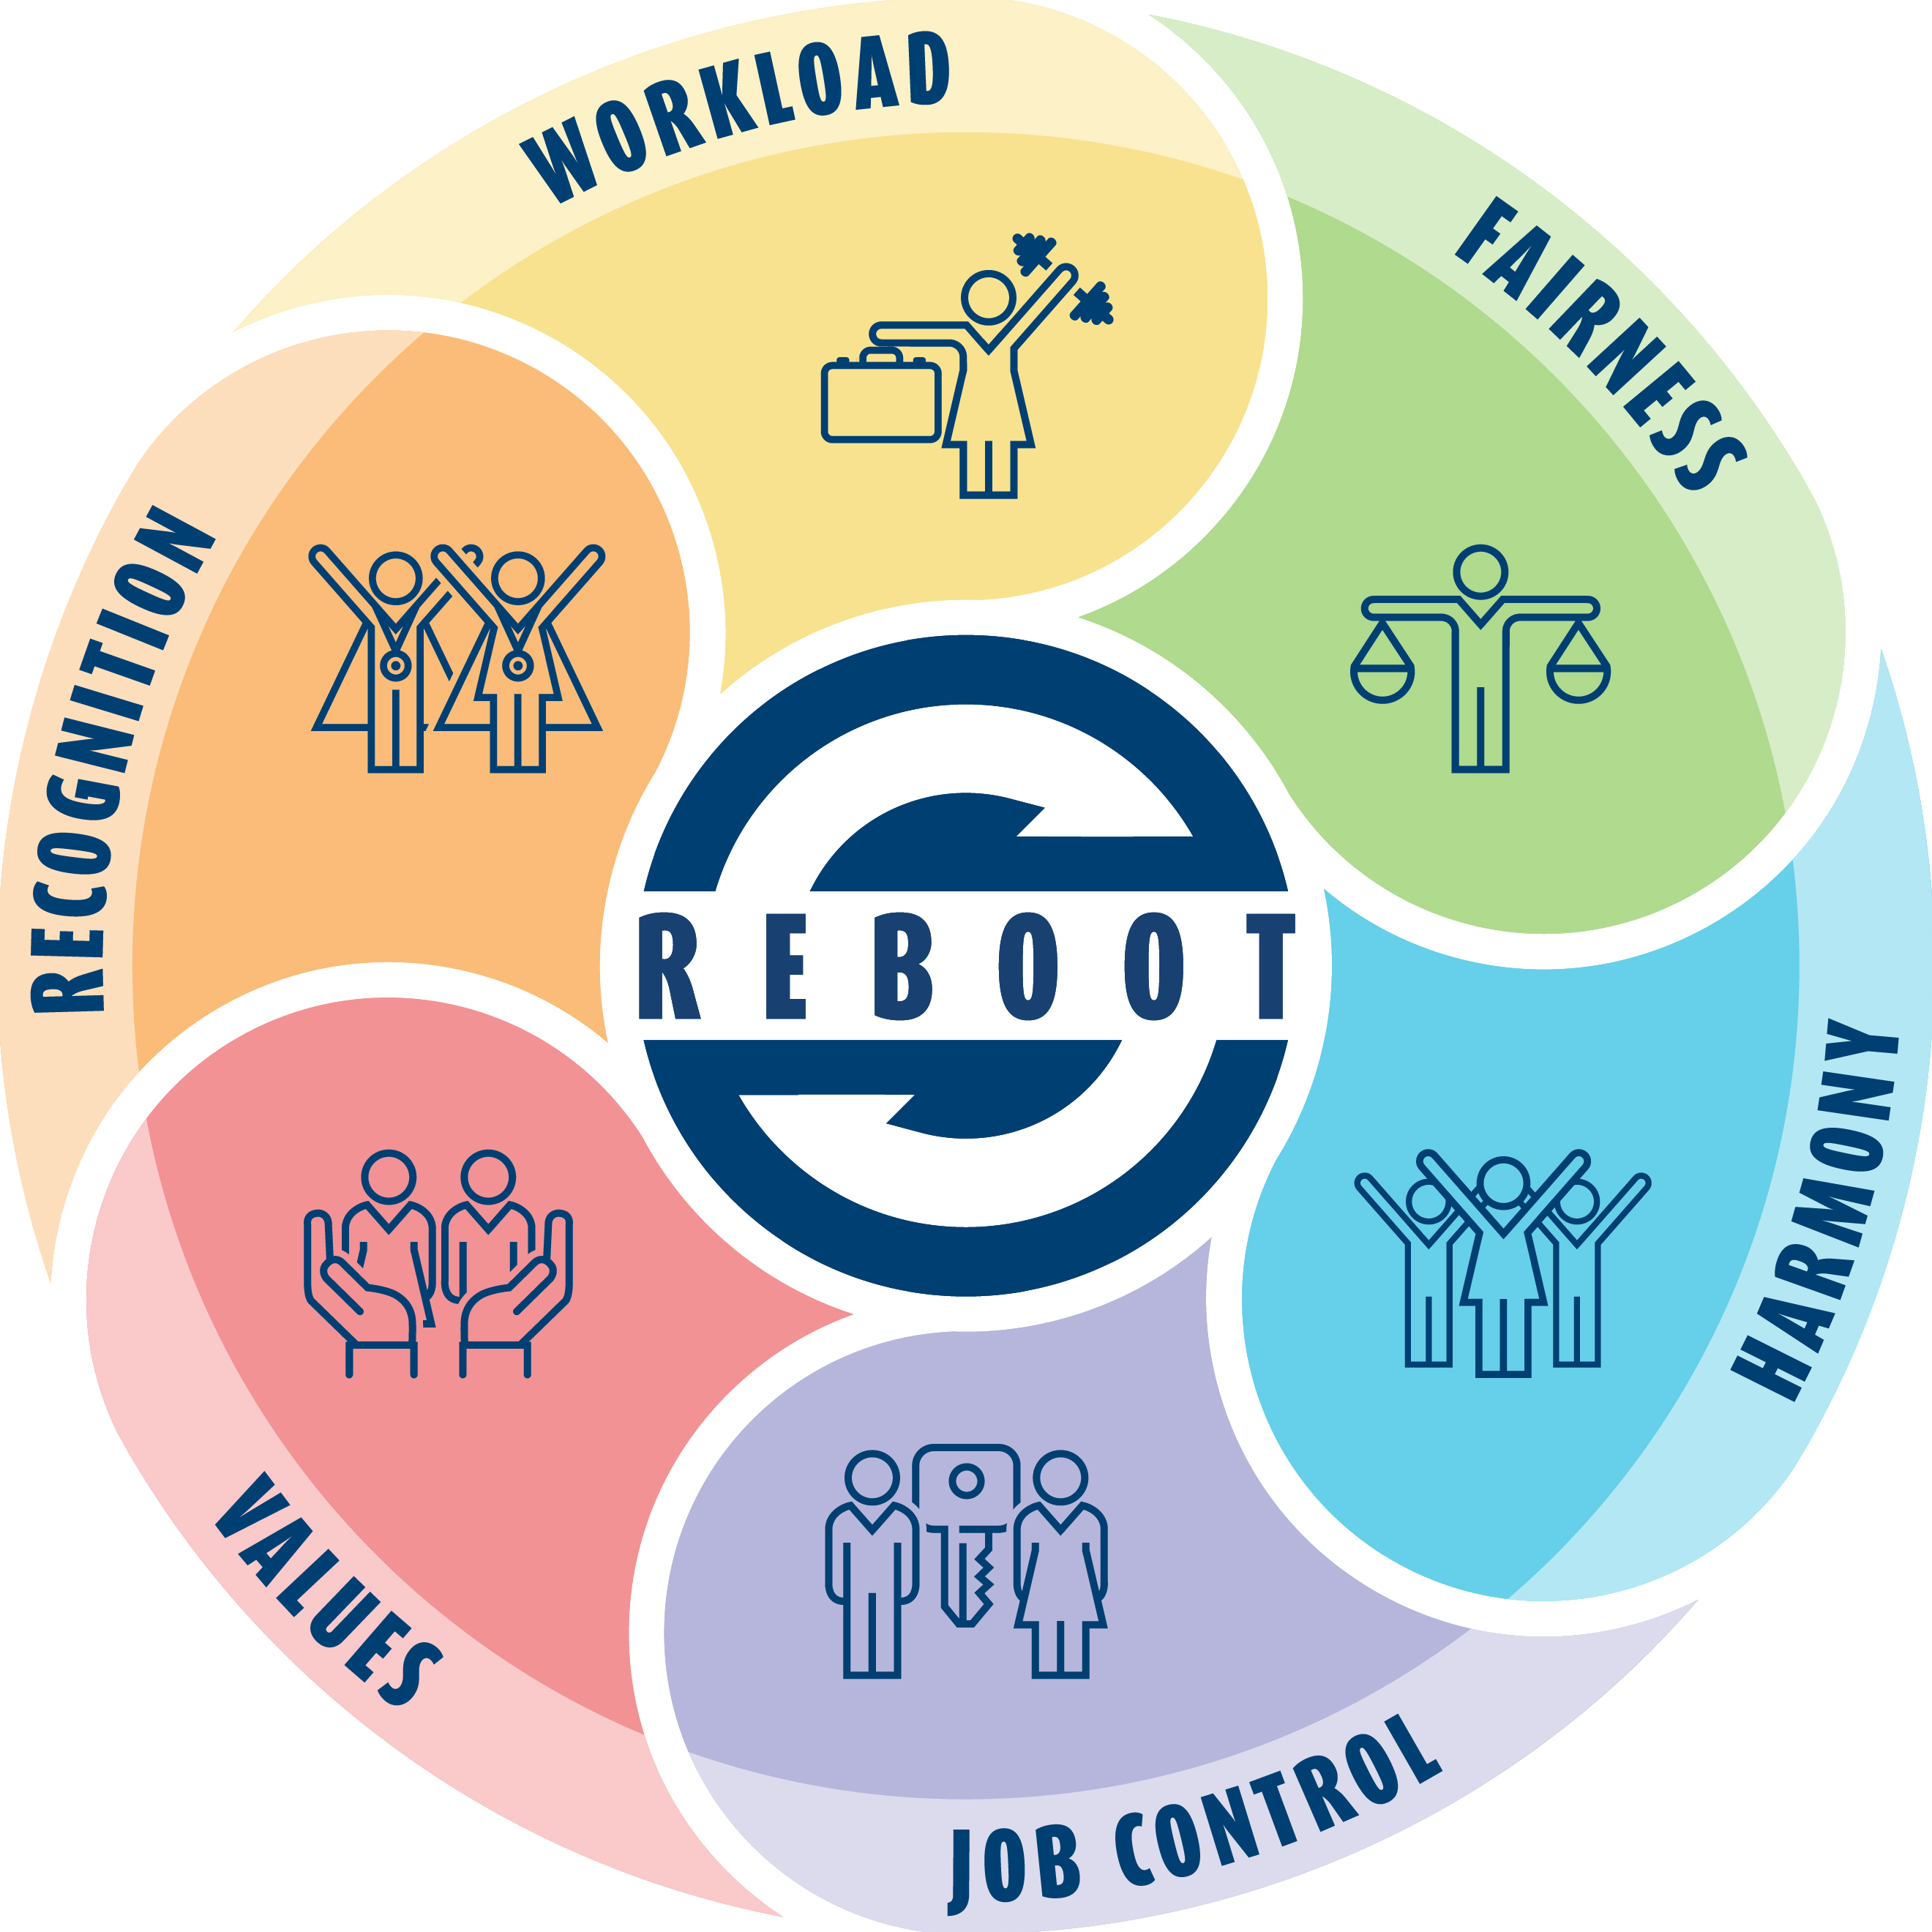
Building a Coalition – Establishing a Taskforce
The Reduce Employee Burnout and Optimize Organizational Thriving (REBOOT) Task Force was instituted in August 2021.
Direct partnership between VHA leaders and frontline employees and union partners
Goal is to foster a work environment where every VHA employee can thrive and find purpose, fulfillment, and joy in their work
This, in turn, supports VHA’s ability to best serve our nation’s Veterans, families, caregivers, and survivors.
This graphic shows the six factors that impact feelings of burnout. REBOOT addresses these by improving the work environment and support for employee well-being. These factors are workload, fairness, harmony, job control, values, and recognition.
Notes:
Talking Points
REBOOT puts a strong focus on organizational design and not just individual resilience.
REBOOT focused on addressing the drivers of burnout and promoting professional fulfillment among employees.

Slide 6
Analysis of VHA Employee Feedback
VHA received more than 700 email messages from employees who shared their challenges, ideas and support.
CAUSES
Drivers of burnout based on employee feedback include:
Workload demands
Staffing needs (i.e., recruitment/retention challenges)
COVID-19 impacts
Feeling a lack of autonomy/job control/fairness
Limited flexibilities to balance work responsibilities with personal/family needs
REBOOT shared recommended actions with employees in 11 focus groups.
Staff turnover
Increasing workloads
COVID-19 pandemic
Low pay rate
Slow recruiting process
Effects of burnout may further fuel the causes
Continuous crisis mode
Decreased staff levels
Fear of COVID
Emotional, mental, and physical exhaustion
Disengagement
Lack of vacation and recreational activities
EFFECTS
Notes:
Talking Points

Slide 7
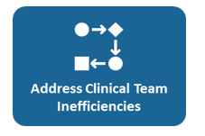
Overview: Moving Forward
The VHA Governance Board and the VHA Under Secretary for Health approved 7 focus areas in August 2022. In September 2022, VHA disbanded the REBOOOT Task Force and formed the REBOOT Implementation Team (RIT).
Chief
To effectively address burnout, we need to attend to individual well-being AND organizational issues
Can’t forget about what each one of us can do for ourselves and each other
REBOOT = Reduce Employee Burnout and Optimize Organizational Thriving
Here is a framework to understand how to target activities
Notes:
Talking Points/Additional Details
REBOOT Implementation Team (RIT) is being led Maureen Marks, Executive Director, VHA National Center for Organization Development (NCOD), Jessica Bonjorni, Chief of Human Capital Management, Lucinda Houghton, Chief Well-being Officer, VA Southern Oregon and by Dr. Mark Upton Deputy to the Deputy USH
Through Reduce Employee Burnout and Optimize Organizational Thriving (REBOOT), VHA is building a workplace where every employee can thrive and find purpose, fulfillment, and joy in their work.
REBOOT is a long-term initiative to address burnout and promote wellbeing among employees.
VHA has listened to employees to gain an understanding about major factors contributing to burnout and ways to better support employee wellbeing.
To address these contributors, REBOOT is implementing sets of actions across seven (7) priority focus areas where VHA can take meaningful action nationally to benefit the most employees.
VHA and the REBOOT Task Force announced seven priority focus areas to all employees on Tuesday, September 6, 2022.
The VHA RIT created seven workstreams to oversee implementation of the actions within each priority focus area.
Actions are designed to inspire, complement, and build on local efforts, such as REBOOT efforts at VA Northeast Ohio (video).
VHA is addressing other challenges such as the hiring process and staffing shortages.

Slide 8
Prioritizing Actions to Combat Burnout – Key Considerations
Administrative Burden
Build on Existing Efforts
Operational Constraints
Team Approach
Begin a Journey
Notes:
Talking points
Before we dive into the 7 workstreams, it’s important to share the key considerations that needed to be taken into account as strategies/interventions were developed so burnout wasn’t inadvertently worsened as a result of REBOOT’s efforts.
Administrative Burden. Focus areas are intended to be carefully deployed in both the short- and long-term to avoid an increased burden on the field and program office staff that would counteract their value.
Build on Existing Efforts. Focus areas are intended to complement existing efforts already underway within VAMCs, VISNs, and VHACO, such as Employee Whole Health activities. REBOOT implementation will take these existing activities into account.
Operational Constraints. Existing constraints can hinder VHA’s ability to immediately address key drivers of burnout, such as staffing challenges and increased workload. However, the focus areas represent opportunities in which VHA believes other improvements can be made.
Team Approach. REBOOT is taking a team-based approach to implementation by including field leadership, union representation, and VHACO leadership in each workstream. This will translate to joint ownership, active partnership, and feedback among VHACO, VISNs, VAMCs, SMEs, frontline, mid-level, and senior employees for shared success.
Start of a Journey. Focus areas represent the beginning of a wide variety of actions VHA will take to reduce burnout. More efforts, both existing and new, will occur alongside REBOOT implementation

Slide 9
Where We Are
Chief Wellbeing Officer (CWO)
All 18 facilities have hired a CWO through the original national executive memo.
16 Early Adopter sites have hired a CWO.
CWO Fundamentals Conferences are hosted to train and support CWOs.
4 Senior Leadership Engagement Sessions completed (Feb. & March 2024).
CWO Experience Pilot underway (launched on March 25, 2024).
Funding has been secured for LEARN FY24 Evaluation efforts.
Optimize Meeting Practices
Launched Operation Exhale in March 2023 across VHA to shorten meetings and encourage best practices to make meetings more effective.
Developed a tool kit to support the Operation Exhale initiative locally.
Worked with VA Illiana Health Care System to develop an implementation tool kit for their promising practice, Focus Fridays (no meetings Friday); over 7k SP views.
Optimize TMS Training
Local Assignment Reduction and Management Plan (LARMP) and Local Assignment Dashboard (LAD) entering pilot phase with more than 30 sites participating.
Knowledge Validation TIGER Team currently redesigning a 90-minute course “Own the Moment” and will impact ALL VHA staff.
Removal of Optional Evaluation Survey job-aid being produced for mass distribution.
Evaluation of MT Moratorium Implementation during pandemic led by SALIENT.
Notes:
Talking Points/Additional Details
The next few slides provide actions and accomplishments for the seven workstreams and gives you an idea of the type of efforts they are working towards.
CWO Program:
All 18 EDM Facilities have hired a CWO
The FY23 findings from the partnered evaluation with Leading Evaluations to Advance VA’s Response to National Priorities (LEARN) are being used to further improve the CWO Program along with initial pilot outcomes. Funding has been secured for LEARN FY24 Evaluation efforts.
Iterative improvements in CWO support structures based on initial pilot outcomes and ongoing feedback
Provided monthly Education Calls, bimonthly Community Calls and monthly Knowledge Network Calls
Developed mentoring/coaching opportunities for CWOs, supplementing CWO peer-to-peer support calls
In order to support Increased Clinical Access, the CWO Team is recommending CWO focus efforts around:
Electronic Health Record Efficiencies (CPRS Booster, Brilliance, etc.)
Addressing Inefficiencies ("Angie's List")
Administrative Burden Reductions (Clinical Reminders, View Alerts)
Listen, Sort, Empower (Addressing Inefficiencies and supporting a Culture of Well-Being)
Optimize TMS Education and Training
OTET is currently collaborating with in-motion projects that align with OTET and REBOOT goals.
LARMP and LAD soft rollout pilot will validate the LAD data and establish a standardized process to help facilities optimize delivery of local mandatory training to ensure organizational goals and requirements are being met, reduce and consolidate duplicative/redundant training, and focus on employee time and satisfaction. Some sites have >50% of MT being assigned at a local level.
Pilot is important to validate the data within the LAD. Note: See sample dashboard in Supplemental section of this slide deck.
Initial pilot impact will include level 1-3 complexity facilities; participation is voluntary, and sites have been solicited the DLO channels.
Resources, guidebooks, and informational sessions will be made available through ILEAD channels (TBD, but ultimately will land in the Learning Development Resource Center).
Knowledge Validation TIGER team is testing the KV and working with Measurement and Evaluation Unit to ensure organizational goals are being met. KV will allow staff to demonstrate existing knowledge (if applicable), bypassing the learning content for completion. This will reduce burnout, improve employee satisfaction, and increase provider access.
Knowledge Validation Talking Points of why current tests can’t automatically be adopted as the KV test:
Every course doesn’t have a test.
There is a modular approach for some things that are more complex. More time is needed to work with the subject matter experts to develop the content.
The post-tests were not developed for that reason. We want to make sure that the test has the necessary content, in case there is anything that occurs legislatively, and we want to make sure the pre-test is covered with that content.
Development of Job Aid to remove optional evaluation surveys from TMS TO DO list. Allowing staff to opt out of these optional surveys can decrease time spent on TMS assignments.
SALIENT (StrAtegic PoLicy Evidence-Based Evaluation CeNTer)
Objective: To evaluate the TMS training moratorium that was implemented during the COVID-19 pandemic for impact on: reach and adoption of the training moratorium, factors that facilitated and hindered adoption of the training moratorium, and overall impact on staff burnout and job satisfaction.
Pilot interviews (n=2) were conducted.
Findings from pilot interviews:
No consistency with who and how the decision was made as to whether or not a VAMC participated in the training moratorium.
The reason that the decision was made [to participate or not in the TMS training moratorium] was often for unknown reasons, and it was frequently made at a high level, above the DLO (Designated Learning Officer).
Interviewees also shared that they felt there was little or no impact on long-term job satisfaction or employee burnout.

Slide 10
Where We Are
Address Clinical Team Inefficiencies
Formed an Order Entry for Community Providers Workgroup.
Recommending that IVC reduce the required minimum mental health scheduling efforts for Veterans who are not high-risk after clinic cancellations or no-shows.
Additional meetings with the Veterans Transportation Program Member Services – discussing the Beneficiary Travel Consult proposal with option for 3-year duration.
Maximize Use of HR Policies/Flexibilities
Good success since VHA Governance Board voted (Sept. 2023) to recommend implementation of the 72/80 schedule for Registered Nurses (RNs) in bedded units.
March 2024 increase for 72/80 was 283, a 145% increase since February 2023.
Developed a 72/80 blueprint and training for implementation; comms plan and evaluation proposal in process.
Established an email group to answer HR policy questions from the field.
Notes:
Talking Points/Additional Details
Address Inefficiencies transitioned to Address Clinical Team Inefficiencies (CTI)
Order Entry for Community Providers Workgroup - stakeholders from Pharmacy Benefits Management, Integrated Veteran Care (IVC), Office of Nursing Services, and Patient Care Services.
Met with IVC to recommend reducing the required minimum mental health scheduling efforts from four to three attempts for Veterans who are not high-risk (not flagged) after clinic cancellations or no-shows.
Met with the Veterans Transportation Program Member Services to discuss the Beneficiary Travel Consult proposal with option for 3-year duration.
Most recent Quick Wins
The new Prescription Renewal policy is in its final stages and awaiting final approval from Patient Care Services Leadership. The updated policy empowers Clinical Pharmacists to renew prescriptions, work at the top of their licensure, and reduce renewal burdens for providers.
PAVE Foot Screen Reminder is currently completed and being implemented.
The New Homelessness Recommendation is an ongoing effort with potential changes from the Office of Primary Care, Office of Care Management, and Social Work.
HR Policies and Flexibilities 72/80:
GB voted in favor of option 2 in the EDM, which is a recommendation memo to implement the 72/80 without a requirement to implement.
Pulling data for 72/80 on a monthly cadence. The increase that we’ve seen in for March 2024 for 72/80 was +283! Much smaller than February’s growth (+775), but probably more typical for a month, and we now have a 145% increase since Feb. 2023.
Email group ((VHA72-802SupportTeam@va.gov) is staffed by those who have successfully implemented 72/80 at their facilities and they are available to answer technical questions.

Slide 11
Where We Are
Strengthen Mental Health Support
Developing an executive decision memo proposal that will include recommendations for EAP, Modernization, Scaling Peer Support and Acute Crisis Support.
Finalizing Standard Operating Procedure (SOP) Peer Support template for the field.
Compilation of acute crisis resources completed and added to the Mental Health tool kit that has 6,150 views on SP.
Looking into the possibility of a national desktop icon to link to employee MH resources.
Strengthen Culture of Servant Leadership
Generated a menu of NCOD Servant Leadership offerings (under review by NCOD Senior Leadership)
Organizational Assessment Committee developed new, behaviorally-oriented items for SL Index on AES; will be included in 2024 AES Administration.
SL definition has been updated.
In the process of refining SL-focused performance plan elements based on feedback.
Notes:
Talking Points/Additional Details
Strengthen Mental Health Support
MH tool kit – was developed to help employees stay or become mentally healthy. It's a way to encourage employees to engage in their own Whole Health.
It has resources for EAP and local contacts as well.
Also has information on how to help colleagues in mental distress
It is available on the VHA SharePoint page and VA Insider REBOOT page.
Employee Assistance Program (EAP) Modernization
Completed initial deliverables (Survey Field, Trainings Needs Assessment, Contact List Update, COP/CPC Calls, Future State Planning)
The COP and clinical calls are going well. We’ve received feedback saying they’re engaged and empowered.
Identified issues with leave usage and EAP – created communication to clarify
Met with VACO to discuss clarification of 5019
Developed question bank for EAP evaluation – undergoing national union approval to decrease duplicating work at each facility
Strengthen Culture of Servant Leadership
NCOD developed content for a variety of Servant Leadership workshops of varying duration, depth, and complexity ranging from a 5 min overview to a 25-day intensive workshop.
All content is currently being offered to VA/VHA sites by request (F2F and Virtual)
NCOD content is available to those practicing OD within VHA to improve visibility and scalability
Organizational Assessment Committee (OAC) new, behaviorally-oriented items for SL Index on AES:
NCOD content has been revised to align with new SL Index items and additional content to aid leaders in giving/receiving feedback is currently in development
Revised SL Index Items
Supervisor Address Concerns: It is worthwhile in my workgroup to speak up because something will be done to address our concerns.
Giving Feedback: My supervisor delivers feedback in a way that helps others grow
Humility: My supervisor admits when they are wrong
Fairness: My supervisory treats everyone fairly, regardless of their level in the organization
Receiving Feedback: My supervisor is receptive to feedback regarding their own personal biases
Praise and Recognition: My supervisor expresses deserved recognition and praise to employees
Revised SL Definition: Servant Leadership is a values-based leadership model that promotes the use of self-reflection, personal growth, empathy for and investment in others, and effective communication strategies to develop people and build a highly reliable organization that meets the need of customers and staff.
ILEAD Supervisor Development Coordinator pilot (launched Sep. 2023).
The pilot includes a Servant Leadership Academy for 3000 VHA supervisors through FY24 (500 at VHACO and 2500 at 10 pilot VAMCs).
Servant Leadership content is scheduled to be delivered by NCOD during Q4 and feedback from this pilot will help to inform future NCOD/ILEAD offerings
NCOD Offerings:
NCOD VA Leadership Canvas SharePoint is active (since 2021) and includes self-guided resources (e.g., leadership job aides, videos, best practices, podcasts) available to all VA leaders.
Leadership canvas is regularly updated (at least quarterly) based on user feedback on tools/resources
Leadership Call series - NCOD-produced Servant Leadership Call Series (The Art of Serving) renewed for a 4th season.
Content for each monthly interactive call includes specific behaviors and best practices for leaders. All calls and resources are archived on NCOD VA Leadership Canvas SharePoint.
These calls are marketed in all NCOD consultation and coaching engagements and consistently receive glowing customer feedback
NCOD SL services are available for all interested leaders and are being actively marketed through AES Briefings and other leadership consultations/engagements (e.g., F2F meetings).
NCOD is actively providing SL content to interested leaders across VA in a variety of formats (e.g., NCOD Speaker Series 1-hour presentation; SL workshops; F2F support for leaders looking to implement SL practices locally).
Communications on Servant Leadership – An article on Dr. Priya Rajagopal was developed and placed on VA Insider in November. All that jazz - VA INSIDER

Slide 12
Where We’re Going
To support long-term efforts, REBOOT is considering:
An internal sustainability plan.
Reassessing its structure.
Engaging with program offices, front line staff, and leadership at all levels of organization.
Actions Completed:
Developed a charter for the REBOOT Collaborative, which includes roles and responsibilities.
Met with Strength and Organizational Management (SOM) office to discuss org chart and staffing.
Current Status: On Pause
Standing up the REBOOT Collaborative is on pause due to uncertainty over VA’s budget situation.
PROPOSED REBOOT STRUCTURE
Human Capital Management
REBOOT Collaborative Leader is a non-voting member on VHA OHC
REBOOT Collaborative
Managed by a leader with dedicated time for REBOOT Efforts
VHA Organizational Health Council
VISN OHCs
FTEE representatives from various Program Offices with 50-100% of time dedicated to
REBOOT Collaborative
VA Medical Center OHCs
Notes:
In May 2023, REBOOT held a strategic face-to-face planning session where the team discussed timelines, challenges, sustainability, and next steps.

Slide 13
What LEADERS Can Do Now
Discuss “hassle factors” in Daily Huddles and Leadership Rounding. Close the loop and celebrate when actions remove or address them.
Talk about drivers of burnout and how to address them during 1:1 discussions with employees or discussions with various teams and workgroups.
Model and promote efficient meeting techniques and adopt shortened meeting times. Use this tool kit to learn about “Operation Exhale.” Check out the "Focus Friday" tool kit to help give you more control over the end of your week.
Use existing communication methods (e.g., email, town halls) to show your employees you care about their well-being and value their feedback. Highlight how you and your team are taking action and promoting REBOOT efforts.
Use the Stay in VA resources to focus on employee retention, engagement, and experience.

Slide 14
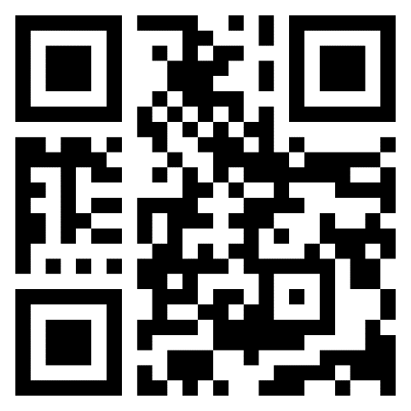
What LEADERS Can Do Now
Model Servant Leadership. Take time to help staff reconnect with their "why" to improve employee engagement and connection with their work. Tell your staff when you see someone doing something you appreciate and how their efforts are meaningful.
Consider using the Listen-Sort-Empower Tool to help teams to problem-solve to identify friction embedded in their work processes. Listen-Sort-Empower Fact Sheet
Use 2023 AES Action Planning Dashboards for workgroup-level action planning. It’s the best place for all employees to see workgroup-level data. Also, the dashboard has tools for leaders at all levels to use their AES data.
Use existing resources including Addressing the 6 Drivers of Burnout: A Guide for Leaders on REBOOT’s VA Insider webpage.
Visit REBOOT’s website on VA Insider for more information about REBOOT and additional resources: https://vaww.insider.va.gov/reducing-employee-burnout/
Addressing the 6 Drivers of Burnout

Slide 15
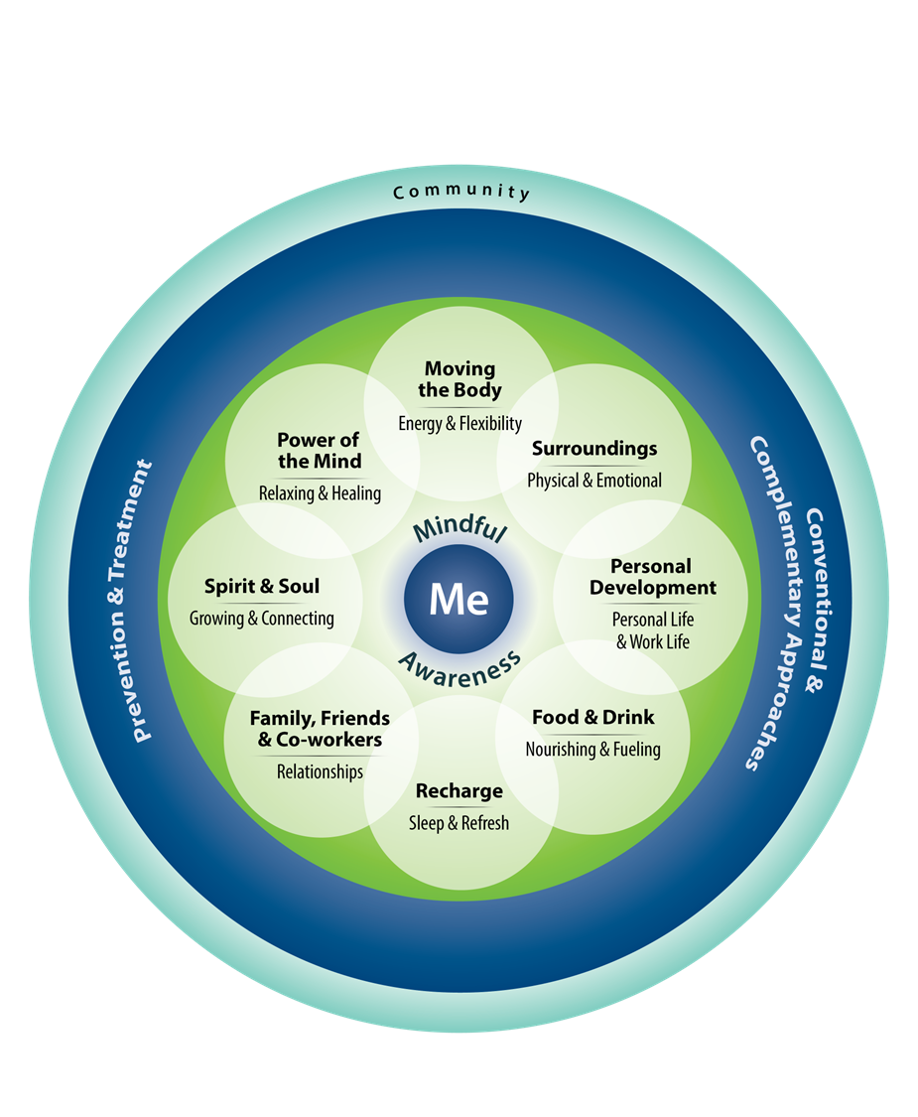
What EMPLOYEES Can Do Now
Share your ideas to improve your work environment. Give feedback on employee surveys.
Encourage forums for camaraderie and peer support. Reducing social isolation and loneliness can contribute to longevity and quality of life. National Institutes of Health Social Wellness Toolkit
Reach out for help when you feel you need more support or mental health treatment.
Lean into Job Crafting by identifying and aligning your work with your purpose and values, working with people you enjoy, and connecting with challenging tasks that support your professional growth. Use well-being coaching to support your efforts.
The Circle Of Health and Well-being – a Tool for Self-Reflection
Notes:
Talking Points
References
Trockel MT, Hamidi MS, Menon NK, Rowe SG, Dudley JC, Stewart MT, Geisler CZ, Bohman BD, Shanafelt TD. Self-valuation: Attending to the Most Important Instrument in the Practice of Medicine. Mayo Clin Proc. 2019 Oct;94(10):2022-2031. doi: 10.1016/j.mayocp.2019.04.040. Epub 2019 Sep 19. PMID: 31543254.
Do workplace-based mindfulness meditation programs improve physiological indices of stress? A systematic review and meta-analysis. Heckenberg RA, Eddy P, Kent S, Wright BJ.J Psychosom Res. 2018 Nov;114:62-71. doi: 10.1016/j.jpsychores.2018.09.010. Epub 2018 Sep 22. PMID: 30314581
Three Good Tools Positively reflecting backwards and forwards is associated with robust improvements: Adair KC, Kennedy LA, Sexton JB. Three Good Tools: Positively reflecting backwards and forwards is associated with robust improvements in well-being across three distinct interventions. J Posit Psychol. 2020;15(5):613-622. doi: 10.1080/17439760.2020.1789707. Epub 2020 Jul 9. PMID: 34295357; PMCID: PMC8294345.
Bialowolski P, McNeely E, VanderWeele TJ, Weziak-Bialowolska D. Ill health and distraction at work: Costs and drivers for productivity loss. PLoS One. 2020 Mar 31;15(3):e0230562. doi: 10.1371/journal.pone.0230562. PMID: 32231382; PMCID: PMC7108714.\
Joanna H. Hong, Julia S. Nakamura, Lisa F. Berkman, Frances S. Chen, Koichiro Shiba, Ying Chen, Eric S. Kim, Tyler J. VanderWeele, Are loneliness and social isolation equal threats to health and well-being? An outcome-wide longitudinal approach, SSM - Population Health, Volume 23,2023,101459,ISSN 2352-8273, https://doi.org/10.1016/j.ssmph.2023.101459

Slide 16
What EMPLOYEES Can Do Now
Practice Self-Compassion. As an example, you can take this short self-compassion assessment from Stanford University. This can improve attention and decision making.
Incorporate mindfulness into your workday, as an employee and a leader. Participate in a free Mindful Fed session. This can contribute to improved immunity and resilience.
Offer Gratitude to your colleagues and yourself. It can improve emotional exhaustion and thriving.
Take your breaks and use short experiences for an attention break during the day through #LiveWholeHealth Blog Series.
Use the Live Whole Health App to set well-being goals for yourself.
The Circle Of Health and Well-being – a Tool for Self-Reflection
Notes:
Talking Points

Slide 17
Discussion and Questions

Slide 18
Additional Resources
VHA REBOOT Initiative
REBOOT Webpage (VA Insider)
Supporting Resources
Scheduling Flexibilities FAQS
Telework for Primary Care Employees Memo
Employee Whole Health
Send gratitude to a colleague through the #VAGratitude app.
USH Updates on REBOOT (2022-Present)
What REBOOT Has for You in 2024 (Feb. 2024)
All that Jazz (Nov. 2023)
VHA REBOOT: Making a Difference (November 2023)
Reduce meeting fatigue by scheduling shorter, more effective meetings (March 2023)
REBOOT Implementation Status Update (December 2022)
Announcing REBOOT priority focus areas (Sep. 2022)
Preparing for REBOOT implementation (Jun. 2022)
Staffing challenges and contribution to burnout (May 2022)
Focus groups, supporting employee Whole Health (Apr. 2022)
Possible recommended actions, focus groups (Mar. 2022)
Flexible schedules, TMS training moratorium (Feb. 2022)
Talking with staff about scheduling flexibilities (Feb. 2022)
USH Updates on REBOOT (2021)
Simplifying your work environment (Dec. 2021)
Video intro to REBOOT from Dr. Marcia Lysaght (Nov. 2021)
Addressing employee burnout: REBOOT task force (Nov. 2021)

