Slide 1
ISRM FY24 Portfolio Report:
Suicide Prevention Priority Setting Process
May 27, 2024

Slide 2
Table of Contents
1
Executive Summary
3-4
2
Phase 1: Understanding Existing Suicide Prevention Research Priorities
5-9
3
Phase 2: Collecting Stakeholder Priorities
10-20
4
Phase 3: Developing AMP Priorities
21-32
5
Appendix
33-44

Slide 3
Executive Summary | Background and Analysis Objective
BACKGROUND
In April 2022, The VA Office of Research and Development (ORD) formally announced the formation of the Investigators, Scientific Review, and Management unit (ISRM) and its decision to transition from the current discipline-based model of research funding and management (the Services) to the Portfolio-based model. This transformation has required many changes across ISRM, and a key change was the development of the new Portfolios. ISRM is creating 2 kinds of Portfolios: Broad and Actively Managed. The Broad Portfolios are replacing the existing services and intend to capture a wide array of projects while the Actively Managed portfolios are more specific around a Veteran health need.
ANALYSIS OBJECTIVE
To ensure that Actively Managed Portfolios (AMPs) are directing research towards the right areas within their field of Veteran need, each AMP needs create Critical Research Priorities. These Priorities are meant to identify short and long-term research focus areas in the given field to enhance real-world impact of research. This report details the process used by the Suicide Prevention AMP to develop its Critical Research Priorities. The AMP started by examining a wide set of priorities set by federal agencies to understand the various fields of research in Suicide Prevention and then narrowed the categories down by capturing VA stakeholder priorities through offline surveys and live discussions.

Slide 4
Executive Summary | Suicide Prevention AMP – Priority Setting
Suicide Prevention developed its Critical Research Priorities through the 3-phased approach detailed below:
Phase 1: Understanding Existing Suicide Prevention Priorities in Federal Research
The first step in Priority Setting was to understand existing suicide prevention research priorities across the federal research landscape. In November 2023, with support from the VA Quality Enhancement Research Initiative (QUERI), the Portfolio workgroup collected and categorized 186 priorities set by various federal agencies into a scoring matrix that served as a framework to map VA Stakeholder priority areas of interest in the next Phase.
Phase 2: Collecting Key VA Stakeholder Priorities
The next step was to gather input and priorities from key stakeholders in the VA suicide prevention space. The team deployed a survey and hosted four discussion sessions with investigators from the Suicide Prevention Research Impact Network (SPRINT), the Veterans Engagement Council, Chief Medical Health Officers (CMHOs), and leads from Veteran Integrated Service Networks (VISNs). By triangulating all the feedback, the team landed on 10 critical research priorities for further consideration.
Phase 3: Finalizing the Suicide Prevention AMP Critical Research Priorities
In the final phase, a survey administered to the SPRINT, CMHOs, VEC stakeholders narrowed down the 10 priorities into 5 critical research priorities: 1) Lethal Means Safety, 2) Community-based interventions, 3) Family, social network-based interventions and postventions, 4) Psychotherapies and other non-somatic interventions, and 5) Risk screening, predictive analytics. Subject matter experts (SMEs) in each of the 5 priorities were contacted for their thoughts on research questions in their respective fields in order to provide the Suicide Prevention Executive Committee with a clear picture of the priorities and the kind of research that will come of out the priorities in the coming years. Phase 3 will culminate with a June 2024 Consensus Panel meeting where the Suicide Prevention Executive Committee will vote to rank research priorities for the Portfolio.

Slide 5
Phase 1: Understanding Existing Suicide Prevention Priorities in Federal Research
The first step in Priority Setting was to understand existing suicide prevention research priorities across the federal research landscape. In November 2023, with support from the VA Quality Enhancement Research Initiative (QUERI), the Portfolio workgroup collected and categorized 186 priorities set by various federal agencies into a scoring matrix that served as a framework to map VA Stakeholder priority areas of interest in the next Phase.

Slide 6
Phase 1: Understanding Existing Suicide Prevention Priorities in Federal Research
Phase 1 had three key steps:
1.1 Identify existing Suicide Prevention Priority Sources
1.2 Categorize Priorities into Methods or Risk Factors
1.3 Develop a Priority Matrix

Slide 7
1.1 Identify existing Suicide Prevention Priority Sources
The Suicide Prevention AMP workgroup gathered suicide prevention research priorities from 12 leading organizations and agencies. Some organizations had multiple publications around Suicide Prevention priorities and others also referred to research articles. The group sourced priorities from a total of 26 sources from the 12 organizations below.
American Foundation for Suicide Prevention
American Psychological Association
Centers for Disease Control and Prevention
Defense Health Agency (DHA)
Department of Defense
Indian Health Service
National Action Alliance for Suicide Prevention (NAASP)
National Alliance on Mental Illness
National Institute of Mental Health
Substance Abuse and Mental Health Services
Veterans Health Administration
White House
Note: A full list of sources is located on slide 33 in the Appendix

Slide 8
1.2 Categorize Priorities into Methods and Risk Factors
The group gathered a total of 186 suicide prevention research priorities and then defined a process to evaluate and categorize these priorities.
Evaluation of Priorities
Process | Create “keyword” categories based on the priority language. These categories were either a research method (e.g., biology/genomics, continuous monitoring) or a suicide risk factor (e.g., firearms, substance abuse)
Decision Rule | 5 or more occurrences of a keyword within the priorities resulted in a new “category.” For example, “Community Interventions” appeared 5+ times across the priorities so it was determined to be a “method” category

Slide 9
1.3 Develop a Priority Matrix
The categories created from the federal agency’s priorities formed this priority matrix. Each category resulted in either a method or procedure listed in the columns of the matrix, or a risk factor listed in the rows of the matrix. The matrix acted as a framework to map VA Stakeholder priority areas of interest in Phase 2.
Risk Factors
Category | Firearms | Older Veterans | Younger Veterans | Female Veterans | Race/Ethnicity | SDOH | Substance Abuse | Medical Disease | TBI | Justice Involvement | LGBTQ | Trauma/ Moral Injury | Mental Health | Cross-Cutting
Biological mechanisms and genetic contributions
Suicide risk screening, evaluation effectiveness, and processes within VA
Machine-based suicide risk algorithms
Technology to assess risk and provide interventions, self-management strategies
Family and social network-based interventions and postventions
Psychotherapies and other non-somatic interventions
Psychotherapy and other Non-Somatic Interventions
Community-based interventions
Educational or messaging offerings
Precision Medicine
Postvention
Cross-Cutting
Research Methods/Procedures

Slide 10
Phase 2: Collecting Key VA Stakeholder Priorities
The next step was to gather input and priorities from key stakeholders in the VA suicide prevention space. The team deployed a survey and hosted four discussion sessions with investigators from the Suicide Prevention Research Impact Network (SPRINT), the Veterans Engagement Council, Chief Medical Health Officers (CMHOs), and leads from Veteran Integrated Service Networks (VISNs). By triangulating all the feedback, the team landed on 10 critical research priorities for further consideration.

Slide 11
Phase 2: Collecting Key VA Stakeholder Priorities
Phase 2 had four key steps:
2.1 Survey SPRINT Stakeholders on Priorities
2.2 Populate Priority Matrix with SPRINT Stakeholder Priorities
2.3 Collect Live Stakeholder Feedback
2.4 Determine Top 10 Priorities

Slide 12
2.1 Survey SPRINT Stakeholders on Priorities
Goal
Understand VA stakeholders’ current sentiment on priorities for VA Suicide Prevention research, and how it overlapped with existing Suicide Prevention priorities across the federal space.
Survey Methodology
Respondents: Investigators within the Suicide Prevention Research Impact Network (SPRINT) database. SPRINT is a national collaborative network of researchers looking to further the field of Suicide Prevention research.
Key Question Area: Identify up to 10 research areas for which there are significant gaps in extant knowledge and for which research support is needed.
Response Count: 54
Note: The text of the Questionnaire is located on slide 34 in the Appendix

Slide 13
2.2 Populate Priority Matrix with SPRINT Stakeholder Priorities
The priorities captured in the survey were then coded into the Priority Matrix, giving #1 priorities a weight of 10, #2 priorities a weight of 9, and so on. In the final column and row, the workgroup totaled priorities by category, with higher sums indicating higher priorities.
Risk Factors
Category | Firearms / Lethal Means Safety | Older Veterans | Younger Veterans | Female Veterans | Race/Ethnicity | SDOH | Substance Abuse | Medical Disease | TBI | Justice Involvement | LGBTQ | Trauma/ Moral Injury | Mental Health | Cross-Cutting | SUM
Biological mechanisms and genetic contributions | 0 | 0 | 0 | 0 | 0 | 0 | 0 | 0 | 0 | 0 | 0 | 0 | 0 | 45 | 45
Suicide risk screening, evaluation effectiveness, and processes within VA | 0 | 5 | 5 | 0 | 0 | 8 | 0 | 10 | 0 | 0 | 0 | 0 | 3 | 25 | 56
Machine-based suicide risk algorithms | 0 | 0 | 0 | 0 | 0 | 0 | 0 | 0 | 0 | 0 | 0 | 0 | 0 | 22 | 22
Technology to assess risk and provide interventions, self-management strategies | 0 | 0 | 0 | 0 | 0 | 0 | 0 | 0 | 0 | 0 | 0 | 0 | 0 | 13 | 13
Family and social network-based interventions and postventions | 6 | 0 | 0 | 0 | 0 | 0 | 0 | 0 | 0 | 0 | 0 | 0 | 0 | 13 | 19
Psychotherapies and other non-somatic interventions | 0 | 0 | 0 | 0 | 0 | 0 | 0 | 0 | 0 | 0 | 0 | 0 | 1 | 29 | 30
Psychotherapy and other Non-Somatic Interventions | 25 | 0 | 0 | 0 | 0 | 22 | 0 | 0 | 0 | 0 | 5 | 5 | 1 | 42 | 100
Community-based Interventions | 7 | 0 | 5 | 0 | 0 | 0 | 0 | 0 | 0 | 0 | 0 | 0 | 0 | 56 | 68
Educational or messaging offerings | 10 | 0 | 0 | 0 | 0 | 0 | 0 | 0 | 0 | 0 | 0 | 0 | 0 | 17 | 27
Precision Medicine | 0 | 0 | 0 | 0 | 0 | 0 | 0 | 0 | 0 | 0 | 0 | 0 | 0 | 6 | 6
Postvention | 0 | 0 | 0 | 0 | 0 | 0 | 0 | 0 | 0 | 0 | 0 | 0 | 0 | 16 | 16
Cross-Cutting | 49 | 34 | 3 | 25 | 16 | 32 | 2 | 4 | 4 | 5 | 31 | 6 | 18 | 5
SUM | 97 | 39 | 13 | 25 | 16 | 62 | 2 | 14 | 4 | 5 | 36 | 11 | 23
Research Methods/Procedures

Slide 14
2.2 Populate Priority Matrix with SPRINT Stakeholder Priorities
Using the scores from the Priority Matrix, 8 categories of Suicide Prevention research emerged as leading priorities. These scores were created by assigning a survey response to a certain cell in the matrix and the responses that were the #1 priority were given a score of 10, #2 priority were given a score of 9, and so on. Aggregated results are below.
Category | Priority Score
Psychotherapy and other Non-Somatic Interventions | 100
Firearms / Lethal Means Safety | 97
Community-based Interventions | 68
Social Determinants of Health | 62
Suicide risk screening, evaluation effectiveness, and processes within VA | 56
Biological mechanisms and genetic contributions | 45
Older Veterans | 39
LGBTQ | 36
Psychotherapies and other non-somatic interventions | 30
Educational or messaging offerings | 27
Female Veterans | 25
Mental Health | 23
Machine-based suicide risk algorithms | 22
Family and social network-based interventions and postventions | 19
Postvention | 16
Race/Ethnicity | 16
Medical Disease | 14
Technology to assess risk and provide interventions, self-management strategies | 13
Younger Veterans | 13
Trauma/ Moral Injury | 11
Precision Medicine | 6
Justice Involvement | 5
TBI | 4
Substance Abuse | 2

Slide 15
2.3 Collect Live Stakeholder Feedback
Goal
Gather feedback from key stakeholder groups to refine the 8 categories from the Priority Matrix.
Method
To ensure the priorities for the Suicide Prevention Portfolio are representative of the interests across stakeholder groups, the Portfolio workgroup collected input during live meetings with:
Veteran Engagement Council
Leads of the Veteran Integrated Service Network (VISN)
Chief Mental Health Officers
Suicide Prevention Research Impact Network (SPRINT)

Slide 16
2.3 Collect Live Stakeholder Feedback:
Veteran Engagement Council
Key Questions for Audience:
What suicide prevention research topics come to mind as most important for Veterans from your perspective?
Are there specific patient populations it would be important to study (if this has not come up)?
Are there any research topics you don’t think are as high a priority?
Are there particular topics within this area that come to mind that would be important for VA researchers to work on?
Research Priorities Discussed during Meeting
Hard to Reach Veterans (Isolating Veterans/ Veterans not in VA care/ Rural Veterans / Transitioning to civilian)
Continuity of Care*
Community Research (including family)
Developing Novel Treatments (including provider perspective)
Moral Injury/Spiritual
Lethal Means Safety
Messaging
Peer Support
Messaging
Data Studies
Racial/Ethnic/Sexual Minorities
Brain/TBI/Genomics
* - category not identified through investigator survey

Slide 17
2.3 Collect Live Stakeholder Feedback:
Leads of Veteran Integrated Service Network
Key Questions for Audience:
What areas in suicide prevention do you think needs more research to support your clinical decision-making?
How does your program implement current research evidence or data regarding assessing suicide risk? What would make risk assessment processes or resulting risk information more useful or actionable?
How do you use the information you have now regarding effectiveness of suicide prevention interventions and treatments? What new information would help your program make evidence-informed treatment planning decisions?
Are there certain patient characteristics that are important to study or to include in VA research?
Research Priorities Discussed during Meeting
Risk Identification Process*
  Needs modification
  Clinician burden too high
Clinical Trial Feasibility*
  Psychotherapy
  Small trials will not advance practice
Community Interventions
Education, Training, and Messaging
Firearms, Lethal Means Safety
Safety Planning
Older Veterans
Female Veterans
* priority areas

Slide 18
2.3 Collect Live Stakeholder Feedback:
Chief Mental Health Officers
Key Questions for Audience:
Reviewed priority setting process and results of survey.
Solicited feedback on topic areas.
Research Priorities Discussed during Meeting
Risk Identification Process*
  Need to rethink static, universal screening
  Critical review of Risk ID processes
  Development of dynamic risk identification processes
No significant feedback on other priorities
* - priority areas (limited discussion)

Slide 19
2.3 Collect Live Stakeholder Feedback:
Suicide Prevention Research Impact Network
Key Questions for Audience:
Suggestions regarding weighting of quantitative and qualitative data to identify content domains for consideration?
Thoughts on ranking or rating of content domains in the survey? That is, what do you see as the benefits of ranking over rating and visa versa?
How many domains should be considered on the survey?
What are the recommendations regarding specificity in the domains in survey?
Research Priorities Discussed during Meeting
Survey Content
  Use of count data
  Include themes important to non-investigator stakeholders
Recommended different instructions
  Framing language to define what is meant by “important”
Broad Categories
  Rate categories
  Rank top 3 categories
  Specify what should be studied in top 3 categories
Populations
  Rank each population

Slide 20
2.4 Determine Top 10 Priorities
Based on the live meeting responses, the 8 categories that emerged from the Priority Matrix were revised. Some categories like “Lethal Means Safety” and “Psychotherapies” were maintained as those categories were discussed at length during the live sessions , while others like “Social Determinants of Health” or “Older Veterans” were removed due to lack of interest. The workgroup determined the following 10 research priorities as the most relevant for Suicide Prevention Portfolio to focus on in Phase 3.
Lethal Means Safety approaches to suicide prevention
Community-based interventions for suicide prevention
Psychotherapies and other non-somatic interventions for suicide prevention
Family and social network-based interventions and postventions
Suicide risk screening, evaluation effectiveness, and processes within VA
Technology, including wearable devices and text data, to assess for suicide risk and to provide suicide prevention interventions and self-management strategies
Educational or messaging offerings to stakeholders (Veterans, community, clinicians, families/peers, etc)
Machine-based suicide risk algorithms that utilize large existing data sets to improve risk accuracy or developing precision-medicine approaches to suicide prevention
Psychopharmacological and other somatic interventions (e.g., TMS) to prevent suicide
Biological mechanisms and genetic contributions to suicide

Slide 21
Phase 3: Finalizing the Suicide Prevention AMP Critical Research Priorities
In the final phase, a survey administered to the SPRINT, CMHOs, VEC stakeholders narrowed down the 10 priorities into 5 critical research priorities: 1) Lethal Means Safety, 2) Community-based interventions, 3) Family, social network-based interventions and postventions, 4) Psychotherapies and other non-somatic interventions, and 5) Risk screening, predictive analytics. Subject matter experts (SMEs) in each of the 5 priorities were contacted for their thoughts on research questions in their respective fields in order to provide the Suicide Prevention Executive Committee with a clear picture of the priorities and the kind of research that will come of out the priorities in the coming years. Phase 3 will culminate with a June 2024 Consensus Panel meeting where the Suicide Prevention Executive Committee will vote to rank research priorities for the Portfolio.

Slide 22
Phase 3: Finalizing the Suicide Prevention AMP Critical Research Priorities
Phase 3 had four key steps:
3.1 Survey SPRINT, Chief Mental Health Officers, and Veterans on Priorities
3.2 Determine Top 5 Critical Research Priorities
3.3 Survey Subject Matter Experts on their Priority Field
3.4 Advisory Group Temperature Check
3.5 Consensus Panel Meeting

Slide 23
3.1 Survey SPRINT, Chief Mental Health Officers, and Veterans on Priorities
Goal
Narrow the 10 identified research priorities to 5 critical research priorities using feedback from a broad set of stakeholders.
Survey Methodology
Respondents: Suicide Prevention Research Impact Network (SPRINT) Investigators, Veteran Engagement Council (VEC) Members, Chief Mental Health Officers
Key Question Areas:
Indicate which research domains should be the highest priority
Which element of this research domain should be a specific area of study
Which groups should be emphasized in funding announcements
Response Count: 98
Note: The questions in this survey along with collected data are located on slide 35-42 in the Appendix

Slide 24
3.2 Determine Top 5 Critical Research Priorities
Based on the analysis of the survey results, these 5 areas were deemed to be the key priority areas, one or more of which the Suicide Prevention AMP will focus on addressing in the coming fiscal years.
Lethal Means Safety approaches
Community-based interventions for suicide prevention
Family and social network-based interventions and postventions
Psychotherapies and other non-somatic interventions
Risk screening, predictive analytics

Slide 25
3.3 Survey Subject Matter Experts on their Priority Field
Goal
Surface research questions that would be a part of the Notice of Special Interest should the priority area be selected as the primary focus of this portfolio.
Survey Methodology
Respondents: Subject Matter Experts across the 5 critical research priority fields
  Lethal Means Safety approaches
  Community-based interventions for suicide prevention
  Family and social network-based interventions and postventions
  Psychotherapies and other non-somatic interventions
  Risk screening, predictive analytics
Key Question Area: Detail research questions, strategies, ideal investigation sizes, and desired outcomes in one of the five priority areas
Response Count: 17
Note: The text of the Questionnaire and the SME stakeholders are located on slide 43-44 in the Appendix

Slide 26
3.3 Survey Subject Matter Experts on their Priority Field
Research Questions on Priority 1. Lethal Means Safety Approaches
SMEs in this priority area provided research questions that were then categorized into the following themes.
Theme 1: Understanding Intervention Effectiveness
Theme 2: Community Interventions
  What targeted interventions are most effective in spurring personal action of an adult with suicide risk to reduce access to firearms?
  Studies seeking to determine the efficacy of secure firearm storage interventions in promoting LMS behaviors and averting suicide outcomes.
  What are effective ways to, counsel, incentivize and support safe firearms storage by Veterans?
  What is the most persuasive, scalable method for promoting secure firearm storage beyond the healthcare system?
  What are barriers and facilitators to widespread availability of participation of firearm businesses (FFLs) in suicide prevention programs for customers, including out-of-home storage?
Theme 3: Messaging
Theme 4: Understanding Mechanisms of Change
  What messages are most effective in changing Veteran firearms safety behavior, and how does the messaging format and content need to be altered to address various subpopulations of Veterans?
  How can we normalize out-of-home firearm storage and make this option readily available to firearm owners?
  Increased behavioral research is needed to extend beyond epidemiological findings. A better understanding of the mechanisms driving behavior change could advance the field. This could involve EMA assessments to get at more fine-tuned assessments of what prompts firearm storage changes, behavioral experiments comparing self-reported and physiological responses to firearm-relevant stimuli (e.g. messaging, images related to firearm suicide), and randomized trials that extend existing research on lethal means counseling.

Slide 27
3.3 Survey Subject Matter Experts on their Priority Field
Research Questions on Priority 2. Community-based Interventions
SMEs in this priority area provided research questions that were then categorized into the following themes.
Theme 1: Lethal Means Safety in the Community
  What universal messages and implementation approaches work best for reaching broad audiences of Veterans/caregivers/community partners/firearm owners?
  What is the impact of community-partnered approaches to dissemination of LMS/secure firearm storage messaging (e.g., raising awareness and disseminating messaging through firearm retailers, gun clubs and ranges, firearm instructors)?
Theme 2: Understanding Community / Social Factors in Suicide
  What community or social factors contribute to suicide risk? How do mental health conditions mediate or moderate this relationship?
Theme 3: What Suicide Prevention Interventions are Best Implemented in the Community?
  What are the best steps for translating evidence-based suicide prevention practices (e.g., suicide screening) in community-based settings (e.g., homeless shelters)?
  What is feasible for community providers and what barriers are present that would (or have) impeded their use of CBI-SPs with Veterans within community settings?

Slide 28
3.3 Survey Subject Matter Experts on their Priority Field
Research Questions on Priority 3. Family, Social Network-based Interventions & Postventions
SMEs in this priority area provided research questions that were then categorized into the following themes.
Theme 1: Empowering families to conduct SP interventions
  What are the effective suicide prevention strategies for use by professional providers with Veterans that can be taught to families and other social network members in a “task-shifting strategy”?
    To what degree can evidence-informed strategies such as suicide safety planning be adapted effectively for implementation by family and social-network members?"
Theme 2: Boosting Social Support
  What are the most effective ways to leverage peer support (both professional peer support specialists and healthy non-professional peers) to help prevent Veteran suicide?
  Developing an evidence base for social support interventions that improve suicide risk and functional outcomes?
Theme 3: Understanding of mechanisms of social support
  Providing a deeper understanding of mechanisms of social support, and how these mechanisms exert influence over suicide risk.
  What are the effects of family interventions on key psychological risk factors for Veteran suicide (i.e., thwarted belongingness, physical and psychological pain, hopelessness)?"

Slide 29
3.3 Survey Subject Matter Experts on their Priority Field
Research Questions On Priority 4. Psychotherapies and Other Non-somatic Interventions
SMEs in this priority area provided research questions that were then categorized into the following themes.
Theme 1: Matching Intervention to Risk
  What psychotherapies work best for whom and under what conditions? In other words, can patients be effectively matched to treatment options?
  Which subset of patients respond (and do not respond) to suicide-focused therapies?
Theme 2: Understanding Effective Components
  "Do certain components and procedures from suicide-focused therapies influence suicide attempt risk more (or less) than others?”
  Are there common elements to effective psychotherapy for suicidality?
Theme 3: Understanding power of existing interventions
  Do brief interventions result in long-term reduction in suicide risk?"
  What can we do about the majority of high-risk Veterans who do not receive VA care?
  What types of interventions are most effective for very high-risk Veterans versus those at moderate risk?

Slide 30
3.3 Survey Subject Matter Experts on their Priority Field
Research Questions on Priority 5. Risk Screening, Predictive Analytics
SMEs in this priority area provided research questions that were then categorized into the following themes.
Theme 1: Risk Screening and Subsequent SP Programming
Theme 2: Improving predictive power
  How can we evaluate the effectiveness of suicide risk screening and evaluation programs, including their impact on care processes, healthcare utilization, and patient outcomes?. For example, how does screening and evaluation influence the care patients receive (e.g., increased access to evidence-based interventions) and does increasing access to these interventions decrease suicide risk?
  Developing models that target intervention response instead of just risk. For example, developing a ML model to determine which VCL callers should get reminder calls the next day because the caller is at high risk of failing to follow through on recommendations.
  What affordable and scalable interventions are effective for reducing risk of self-harm in the large population of people at moderately increased risk?"
  Developing appropriate (and different) risk models for each clinical touchpoint (e.g., developing different models for ED versus Primary Care versus VCL callers). These models need to be dynamic and developed for specific patient populations/settings.
  How can we enhance the accuracy of suicide risk screening tools (including predictive analytics) in diverse patient populations and clinical settings?
  Understanding differences in distinguishing between models for suicide death and models for nonfatal suicide attempts.
  What is the evidence for the VA’s CSRE screening program?

Slide 31
3.3 Survey Subject Matter Experts on their Priority Field
Perceived Advantages & Disadvantages to Funding each Priority Area
These advantages and disadvantages of funding research in each proposed priority were generated based on the analysis of responses from subject matter experts across the five priority fields.
Advantages
Disadvantages
70% decedents die by firearm
Realistic chance to change # death
Have VA cohort who can conduct
Frequent congressional inquires
1. Lethal Means Safety Approaches
OMHSP has contracted for messaging
Measuring attitudinal/behavior change = large expense
Highly valued by VEC
2/3 decedents outside of VA
Involve other priority domain
2. Community-based Interventions
Measuring impact very difficult
Unclear to have significant change
Unclear sufficient # of investigators.
Understudied area
Veteran support
Involves other priority domains
3. Family, Social Network-based Interventions & Postventions
Existing studies underdeveloped
Unlikely to have short term impact
Precision medicine synchronize with risk ID
Direct importance to clinicians
4. Psychotherapies and Other Non-somatic Interventions
Unclear feasibility of large trial
Unclear if will have impact on total number of deaths
SPC priority
Can reduce current burden
Can inform clinical touchpoints
Can advance precision medicine
5. Risk Screening, Predictive Analytics
Need OSP support
Can models be developed by OSP?

Slide 32
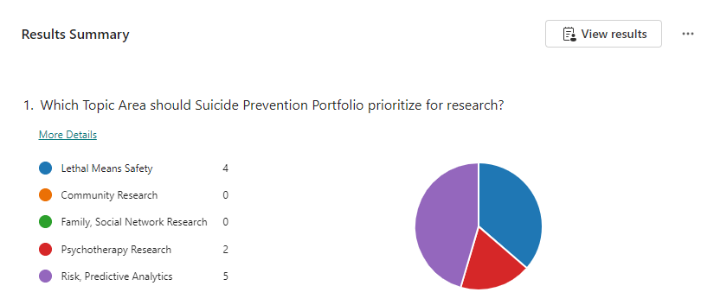
3.4 Advisory Group Temperature Check
In advance of the Consensus Panel meeting, the advisory group was polled on April 23rd on which topic area should the portfolio prioritize for research. This served as a temperature check on where the interest was across the priority areas. The two priorities that individuals indicated should be top priority were Risk, Predictive Analytics and Lethal Means Safety. The Consensus Panel meeting will be the next step and the formal survey.
Survey Results Link

Slide 33
3.5 Consensus Panel Meeting
The final step in the process will be the Consensus Panel Meeting, scheduled for June 4, 2024.
Objective: Convene the Executive Committee to rank Critical Research Priorities in order of importance. The members will review the process taken to arrive the 5 identified priorities and then complete a live survey to rank the priorities from #1 to #5.
Key Discussion Questions:
What research domain would be the most impacted by additional funding? Where can funding “push the needle”?
Where is VA well positioned across these research domains to create impact?
Outcome: The AMP will develop Suicide Prevention Notices of Special Interest to solicit research applications for the top priorities.

Slide 34
1.1 Identify existing Suicide Prevention Priority Sources
Utilizing these sources as a base, the team gathered priorities from a total of 26 sources, resulting in 186 cumulative priorities.
American Foundation for Suicide Prevention | https://afsp.org/public-policy-priorities/
American Psychological Association | American Psychological Association summary of new research in suicide prevention
Center for Disease Control and Prevention | CDC Suicide Prevention Research Priorities
Defense Health Agency (DHA) | DHA 2020 Prioritized Research Gaps Report for Suicide Prevention Topics
 | The 2020 Research Gaps Report: Suicide Prevention Research Priorities | Health.mil
Department of Defense | DOD Suicide Prevention Research Strategy
 | DoD Mtg 10/30 - Resource from Steve
 | https://media.defense.gov/2023/Feb/24/2003167430/-1/-1/0/SPRIRC-FINAL-REPORT.PDF
 | 2023 Integrated Prevention Research Agenda.pdf
 | https://www.esd.whs.mil/Portals/54/Documents/DD/issuances/dodi/640009p.pdf?ver=2020-09-11-104936-223
Indian Health Service | https://www.ihs.gov/zerosuicide/about/
National Action Alliance for Suicide Prevention (NAASP) | Action Alliance Prioritized Research Agenda for Suicide Prevention
National Alliance on Mental Illness | https://www.nami.org/NAMI/media/NAMI-Media/Public%20Policy/NAMI-s-Federal-Priorities-2023-2024.pdf
National Institute of Mental Health | https://www.nimh.nih.gov/research/priority-research-areas
 | NIMH Practice-Based Suicide Prevention Research Centers
Substance Abuse and Mental Health Services | https://www.samhsa.gov/about-us/strategic-plan
Veterans Health Administration | Office-of-Mental-Health-and-Suicide-Prevention-National-Strategy-for-Preventing-Veterans-Suicide.pdf (va.gov)
 | https://www.mentalhealth.va.gov/docs/data-sheets/2022/2022-National-Veteran-Suicide-Prevention-Annual-Report-FINAL-508.pdf
 | https://hsrd.research.va.gov/centers/core/sprint/priorities.cfm
 | https://www.mentalhealth.va.gov/suicide_prevention/docs/Office-of-Mental-Health-and-Suicide-Prevention-National-Strategy-for-Preventing-Veterans-Suicide.pdf
White House | White House Report on Mental Health Research Priorities
 | Fact Sheet: New Strategy Outlines Five Priorities for Reducing Military and Veteran Suicide | The White House
Peer-reviewed Research | Suicidal ideation, suicide attempts, and suicide death among Veterans and service members: A comprehensive meta-analysis of risk factors - PMC (nih.gov)
 | Suicide Prevention Research Priorities in Health Care | Psychiatry and Behavioral Health | JAMA Psychiatry | JAMA Network
 | Systematic review of Evidence-Based strategies
 | Frontiers | Establishing a Research Agenda for Suicide Prevention Among Veterans Experiencing Homelessness (frontiersin.org)
Other | Association for Psychological Science summary of science of suicide prevention

Slide 35
2.1 Survey SPRINT Stakeholders on Priorities
Greetings VA Suicide Prevention investigators,
Beginning October 1, 2024, suicide prevention research will be housed within the Suicide Prevention Actively Managed Portfolio (SP AMP). The SP AMP team is currently working with an Executive Steering Committee to establish governance policy and processes for the SP AMP and to establish initial priority areas for VA suicide prevention research.
The priority setting efforts will follow a strategy developed by QUERI which seeks input from multiple stakeholders throughout the priority setting process. As part of our initial efforts, we are asking for your assistance in identifying topic areas that you believe are important to advance suicide prevention efforts in VA. To help us gather a thorough body of topic areas, we ask that you identify up to 10 research areas for which there are significant gaps in extant knowledge and for which research support is needed.
If you are willing to assist us in these initial efforts to identify possible priority areas, please click on this link which will provide further instruction. Please provide feedback as soon as possible but no later than November 17th.
Thanks in advance for your willingness to help. We will be providing more information to the field as this process advances.

Slide 36
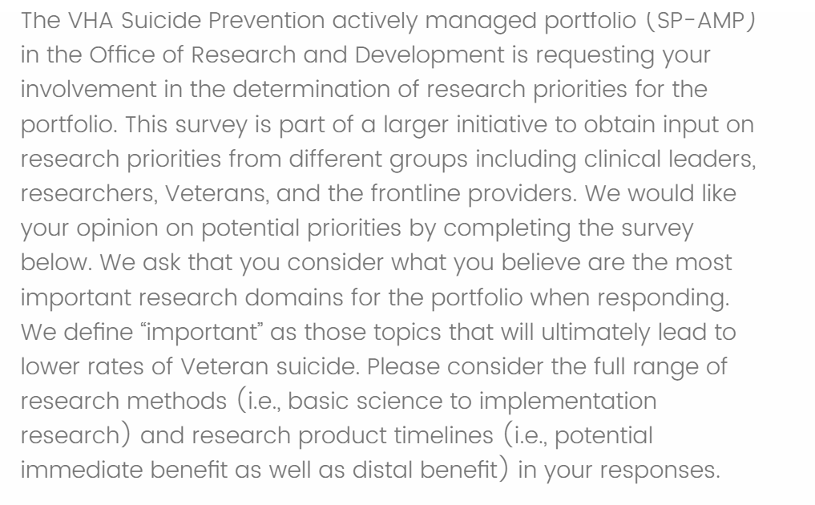
3.1 Survey SPRINT, Chief Mental Health Officers, and Veterans on Priorities
Preview

Slide 37
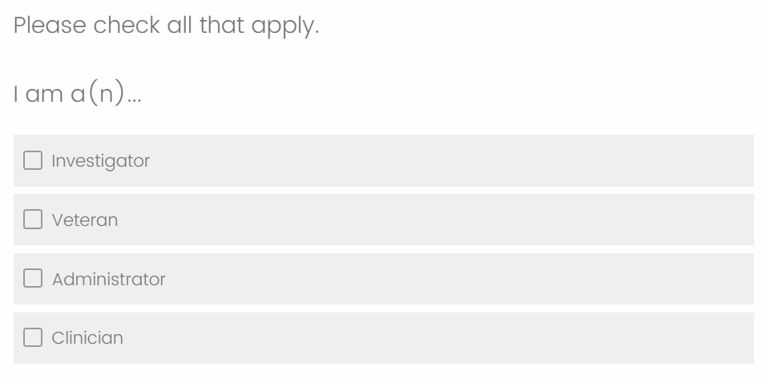
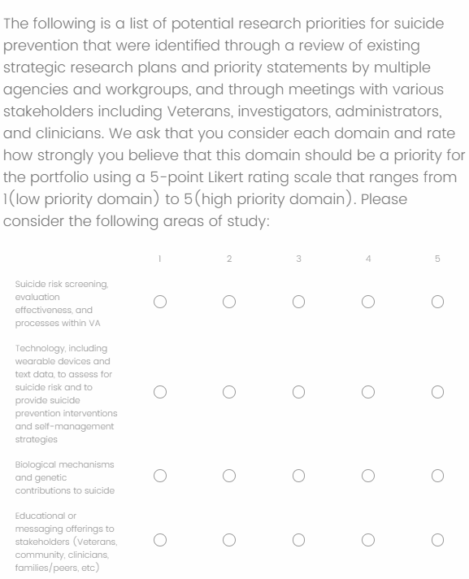
3.1 Survey SPRINT, Chief Mental Health Officers, and Veterans on Priorities

Slide 38
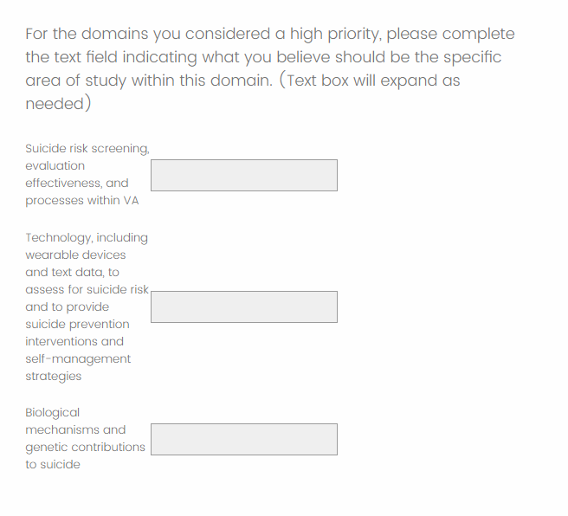
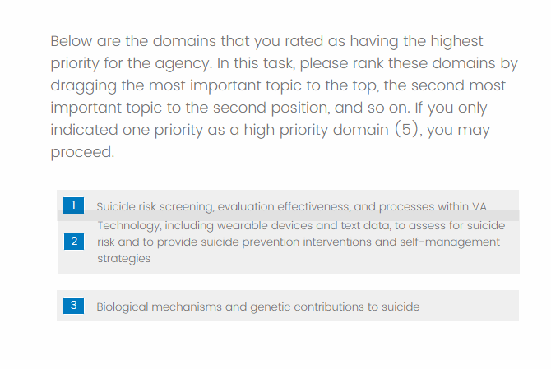
3.1 Survey SPRINT, Chief Mental Health Officers, and Veterans on Priorities

Slide 39
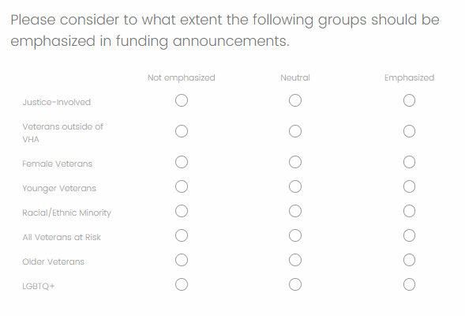
3.1 Survey SPRINT, Chief Mental Health Officers, and Veterans on Priorities

Slide 40
3.1 Survey SPRINT, Chief Mental Health Officers, and Veterans on Priorities - Responders
Distribution Group | Survey Response Timeline | Responses
SPRINT Investigators | 2/14 – 2/23 | 72
VEC Veterans | 2/21 – 3/04 | 11
CMHOs | 2/28 - 3/13 | 15
Stakeholder Roles across Distribution Groups
 | CMHO (15 responses) | VEC (11 responses) | SPRINT (72 responses) | Total (98 responses)
Administrator | 73% | 18% | 10% | 20%
Investigator | 47% | 9% | 92% | 76%
Clinician | 7% | 0% | 36% | 28%
Veteran | 0% | 82% | 1% | 10%
*Respondents could select multiple roles, the columns & rows can exceed 100%

Slide 41
3.1 Survey SPRINT, Chief Mental Health Officers, and Veterans on Priorities – Domain Rating
Domains | VEC Rating (11) | SPRINT Rating (68) | CMHO Rating (15) | Average Rating - Unweighted | Average Rating - Weighted
Lethal Means Safety approaches to suicide prevention | 3.91 | 4.3 | 4.15 | 4.12 | 4.23
Community-based interventions for suicide prevention | 4.36 | 4.24 | 3.46 | 4.02 | 4.13
Psychotherapies and other non-somatic interventions for suicide prevention | 3.36 | 4.18 | 3.69 | 3.74 | 4.01
Family and social network-based interventions and postventions | 4.09 | 4.07 | 3.69 | 3.95 | 4.01
Suicide risk screening, evaluation effectiveness, and processes within VA | 3.45 | 3.79 | 4.62 | 3.95 | 3.88
Technology, including wearable devices and text data, to assess for suicide risk and to provide suicide prevention interventions and self-management strategies | 3.55 | 3.51 | 3.38 | 3.48 | 3.49
Educational or messaging offerings to stakeholders (Veterans, community, clinicians, families/peers, etc) | 3.73 | 3.38 | 2.62 | 3.24 | 3.3
Machine-based suicide risk algorithms that utilize large existing data sets to improve risk accuracy or developing precision-medicine approaches to suicide prevention | 2.73 | 3.31 | 3.62 | 3.22 | 3.29
Psychopharmacological and other somatic interventions (e.g., TMS) to prevent suicide | 2.36 | 3.19 | 3.62 | 3.06 | 3.16
Biological mechanisms and genetic contributions to suicide | 2.91 | 2.76 | 3.54 | 3.07 | 2.9
The weighted results consider the number of responders in each survey group

Slide 42
3.1 Survey SPRINT, Chief Mental Health Officers, and Veterans on Priorities – High Priority Domain Rating
Domains | VEC Ranking (incomplete)* | SPRINT Ranking | CMHO Ranking | Aggregate Ranking | Aggregate No. 1 Rankings
Lethal Means Safety approaches to suicide prevention | 20 | 342 | 29 | 391 | 12
Community-based interventions for suicide prevention | 18 | 467 | 19 | 504 | 6
Psychotherapies and other non-somatic interventions for suicide prevention | 7 | 350 | 35 | 392 | 14
Family and social network-based interventions and postventions |  | 374 | 0 | 374 | 4
Suicide risk screening, evaluation effectiveness, and processes within VA |  | 138 | 31 | 169 | 2
Technology, including wearable devices and text data, to assess for suicide risk and to provide suicide prevention interventions and self-management strategies |  | 209 | 15 | 224 | 0
Educational or messaging offerings to stakeholders (Veterans, community, clinicians, families/peers, etc) | 9 | 57 | 0 | 66 | 1
Machine-based suicide risk algorithms that utilize large existing data sets to improve risk accuracy or developing precision-medicine approaches to suicide prevention | 9 | 145 | 19 | 173 | 3
Psychopharmacological and other somatic interventions (e.g., TMS) to prevent suicide |  | 200 | 17 | 217 | 1
Biological mechanisms and genetic contributions to suicide |  | 72 | 17 | 89 | 3
Weighted Methods:
- A Ranking of 1 gives the domain a score of 10, down to a Ranking of 10 gives the domain a score of 1. Combining all rankings across all responses results in these overall ranks.

Slide 43
3.1 Survey SPRINT, Chief Mental Health Officers, and Veterans on Priorities – High Priority Domain Example Responses
Domains | Selected Free Responses
Lethal Means Safety approaches to suicide prevention | Focus resources on rapidly implementing and assessing the impact of current best practice lethal means safety for suicide prevention. Examining the impact of Lethal Means Safety Counseling Interventions on Behavior (e.g., use of safe storage); examining the impact of LMS programs and distribution of safe storage on suicidal behaviors and death
Suicide risk screening, evaluation effectiveness, and processes within VA | Identification of Veterans at low to moderate risk who should be targeted through public health approaches, particularly those outside of mental health evaluation of effectiveness of traditional screening within VA. Does filling out a CSSRS impact clinical outcomes
Family and social network-based interventions and postventions | Interventions to improve support and helpfulness of family members and professional caregivers in their efforts to support a Veteran at risk for suicide
Psychotherapies and other non-somatic interventions for suicide prevention | We need more work aimed at figuring out the most cost effective approaches for reducing suicide risk through therapy. It's not clear how much CBT-SP does over and above safety planning alone; group format's need to be explored as well as web-based and digital interventions. We need to try to get the interventions that are known to work to as many at risk Veterans as possible. Developing novel psychotherapies to address suicide risk and conducting randomized controlled trials to build their evidence base Developing a large network of sites for large multi-site clinical trials.
Community-based interventions for suicide prevention | I agree with those who note that VA work must be paired with community interventions to help those who will never enter a VA (the majority of suicides). We know very little in this area. Developing strategies to engage non-VHA users in SP programming at VA including LMS counseling. building collaborations with community partners and leveraging community resources to create shifts/changes in suicide outcomes over the longer term

Slide 44
3.3 Survey Subject Matter Experts on their Priority Field
Based on your knowledge of the state of the science, can you identify 1 to 3 research questions that would be especially important to answer and/or key next steps for developing our knowledge about [Priority Area]
What type of research strategies would best help to answer these research questions? For example, do you believe that advancement would be best realized through clinical trial research, implementation science investigations, development of novel interventions, or improve understanding of the mechanisms through which this topic area is associated with suicide?
In considering your response above, do you believe that organizations should prioritize funding smaller numbers of large trials to improve confidence in existing findings or more numerous smaller investigations that may lead to improved or novel strategies?
Given the state of the science, what outcomes would be most appropriate for the type of research that you are recommending?

Slide 45
3.3 Survey Subject Matter Experts on their Priority Field - Stakeholders
Lethal Means Safety | Community-Facing SP Research | Psychotherapies Research | Family and social network-based interventions and postventions | Suicide risk screening, predictive analytics
Steve Dobscha (VA) | Gala True (VA) | Peter Britton (VA) | Marianne Goodman (VA) | Nasi Bahraini (VA)
Emmy Betz (non-VA) | Rajeev Ramchand (non--VA) | Craig Bryan (VA) | BryAnn Debeer (VA) | Ron Kessler (non-VA)
Joe Simonetti (VA) | Lindsey Monteith (VA) | Mark Ilgen (VA) | Steve Sayers (VA) | Nate Kimbrell (VA)
Mike Anestis (non-VA) | Aaron Eagan (VA) | David Rudd (non-VA) | Jason Chen (VA) | John McCarthy (VA)
 |  |  |  | Greg Simon (non-VA)

