Slide 1
Suicide Prevention: Advisory Group Monthly Meeting
May 28, 2024
Joe Constans

Slide 2
Agenda
Time | Item | Objective
3:00 – 3:10 | Review Priority Setting | Review priority setting process Results of temperature check next month
3:10 – 3:30 | Voting Session preview | Review voting members Demonstration of voting process
3:30 – 3:35 | Priority setting document | Consider publication?
3:35 – 3:45 | Next Steps | NOSI development Review of studies in AMP portfolio Likely budget for FY25

Slide 3
Priority Setting for Suicide Prevention Portfolio

Slide 4
Key Priority Areas
Based on the analysis of the survey results, these 5 areas were deemed to be the key priority areas. Suicide Prevention Portfolio will focus on addressing one or more of these priorities in the coming fiscal years.
Lethal Means Safety approaches to suicide prevention
Community-based interventions for suicide prevention
Family and social network-based interventions and postventions
Psychotherapies and other non-somatic interventions for suicide prevention
Suicide risk screening, evaluation effectiveness, and processes within VA; predictive analytics

Slide 5
Survey Subject Matter Experts on their Priority Field Perceived Advantages & Disadvantages to Funding each Priority Area
These advantages and disadvantages of funding research in each proposed priority were generated based on the analysis of responses from subject matter experts across the five priority fields.
Advantages
Disadvantages
70% decedents die by firearm
Realistic chance to change # death
Have VA cohort who can conduct
Frequent congressional inquires
1. Lethal Means Safety Approaches
OMHSP has contracted for messaging
Measuring attitudinal/behavior change = large expense
Highly valued by VEC
2/3 decedents outside of VA
Involve other priority domain
2. Community-based Interventions
Measuring impact very difficult
Unclear to have significant change
Unclear sufficient # of investigators.
Understudied area
Veteran support
Involves other priority domains
3. Family, Social Network-based Interventions & Postventions
Existing studies underdeveloped
Unlikely to have short term impact
Precision medicine synchronize with risk ID
Direct importance to clinicians
4. Psychotherapies and Other Non-somatic Interventions
Unclear feasibility of large trial
Unclear if will have impact on total number of deaths
SPC priority
Can reduce current burden
Can inform clinical touchpoints
Can advance precision medicine
5. Risk Screening, Predictive Analytics
Need OSP support
Can models be developed by OSP?

Slide 6
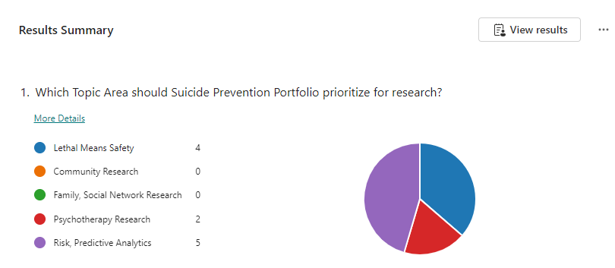
Advisory Group Temperature Check
In advance of the Consensus Panel meeting, the advisory group was polled on April 23rd on which topic area should the portfolio prioritize for research. This served as a temperature check on where the interest was across the priority areas. The two priorities that individuals indicated should be top priority were Risk, Predictive Analytics and Lethal Means Safety. The Consensus Panel meeting will be the next step and the formal survey.
Survey Results Link

Slide 7
Voting Session - Suicide Prevention Portfolio

Slide 8
Consensus Panel Meeting – Voting Status Eligibility
Name | Role | ESC Function
Department of Veterans Affairs – Office of Research & Development |  | Constituency
Wendy Tenhula | Deputy Chief Research and Development Officer (CRADO), ORD, Dept. of Veterans Affairs | Voting Member
David Atkins | Former Director, HSR&D, Dept. of Veterans Affairs, VA WOC employee | Voting Member
Kara Beck | QUERI Representative, ORD, Dept. of Veterans Affairs | Voting Member
Joseph Constans | SP AMP Lead, ORD, Dept. of Veterans Affairs | Non-Voting, Ex Officio
Robert O’Brien | SPM, HSR&D, ORD, Dept. of Veterans Affairs | Non-Voting, Ex Officio
Vetisha McClair | SPM, CSR&D, ORD, Dept. of Veterans Affairs | Non-Voting, Ex Officio
Peter Hunt | SPM, RR&D, ORD, Dept. of Veterans Affairs | Non-Voting, Ex Officio
Department of Veterans Affairs – ORD funded Suicide Prevention Research Centers |  | Constituency
Steven Dobscha | Co-Director, Suicide Prevention Research Impact NeTwork (SPRINT) | Non-Voting Member
Brian Marx | Co-Director, Suicide Prevention Research Impact NeTwork (SPRINT) | Non-Voting Member
Department of Veterans Affairs – Office of Mental Health and Suicide Prevention |  | Constituency
Matt Miller | Director, Suicide Prevention, Office of Mental Health and Suicide Prevention | Voting Member
Susan Strickland | Director of Research Coordination, Office of Mental Health and Suicide Prevention | Voting Member
Edgar Villareal | National Clinical Director, Office of Mental Health and Suicide Prevention | Voting Member
VHA Stakeholders |  | Constituency
Jodi Trafton | Director, VA Program Evaluation and Resource Center | Member
Bradley Watts | Research Director, VHA Office of Rural Health | Member
Lisa Brenner | Director, Rocky Mountain MIRECC | Non-Voting Member
Stephanie Gamble | Director, CoE for Suicide Prevention | Non-Voting Member
Veteran Representative (Federal Employee) from Veteran Engagement Council Constituency
TBD | Veteran Representative | Voting Member

Slide 9
Consensus panel will convene 6/4 for final ranking
The final step in the process will be the Consensus Panel Meeting, scheduled for June 4, 2024.
Objective: Convene the Executive Committee to rank Critical Research Priorities in order of importance. The members will review the process taken to arrive the 5 identified priorities and then complete a live survey to rank the priorities from #1 to #5.
Key Discussion Questions:
What research domain would be the most impacted by additional funding? Where can funding “push the needle”?
Where is VA well positioned across these research domains to create impact?
Outcome: The AMP will develop Suicide Prevention Notices of Special Interest to solicit research applications for the top priorities.

Slide 10
Informing the field of Suicide Prevention AMP Priority Process

Slide 11
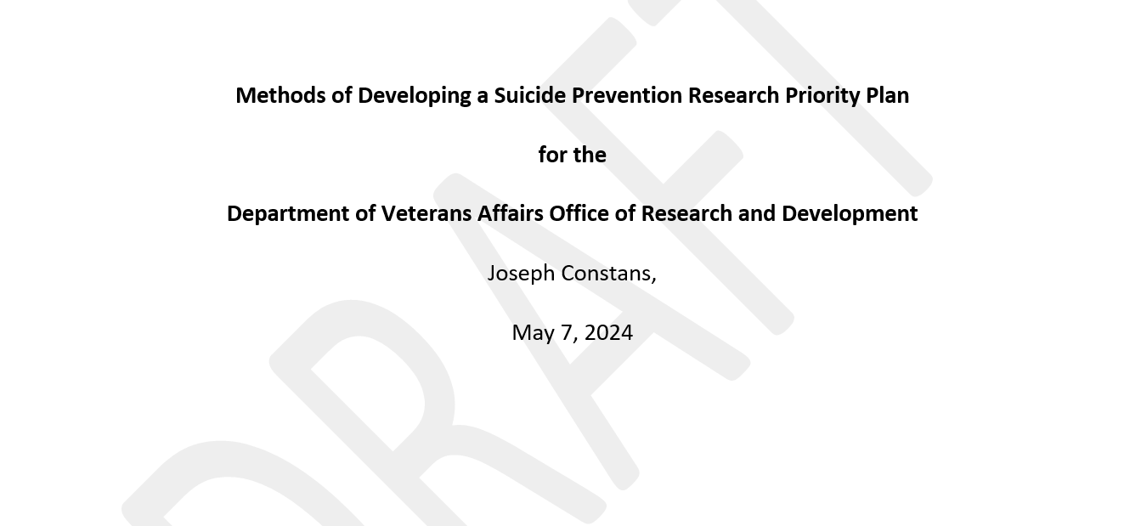
Informing the field of Suicide Prevention AMP Priority Process
Consider publication
Comparable to VA/DoD SP CPG process?
Suicide and Life-Threatening Behavior?
Presentation at the VA/DoD Suicide Prevention Meeting (July, 2024)

Slide 12
Next Steps

Slide 13
Next Steps
June 25 – NOSIs
Broad
Priority NOSI
July 25
Review of existing portfolio
Review budget for FY25

