Slide 1
Suicide Prevention: Advisory Group Monthly Meeting
June 25, 2024
Joe Constans

Slide 2
Agenda
Time | Item | Objective
3:00 – 3:10 | Review Results of Priority Setting | Presentation of results
3:10 – 3:30 | Discuss Results | Comment and discussion
3:30 – 3:45 | Broad NOSI | Review and comment
3:45 – 3:50 | Specific NOSI | Discuss plan Discuss communication plan
3:50 – 3:55 | Next Steps | NOSI – priority area Review of studies in AMP portfolio Likely budget for FY25

Slide 3
Priority Setting for Suicide Prevention AMP

Slide 4
Key Priority Areas
Based on the analysis of the survey results, these 5 areas were deemed to be the key priority areas. Suicide Prevention Portfolio will focus on addressing one or more of these priorities in the coming fiscal years.
Lethal Means Safety approaches to suicide prevention
Community-based interventions for suicide prevention
Family and social network-based interventions and postventions
Psychotherapies and other non-somatic interventions for suicide prevention
Suicide risk screening, evaluation effectiveness, and processes within VA; predictive analytics

Slide 5
Voting Session
Voting members of the ESC attended a Consensus Panel Meeting on June 4, 2024.
Objective: Convene the Executive Committee to rank Critical Research Priorities in order of importance. The members will review the process taken to arrive the 5 identified priorities and then complete a live survey to rank the priorities from #1 to #5.
Process: Presentations on existing funding for candidate priority domains followed by Q&A and voting. Presentations were made by Office of Suicide Prevention, Center of Excellence, RM MIRECC, Office of Rural Health, & ORD.
Key Discussion Questions:
What research domain would be the most impacted by additional funding?
Where can funding “push the needle”?
Where is VA well positioned across these research domains to create impact?

Slide 6
ORD Funded Studies -
Domain | Total $ * | # of ORD Projects | # of Sprint Projects
Psychotherapy | $25,105,021 | 24 | 2
Risk / Predictive Analytics | $20,352,833 | 20 | 4
Family | $8,446,398 | 10 | 1
Community | $5,184,353 | 5 | 2
Lethal Means | $2,704,120 | 4 | 3
* - total for all years

Slide 7
Ranking Exercise
Ranking Process:
9 individuals ranked 5 CRP options from highest priority (first position) to lowest priority (last position) using a Microsoft Forms (MS Forms) Survey.
Ranking Products:
Strategy 1 –
The highest priority (first position) was assigned the highest numerical value (5), and the lowest priority (last position) was assigned the lowest numerical value (1).
MS Forms calculated the total score for each option by summing the values assigned by all respondents.
Strategy 2 –
Domain with highest number of Rank #1 votes.

Slide 8
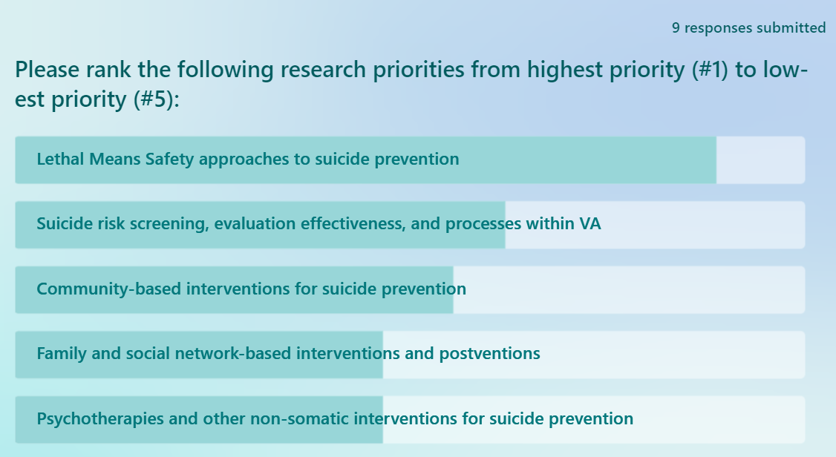
Overall Ranking: Strategy 1
(score = 36)
(score = 27)
(score = 25)
(score = 21)
(score = 21)
(score could range from 9 – 45)

Slide 9
Ranking: Strategy 2

Slide 10
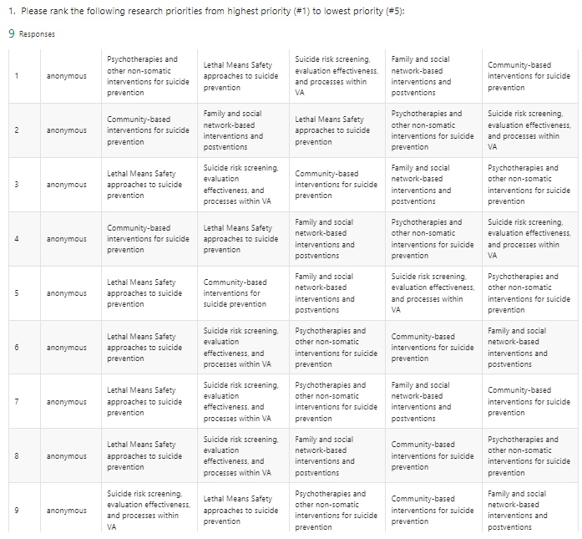
Detailed View (Strategy 2)

Slide 11
Voting Session Discussion

Slide 12
Notice of Special Interest (NOSI)

Slide 13
Revised Research Application Process
Post ORD-Wide RFAs
Notices of Special Interest
Request Pre-Application
Submit Pre-Application
Submit Full Application
Review/Score Applications
ISRM publishes ORD-wide RFAs for research types (i.e. wet lab study, clinical trial, epidemiology, etc.)
Portfolios release Notices of Special Interest to indicate their purviews and priority areas (TBI, Health Systems Research, etc.)
Each Portfolio utilizes eRA Pre-Application (PA) requesting information on the proposed study and a specific SRG request.
Investigators submit PAs through a Portfolio PA RFA. Portfolios review PAs and accept, reject or reassign.
Investigators submit full proposals through the ORD-wide RFAs into eRA including their PA acceptance letter.
SRG reviews/scores the application & then go to a Portfolio ranking meeting.
New Step
Note: Rankings go to the ISRM Leadership Council which establishes a pay line.
RFAs provide guidance on how to apply.
Notices of Special Interest indicate areas of interest.
Notes:
So going back to our application process, our two main purposes have changed in that Notices of Special Interest will noe indicate areas of interest. <COMM’s NOTE: Notices of Special Interest is a working title. Exact name TBD>
ISRM will publish ORD-wide RFA for research types. These will span across portfolios
The second step is new in which Portfolios will release Notices of Special Interest that will indicate their purviews and priority areas. These Notices of Special Interest will be updated as needed by the Portfolios depending on changes in priority
Each Portfolio will then utilize a standard eRA Pre-Application requesting key information and specifying the SRG for review
Investigators then submit the Pre-App through the Portfolio PA RFA to either accept, reject, or reassign
If accepted, Investigators would then submit the full Application through the ORD-wide RFA, which includes the PA acceptance letter
The SRG then reviews and goes to Portfolio Funding Ranking meeting. From there the rankings go to ISRM Leadership Council to establish the payline
The main takeaway here is that that: By utilizing a combination of Standard ORD-Wide RFAs that are organized by research types, with Notices of Special Interest on research topic areas, ORD can increase efficiency in the new portfolio structure, while still meeting VA research requirements

Slide 14
NOSIs for Suicide Prevention AMP
Broad NOSI
Capture SP studies across translational science spectrum
Have a long timeline (5 years)
Responsive to full range of investigator-initiated research proposals
Based on SP Purview Statement
Specific NOSI based on AMP priorities
Capture SP studies responsive to identified priority
Have shorter timeline (2 years)
Will evolve over time
May be multiple Specific NOSIs
Will include recommended topics SMEs recommended to advance state of the science.

Slide 15
Broad NOSI for Suicide Prevention AMP

Slide 16
Broad NOSI for Suicide Prevention AMP

Slide 17
Broad NOSI for Suicide Prevention AMP

Slide 18
NOSI for Lethal Means Safety
Example of SME recommendations for LMS domains…..
What is the most persuasive, scalable method for promoting secure firearm storage beyond the healthcare system?
How can we normalize out-of-home firearm storage and make this option readily available to firearm owners?

Slide 19
Informing the field of Suicide Prevention AMP Priority Process

Slide 20
Informing the field of VA SP AMP priorites
Presentation at the VA/DoD Suicide Prevention Meeting (July, 2024)
SPRINT
CSRD newsletter (early July)
VA Comms Article
ORD website
Publication
Comparable to VA/DoD SP CPG process.?
Suicide and Life-Threatening Behavior.

Slide 21
Next Steps

Slide 22
Next Steps
July 25 – NOSI
Priority NOSI
July 25 & August 27
Review of existing portfolio
Review budget for FY25

