Slide 1
Suicide Prevention Portfolio Analysis
Veterans Health Administration Office of Research and Development
May 2023

Slide 2
Agenda
1.
Portfolio Analysis Overview
2.
Portfolio Analysis approach for Suicide Prevention
  Core analysis areas
  Process overview
  Primary data sources / sample data analysis
3.
Open Discussion
  Strategic goals and areas to analyze
4.
Appendix
  Dimensions data set overview
  Pain and Opioid abridged report

Slide 3
Portfolio Analysis Overview
Project Background
  Rios is supporting the VA Office of Research and Development (ORD) on the Research Enterprise Transformation
  Portfolio Analysis focuses on helping VA leaders understand the depth and breadth of the research ORD is funding within certain focal areas: Oncology, Pain and Opioid, Mental Health, and more…
  As part of our broader involvement with the ORD we have been greenlighted to kickoff an analysis on the Suicide Prevention portfolio
Project Goals
  The Rios Portfolio Analysis team will work with ORD clients to define, analyze, and visualize the Suicide Prevention portfolio to enable leader to make strategic decisions about the future portfolio focus and funding
Suicide Prevention Portfolio Analysis Team
  ORD: Joe Constans – Senior Program Manager
  Rios: Shelley West – Principal
  Rios: Caroline Mwonga – Consultant
  Rios: Marion Geary – Data Analyst

Slide 4
Core Portfolio Analysis Topic Areas
There are four key areas we analyze to provide Portfolio leaders with a holistic current state understanding of their portfolio’s research projects
1
2
3
4
VA Project Distribution Analysis
VA Investigator Distribution Analysis
VA Medical Center Distribution Analysis
Analysis of Relevant Research Beyond the VA
What are the characteristics of the projects in this portfolio, and what unique areas of research does this portfolio address?
What qualities do the investigators in this portfolio have and how do they contribute to the portfolio?
How are projects distributed across VA medical centers?
What is the scope of research at other organizations outside VA?

Slide 5
Portfolio Analysis Process
This process outlines how Rios performs portfolio analysis, starting from defining the portfolio to the final report. This process will be implemented for the Suicide Prevention AMP.
Define Portfolio
Identify Data Sources
Aggregate &
Clean Data
Set Parameters for Analysis
Analyze Data
Synthesize &
Visualize Findings
Work with Portfolio leaders and stakeholders to develop criteria on which projects fit in the portfolio
Through conversations with portfolio leaders and stakeholders, databases are sourced for information based upon the portfolio criteria
Data from these databases are collected, cleaned, and organized for analysis
Final corpus of projects verified
Discussion and decision on which pieces of information and analyses would be the most relevant for understanding the portfolio
Data analyses are done to develop an understanding of the status of the portfolio
Analyzed data is incorporated into visuals that will be collated into an executive summary, and full report for portfolio leaders and other stakeholders

Slide 6
Primary Data Sources
System | Description
Research Analysis and Forecasting Tool (RAFT) | RAFT is a web-based software tool which ORD uses to track VA funded projects across facilities
VA Innovation Research and Review System (VAIRRS) | VAIRRS is VA’s enterprise version of IRBNet, which collects data on active projects across facilities
Dimensions | Dimensions for VA is a web-based research database containing information on publications, awarded grants, patents, clinical trials and policy documents
Note: For Suicide Prevention we will also plan to supplement data sources with Suicide Prevention Research Impact NeTwork (SPRINT) active project inventory list.

Slide 7
Early analysis
There are 125 RAFT projects with RPA tags “MI – Suicide” that have started since 2016 or are currently active.
Distribution of Project Count
by Project Status
Distribution of Amount Allocated
in FY2022 by Project Status
2
30
2
30
2%
$1.4M
$0
24%
Project Status
Active
Completed
93
Inactive
74%
93
$16.8M

Slide 8
Discussion - Strategic Goals and Areas to Analyze
Are there any other topics of interest or analyses this group would find meaningful?

Slide 9
Dimensions

Slide 10
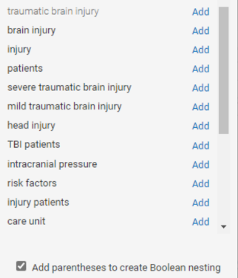
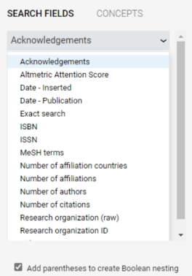
Dimensions’ search tool has Boolean functionality and AI-generated suggestions
Dimensions’ advanced search tool enables users to query all available fields using Boolean nesting, a feature prized by portfolio leaders
Additionally, Dimensions’ search tool contains a feature which uses AI suggests additional terms for a user to search based on their existing query
For instance, searching for “traumatic brain injury” returns suggestions to add terms such as “severe,” “mild,” and “moderate,” as well as related terms such as “intercranial pressure” and “risk factors”
Finally, Dimensions has a search save function which allows users to save their searches for future use
Figure 21: Dimensions Boolean search
Figure 22: Dimensions all-field search

Slide 11
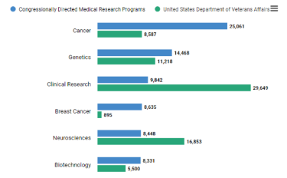
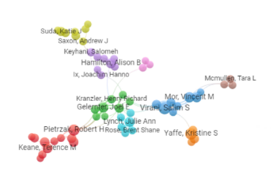
Dimensions’ integrated analytical capabilities advance beyond simple summarizations
Dimensions’ integrated analytical capabilities are very advanced. The system possesses a basic visualization suite enabling summarization of project quantity and project funding data over a variety of categories, and also enables comparison of this data across user-selected groups
For instance, Dimensions can generate charts comparing VA funding to CDMRP funding across condition types, or comparing two VA medical centers to each other
In addition to simple summarizations of data across fields, Dimensions can produce investigator network charts based on co-authorship and citations, allowing users to investigate collaboration patterns across different groups of investigators
Figure 23: Example Dimensions visualization
Figure 24: Example Dimensions visualization

Slide 12
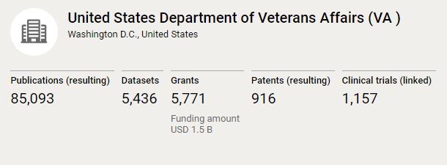

While Dimensions is not a comprehensive repository of all agency-funded projects, it has an easy-to-use interface
Comprehensiveness
At present, Dimensions does not contain comprehensive data on all funded projects
For instance, it contains data on only ~6000 VA-funded projects, which does represent the total corpus
Interface
Dimensions’ user interface meets portfolio leader needs. It is relatively easy to use, and does not require a significant amount of clicks to access needed information
Projects are provided in list form, with links to find more details
Additionally, short tutorials and trainings are available for users who require additional training
Figure 26: Dimensions training
Figure 25: Dimensions VA data

Slide 13
ABRIDGED REPORT:
Pain and Opioid Actively Managed Portfolio Analysis
Veterans Health Administration Office of Research and Development
Delivered May 2023

Slide 14
Table of Contents
1
Executive Summary
4 – 8
This Table of Contents reflects the full contents of the Precision Oncology AMP Portfolio Analysis report to show its breadth and depth.
The following slides are an abridged version of that report providing examples from major section of the report.
The full report is available here.
2
Key Findings
9 – 75
2.1
Introduction
10
2.2
VA Project Distribution Analysis
11 – 45
2.3
VA Investigator Distribution Analysis
46 – 62
2.4
VA Medical Center Distribution Analysis
63 – 67
2.5
Analysis of Relevant Research Beyond the VA
68 – 75
3
Methods
76 – 81
4
Recommendations
82 – 83
5
Appendix
84 – 174

Slide 15
Pain and Opioid AMP Background and Analysis Objective
BACKGROUND
The VA Office of Research and Development (ORD) team launched the Pain and Opioid Actively Managed Portfolio (POp AMP) under the Investigators, Scientific Review, and Management (ISRM) unit on January 31, 2023. The POp AMP is a collection of related research focused on the real-world health challenges faced by Veterans in the pain and opioid space that prioritizes communication, coordination, and collaboration between clinicians, researchers, and other stakeholders.
PORTFOLIO ANALYSIS OBJECTIVE
This analysis equips POp AMP leaders and ORD leaders with an overview of the current state of ORD-funded pain and opioid research in this AMP. The information presented is intended to assist portfolio leaders and key stakeholders in making strategic decisions on how to allocate and prioritize resources for the POp AMP portfolio, based on the requirements outlined by the ORD Chief Research and Development Officer (CRADO)¹. By offering a holistic view of the portfolio, key stakeholders can make more informed choices that will benefit the POp AMP.
¹AMP requirements outlined by the CRADO are listed in Appendix A.

Slide 16




Executive Summary | Project Methodology
PROJECT PROCESS
Portfolio Definition
Project Extraction
Data Analysis
Portfolio Report
We engaged Dr. Audrey Kusiak, Ph.D., Scientific Program Manager for ORD Rehabilitation Research and Development (RR&D), and other POp stakeholders and defined POp projects Projects were defined using the agreed upon POp AMP purview statement | We were provided the Pain and Opioid corpus from the 2023 fiscal year We utilized the corpus to extract supplementary data from RAFT, VAIRRS, and Dimensions | We met with portfolio leaders and identified the key questions to be answered We engaged a broad range of pain and opioid stakeholders and identified key insights and analyses | We synthesized data analyses and stakeholder feedback into a final report We incorporated additional information to address the structure and funding of studies in the Pain and Opioid Actively Managed Portfolio

Slide 17
Introduction | Four key areas of analysis inform AMP leaders' ability to meet requirements
The POp AMP portfolio launched January 31, 2023, and as an AMP, there is a set of requirements¹ developed by the ORD CRADO that the portfolio must fulfill:
  Enable strategic coordination of research projects
  Foster greater collaboration between ORD and VHA clinical partners / external partners
  Enhance data and analytical tools increase collaboration of research
  Define roadmaps and critical research priorities
  Encourage rapid review and funding of prioritized studies
Portfolio leaders must have a holistic current state understanding of the portfolio's research projects to meet requirements and make strategic decisions
The project team analyzed the data across a standard framework to provide a holistic overview for the SPMs and stakeholders of this AMP:
VA Project Distribution Analysis
VA Investigator Distribution Analysis
VA Medical Center Distribution Analysis
Analysis of Relevant Research Beyond the VA
What are the characteristics of the projects in this portfolio, and what unique areas of research does this portfolio address?
What qualities do the investigators in this portfolio have and how do they contribute to the portfolio?
How are projects distributed across VA medical centers?
What is the scope of research at other organizations outside VA?
¹The full set of AMP requirements developed by the CRADO are listed in Appendix A.

Slide 18
Framework | VA Project Distribution Analysis
High Level Portfolio Overview To understand the projects that comprise the Pain and Opioid AMP, we asked the following questions: What is the count and total budget of active projects vs. completed projects in the portfolio? What is the count and budget of active vs. completed pain and opioid projects not in the POp AMP? How many active projects vs completed projects are in the AMP over time? How many projects are there and how much was awarded to the entire portfolio over time? How much have new projects been awarded over time? How much of the total amount awarded by the ORD has the POp AMP received? How has the total amount awarded to the AMP and the annual budget of the AMP changed over time? Pages 13 – 20
High Level Portfolio Overview
What are the characteristics of the projects in this portfolio, and what unique areas of research does this portfolio address?
Funding Mechanism
Project Focus Area
Subject Population
Clinical Trial Distribution

Slide 19
VA Project Distribution Analysis | High-level Portfolio Overview
The POp AMP has grown steadily since 2014 to 115 projects and $137 million of awarded funding
How many projects are there and how much was awarded to the entire portfolio over time?
Total Awarded vs Number of Projects Cumulatively over Time
The ORD awarded $137 million for 115 projects between 2014 and 2023
The total number of projects and the total funding awarded by the ORD in the POp AMP has increased year over year
$133M
$137M
$120M
120
$101M
$86M
$80M
80
Cumulative Total Awarded in Millions
Number of Projects
$63M
107
115
$40M
$37M
82
40
64
$17M
39
$1M
$3M
23
$0
1
3
7
0
2014
2015
2016
2017
2018
2019
2020
2021
2022
2023
Start Year
Cumulative Total Awarded
Cumulative Number of Projects
Source: RAFT data on 115 projects in the Pain and Opioid portfolio with start years between 2014-2023.

Slide 20
Framework | VA Project Distribution Analysis
Project Focus Area To understand what projects in the Pain and Opioid AMP are studying, we asked the following questions: What is the distribution of RPA tags across the portfolio and the ORD? What is the distribution of co-existing conditions across the portfolio? What is the distribution of the RAFT Portfolio field across the POp AMP? What is the distribution of DRA tags across the portfolio? What is the distribution of TRL across the portfolio? What is the distribution of TRL in POp AMP vs. non-POp AMP projects? What is the distribution of Treatment Maturity across the portfolio? What is the distribution of Treatment Maturity in POp AMP vs. non-POp AMP? What is the distribution of DRE tags other than TRL and TM across the portfolio? What is the distribution of DRE tags across the portfolio? What is the distribution of translational level across the portfolio? What is the distribution of project characteristics across the portfolio? Pages 25 – 39
High Level Portfolio Overview
What are the characteristics of the projects in this portfolio, and what unique areas of research does this portfolio address?
Funding Mechanism
Project Focus Area
Subject Population
Clinical Trial Distribution

Slide 21
VA Project Distribution Analysis | Project Focus Area
The majority of POp AMP projects include the OC – Pain tag, while the majority of non-POp AMP pain and opioid projects use the OC – Opioids tag
What is the distribution of RPA tags across the portfolio and the ORD?
Research Portfolio Area (RPA) tags identify the focus area of a project in RAFT
While most pain projects are included in the POp AMP, many opioid projects are outside the scope of the AMP
POp AMP includes projects with an OC – Pain tag and/or an OC – Opioids tag
  80 projects list OC – Pain only
  21 projects list both OC – Pain and OC – Opioids
  14 projects list OC – Opioids only
Non-POp AMP projects include:
  11 projects with OC – Pain only
  10 projects with both OC – Pain and OC – Opioids
  77 projects with OC – Opioids only
Distribution of POp AMP OC RPA Tags
OC - Pain
80
RPA Tag
OC - Pain and
21
OC - Opioids
OC - Opioids
14
0
20
40
60
80
Number of Tags
Distribution of OC RPA Tags in non-POp AMP Projects
OC - Pain
11
RPA Tag
OC - Pain and
10
OC - Opioid
OC - Opioids
77
0
20
40
60
80
Number of Tags
Source: RAFT data on 115 projects in the Pain and Opioid portfolio with start years between 2014-2023.
Source: RAFT data on 98 pain and opioid projects not in the POp AMP with start years between 2013-2023.

Slide 22
Framework | VA Investigator Distribution Analysis
High Level Investigator Overview To understand the investigators that contribute to the Pain and Opioid AMP, we asked the following questions: How many investigators have contributed to the POp AMP? How many investigators are active in the POp AMP? Pages 48 – 49
What qualities do the investigators in this portfolio have and how do they contribute to the portfolio?
High Level Investigator Overview
Investigator Attributes
Publication Distributions

Slide 23
VA Investigator Distribution Analysis | High Level Investigator Overview
Currently, 103 investigators have contributed to the 115 projects in the AMP as of March 2023
How many investigators have contributed to the POp AMP?
There are 103 investigators¹ and 115 projects in the AMP as of 2023
  Some investigators work or have worked on more than one project in the POp AMP
  8 investigators have finished their POp AMP projects as of 2023, so 95 investigators are currently active (see pages 42 and 43 for details)
Cumulative Distribution of Investigators and Project Number over Time
125
115
107
100
82
75
64
Cumulative Total Count
50
97
103
39
74
25
23
60
37
1
3
7
22
0
1
3
7
2014
2015
2016
2017
2018
2019
2020
2021
2022
2023
Start Year
Project Count
Number of Investigators
Note: Number of investigators is counted cumulatively over time, amounting to the current total number of investigators in the portfolio in 2023.
Source: RAFT data on 115 projects in the Pain and Opioid portfolio with start years between 2014-2023.
¹The full list of portfolio investigators can be found in Appendix C.

Slide 24
Framework | VA Medical Center Distribution Analysis
VA Medical Center Distribution Analysis Overview To understand where projects in the Pain and Opioid AMP are located across VA Medical Centers, we asked the following questions: Which VAMCs have the highest concentration of portfolio research? How many pain and opioid projects has each VAMC conducted since 2016, and how many is each VAMC currently conducting? How much funding has each VAMC been awarded for pain and opioid research? Page 65 – 67
How are projects distributed across VA medical centers?
High Level Geography Overview
Funding Distribution

Slide 25
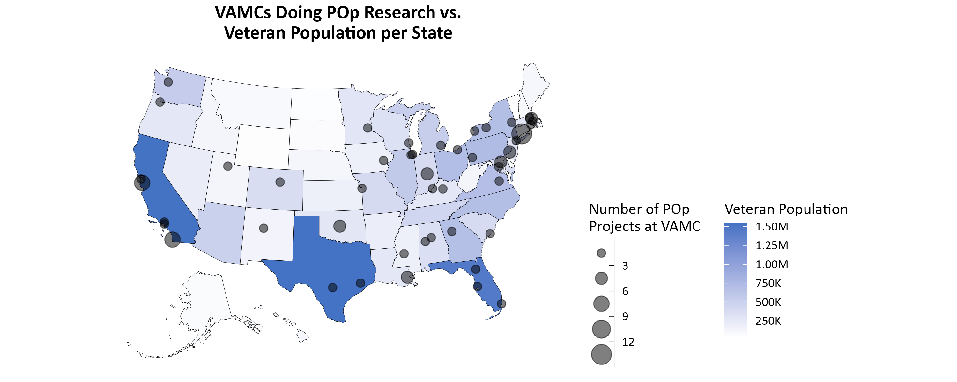
VA Medical Center Distribution Analysis | High Level Geography Overview
The majority of POp AMP research occurs at VAMCs in New England and California
Which VAMCs have the highest concentration of portfolio research?
1 – 3
4 – 6
7 – 9
10 – 12
13 – 15
Note: See tables in Appendix D for detailed information about each VAMC.
Source: RAFT data on 115 projects in the Pain and Opioid portfolio with start years between 2014-2023.
Source: Projected 2022 population data from the National Center for Veterans Analysis and Statistics pulled on April 12, 2023.

