Slide 1
Utilization Management: High Performing Providers (HPP) Project
9/11/2020

Slide 2
Agenda
HPP Project Background
HPP Designation Process
Which Specialties are Eligible for the HPP Designation in CCN R1-3
How are CCN Providers Designated as HPP in CCN R1-3
Which Specialties are Eligible for the HPP Designation in CCN R4
How are CCN Providers Designated as HPP in CCN R4
HPP Key Performance Indicators
Product Effectiveness (PE) Evaluation & Findings
HPP Provider Directory/VEO
Notes:
Maybe using preferred providers over high performing (Giving a singular option vs. a rollup option because it eliminates decision-making power; giving Veterans more choices)
Military specific training is different than the HPP criteria that CCN contractors uses
Change PPMS to show different designations (HPPs vs. PP)
How its used on the ground in terms of choice for Veterans
How can we get to the granular piece vs. the rollup piece/combined metrics (no rolling up b/c Provider could be bad on one metric and good on another)
Using Provider profiles for Veterans instead of just contact info
General competency training being pulled into the algorithm than the others
Meeting competency standards over training
Doing a focus groups for Veterans on HPP to help answer questions on what Veterans are looking for in providers
HPP designation can skew the image of providers who are high-quality, but not HPPs
Could lead to a liability case
GS-5s being able to have the right conversation with Veterans (very clear comms)
RTI(?) group…
Decision/Question:
General military competency should go into the algorithm to be a part of the HPP designation weighting and not a requirement
Don’t fold the Veteran specific courses into the HPP algorithm
Y/N about taking the trainings
Not all specialties are covered for the trainings for all providers to have to take/want to take them (neurosurgeons don’t need to take TBI and will not want to)
Change in contract language
It should be on the region 1-3 mod list to have it come in quarterly as it was implemented in the contract for R4
Releasing algorithm for HPPs over time as CMS
Over time, for generation 4 VHA needs to define their own algorithm that contactors must use

Slide 3
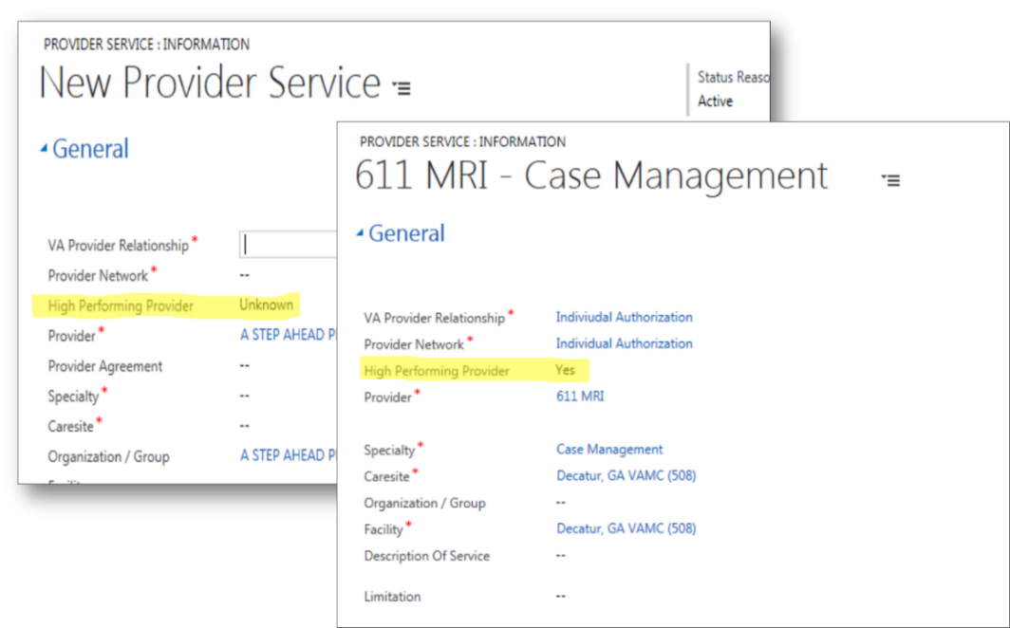
Background: High Performing Provider (HPP) Designation
The UM HPP project introduces three HPP designations (Y, N, U) to easily identify high performing community providers when managing referrals, scheduling, and providing care coordination for Veterans.
Designation | Definition
Y (Yes) | Provider meets the HPP designation based on the quality and cost-efficient care criteria
N (No) | Provider does not meet the HPP designation based on the quality and cost-efficient care criteria
U (Unknown) | This is the default value and indicates that a Provider’s HPP designation has not been submitted to PPMS Note: The CCN Contractor submits HPP data on a quarterly basis and designation are subject to change. The CCN Contractor is responsible for designating providers with Y/N. If the Contractor leaves the HPP designation field blank, null, or any other value besides Y or N, PPMS will set the HPP designation to U.
The HPP designations are documented and visible in both the Provider Profile Management System (PPMS) and the HealthShare Referral Manager (HSRM) to enable facility community care staff to quickly identify and communicate to Veterans the availability of high performing providers when an eligible Veteran does not have a preferred community provider.

Slide 4
HPP Designation Process by CCN Contractor
The High Performing Provider (HPP) designation evaluates Community Care Network (CCN) providers based on quality and cost-efficiency criteria. The intent is for Veterans to have the opportunity to be scheduled with the highest quality CCN providers available.
1
2
3
CCN Contractor processes HPP metrics and conducts HPP algorithm
CCN Contractor submits HPP designation (Yes/No/Unknown) via the provider file in the Provider Profile Management System (PPMS)
Facility scheduling staff can view, and schedule Veterans, with HPPs using the HealthShare Referral Manager (HSRM)
Notes:
This HPP designation and submission process (via the provider file) will be uniform across all CCN Regions.
HPPs are visible in the provider file and the PPMS real-time search

Slide 5
Which Specialties are Eligible for the HPP Designation in CCN R1-3
Specialty* | Subspecialties
Allergy | Allergy and Allergy and Immunology
Cardiology | Cardiac Diagnostic, Cardiology, Cardiovascular Disease, Clinical Cardiac Electrophysiology and Interventional Cardiology
Ear, Nose, and Throat | Laryngology, Otolaryngology, Otology, Pediatric Otolaryngology, Rhinology and Surgery Head and Neck
Endocrinology | Endocrinology and Diabetes and Metabolism
Family Medicine | Family Practice, General Practice and Preventive Medicine
Gastroenterology | Digestive Diseases, Endoscopy, Gastroenterology and Hepatology – Liver Disease
General Surgery | Colon and Rectal Surgery, Proctology, Surgery and Surgery Abdominal
Internal Medicine | Internal Medicine and Pediatric Internal Medicine
Nephrology | Nephrology
Neurology | Neurology, Neurology and Psychiatry and Neuromuscular Disease
Neurosurgery, Orthopedics and Spine | Back and Spine, Hand, Knee, Neurological, Orthopedic, Shoulder and Sports Surgeries
Obstetrics and Gynecology | Gynecology, Obstetrics and Obstetrics and Gynecology
Pediatrics | Adolescent Medicine, Pediatrics and Pediatric Adolescent
Pulmonology | Pulmonary Medicine
Rheumatology | Rheumatology
Urology | Urology
*These specialties are specific to Regions 1 – 3 (Optum) and differs from Region 4 (TriWest).

Slide 6
How are CCN Providers Designated as HPP
How are CCN Providers Designated as HPP in CCN R1-3
Optum will evaluate whether the CCN providers achieved pre-determined quality and cost-efficiency results.
Percent | HPP Algorithm Components*
75% | Healthcare Effectiveness Data and Information Set (HEDIS) and Physician Quality Reporting System (PQRS) Primary Care Measures
25% | United Healthcare (UHC) Premium Designation (PD)
Participating providers are eligible for the HPP designation if the provider:
Is located within the region
Practices in one of the 16 provider specialty types
Achieves the following:
Performs in the top 75th percentile for HEDIS measures AND
Performs in the top 70th percentile for the PQRS measure AND
Earns the UHC PD for the assigned specialty
*This HPP algorithm is specific to Regions 1 - 3 (Optum) and differs from Region 4 (TriWest).

Slide 7
How are CCN Providers Designated as HPP in CCN R4
The below specialties are eligible for HPP designation evaluation in Region 4.
1
Cardiology
7
Neurology
2
Endocrinology
8
OB/GYN
3
Gastroenterology
9
Orthopedic
4
General Surgery
10
Primary Care
5
Mental Health
11
Pulmonology
6
Urology

Slide 8
3. How TriWest (Region 4) Designates CCN Providers as HPP
How are CCN Providers Designated as HPP in CCN R4
TriWest will evaluate whether the CCN providers achieved pre-determined quality and cost-efficiency results.
Percent | *HPP Algorithm Components
75% | Healthcare Effectiveness Data and Information Set (HEDIS) Primary Care Measures
25% | Blue Health Intelligence (BHI) Primary and Specialty Care measures
Participating providers are eligible for the HPP designation if the provider:
Is an active provider within the Region 4 Provider Network
Practices in one of the 10 specialty types
Has a score in the top 75th percentile for HEDIS measures (Primary Care)
Has no peer reviewed Practice Level 3 findings in the past year (Level 3 findings represent cases where the provider clearly acted outside the standard of care)

Slide 9
HPP Key Performance Indicators
As of 11/1/2020:
13.35% (156,666) of all providers in CCN Regions 1 – 4 are HPPs (indicated with a Y)
4.15% (48,647) of all providers in CCN Regions 1 – 4 are non-HPPs (indicated with a N)
From June 10,2020 to November 1, 2020 HPPs increased by 197%.
Note: Graph does not display data for February and April as it is unavailable

Slide 10
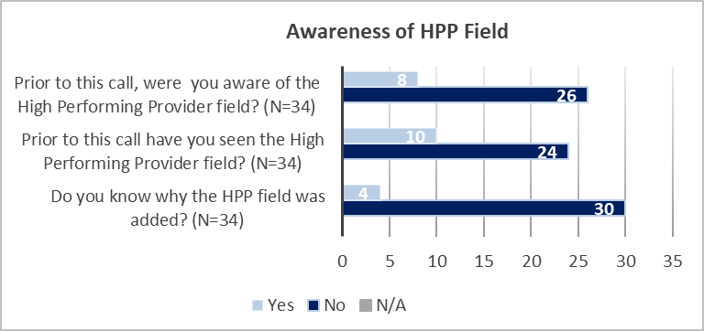
Product Effectiveness (PE) Evaluation & Key Findings
The HPP Team partnered with the PE Team to develop quantitative and qualitative measures to determine the functionality, usability and adoption of the HPP designation in PPMS.
Design/Process
The PE Team held 20-minute interviews with questions targeting functionality, usability, and adoption. A total of 34 staff in various positions were interviewed.
Findings
Next Steps/Solutions:
Partnered with the OCC Strategic Comms Team to bolster some of our communication/educational resources
Updated the FGB to include step-by-step instructions for locating the HPP designation in PPMS/HSRM
Collaborating with the Transformation Team to incorporate HPP content into the E2E Training
Partnering with the Trainings Team to hold office hours
Full functionality and usability of the HPP field could not be assessed due to the lack of awareness of the HPP field resulting in zero utilization of the HPP field by interviewees. Of the 34 interviewees, only 23% of participants (N=8) were aware of the HPP field prior to PE’s engagement, and only 12% of participants (N=4) were aware of why the HPP field was added.

Slide 11
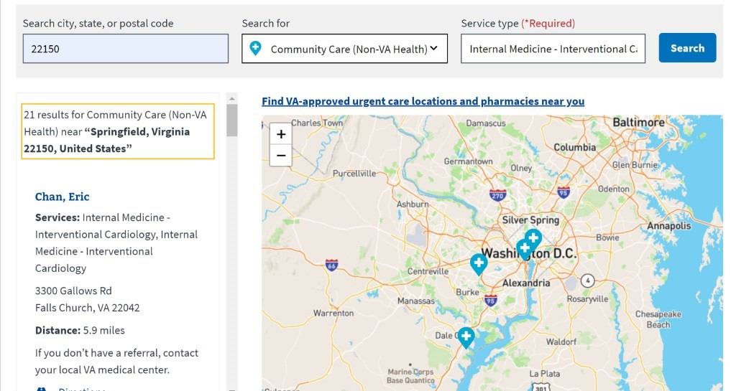
HPP Provider Directory
The HPP Team received formal approval from VA leadership to place the HPP designation on VA.gov, the public-facing website in which Veterans can locate providers using the provider directory. VA.gov will only display Y (Yes) designations to indicate HPPs.
VA.gov Directory Legend
HPP: Y (Yes)
The website will display the definition of the Y designation
Veterans will have access to more information through education tools linked to a provider locator webpage
Note: This will be on the va.gov provider directory page

