Slide 1


Utilization Management: High Performing Providers (HPP) Project
November 2021

Slide 2
Agenda
HPP Project Background
HPP Designation Process
Which Specialties are Eligible for the HPP Designation in CCN R1-3
How are CCN Providers Designated as HPP in CCN R1-3
Which Specialties are Eligible for the HPP Designation in CCN R4 & R5
How are CCN Providers Designated as HPP in CCN R4 & R5
HPP Key Performance Indicators
Product Effectiveness (PE) Evaluation & Findings
HPP Provider Directory/VEO

Slide 3
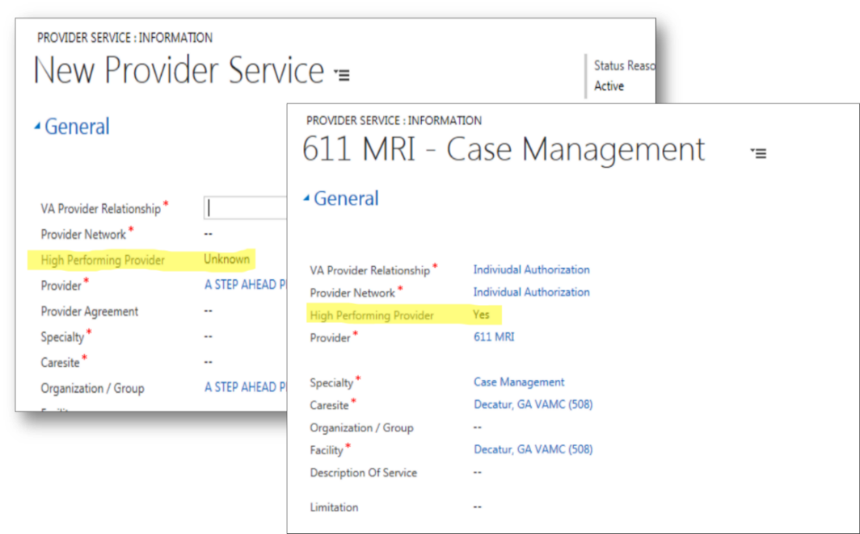
Background: High Performing Provider (HPP) Designation
The UM HPP project introduces three HPP designations (Y, N, U) to easily identify high performing community providers when managing referrals, scheduling, and providing care coordination for Veterans.
Designation | Definition
Y (Yes) | Provider meets the HPP designation based on the quality and cost-efficient care criteria
N (No) | Provider does not meet the HPP designation based on the quality and cost-efficient care criteria
U (Unknown) | This is the default value and indicates that a Provider’s HPP designation has not been submitted to PPMS Note: The CCN Contractor submits HPP data on a quarterly basis and designation are subject to change. The CCN Contractor is responsible for designating providers with Y/N. If the Contractor leaves the HPP designation field blank, null, or any other value besides Y or N, PPMS will set the HPP designation to U.
The HPP designations are documented and visible in both the Provider Profile Management System (PPMS) and the HealthShare Referral Manager (HSRM) to enable facility community care staff to quickly identify and communicate to Veterans the availability of high performing providers when an eligible Veteran does not have a preferred community provider.

Slide 4



HPP Designation Process by CCN Contractor
The High Performing Provider (HPP) designation evaluates Community Care Network (CCN) providers based on quality and cost-efficiency criteria. The intent is for Veterans to have the opportunity to be scheduled with the highest quality CCN providers available.
1
2
3
CCN Contractor processes HPP metrics and conducts HPP algorithm
CCN Contractor submits HPP designation (Yes/No/Unknown) via the provider file in the Provider Profile Management System (PPMS)
Facility scheduling staff can view, and schedule Veterans, with HPPs using the HealthShare Referral Manager (HSRM)
Notes:
This HPP designation and submission process (via the provider file) will be uniform across all CCN Regions.
HPPs are visible in the provider file and the PPMS real-time search

Slide 5
Which Specialties are Eligible for the HPP Designation in CCN R1-3
Specialty* | Subspecialties
Allergy | Allergy and Allergy and Immunology
Cardiology | Cardiac Diagnostic, Cardiology, Cardiovascular Disease, Clinical Cardiac Electrophysiology and Interventional Cardiology
Ear, Nose, and Throat | Laryngology, Otolaryngology, Otology, Pediatric Otolaryngology, Rhinology and Surgery Head and Neck
Endocrinology | Endocrinology and Diabetes and Metabolism
Family Medicine | Family Practice, General Practice and Preventive Medicine
Gastroenterology | Digestive Diseases, Endoscopy, Gastroenterology and Hepatology – Liver Disease
General Surgery | Colon and Rectal Surgery, Proctology, Surgery and Surgery Abdominal
Internal Medicine | Internal Medicine and Pediatric Internal Medicine
Nephrology | Nephrology
Neurology | Neurology, Neurology and Psychiatry and Neuromuscular Disease
Neurosurgery, Orthopedics and Spine | Back and Spine, Hand, Knee, Neurological, Orthopedic, Shoulder and Sports Surgeries
Obstetrics and Gynecology | Gynecology, Obstetrics and Obstetrics and Gynecology
Pediatrics | Adolescent Medicine, Pediatrics and Pediatric Adolescent
Pulmonology | Pulmonary Medicine
Rheumatology | Rheumatology
Urology | Urology
*These specialties are specific to Regions 1 – 3 (Optum) and differs from Regions 4 & 5 (TriWest).

Slide 6
How are CCN Providers Designated as HPP
How are CCN Providers Designated as HPP in CCN R1-3
Optum will evaluate whether the CCN providers achieved pre-determined quality and cost-efficiency results.
Percent | HPP Algorithm Components*
75% | Healthcare Effectiveness Data and Information Set (HEDIS) and Physician Quality Reporting System (PQRS) Primary Care Measures
25% | United Healthcare (UHC) Premium Designation (PD)
Participating providers are eligible for the HPP designation if the provider:
  Is located within the region
  Practices in one of the 16 provider specialty types
  Achieves the following:
    Performs in the top 75th percentile for HEDIS measures AND
    Performs in the top 70th percentile for the PQRS measure AND
    Earns the UHC PD for the assigned specialty
*This HPP algorithm is specific to Regions 1 - 3 (Optum) and differs from Regions 4 & 5 (TriWest).

Slide 7
How are CCN Providers Designated as HPP in CCN R4 & R5
The below specialties are eligible for HPP designation evaluation in Regions 4 & 5.
1
Cardiology
7
Neurology
2
Endocrinology
8
OB/GYN
3
Gastroenterology
9
Orthopedic
4
General Surgery
10
Primary Care
5
Mental Health
11
Pulmonology
6
Urology

Slide 8
3. How TriWest (Region 4) Designates CCN Providers as HPP
How are CCN Providers Designated as HPP in CCN R4 & R5
TriWest will evaluate whether the CCN providers achieved pre-determined quality and cost-efficiency results.
Percent | *HPP Algorithm Components
75% | Healthcare Effectiveness Data and Information Set (HEDIS) Primary Care Measures
25% | Blue Health Intelligence (BHI) Primary and Specialty Care measures
Participating providers are eligible for the HPP designation if the provider:
Is an active provider within the region
Practices in one of the 10 specialty types
Has a score in the top 75th percentile for HEDIS measures (Primary Care)
Has no peer reviewed Practice Level 3 findings in the past year (Level 3 findings represent cases where the provider clearly acted outside the standard of care)

Slide 9
HPP Staggered National Deployment Dashboard
R5 Data Added
R4 Data Added
CCN Region 1-5 PPMS Data (November 2, 2021)
Designation | Region 1 | Region 2 | Region 3 | Region 4 | Region 5 | Regions 1 - 5
Yes | 84,717 (26.89%) | 74,973 (24.10%) | 44,247 (24.77%) | 2,997 (1.33%) | 2 (0.06%) | 203,186 (20.11%)
No | 4,608 (1.46%) | 7,369 (2.37%) | 5,890 (3.30%) | 31,516 (13.97%) | 80 (2.38%) | 49,303 (4.88%)
Unknown | 225,771 (71.65%) | 228,733 (73.53%) | 128,475 (71.93%) | 185,992 (82.46%) | 3,283 (97.56%) | 757,841 (75.01%)
Total** | 315,098 | 311,074 | 178,617 | 220,505 | 3,365 | 1,010,330
* Jan-Oct data is for R1-3 only; R4 data added starting Nov; R5 data added Oct ‘21
** Some providers are in multiple regions

Slide 10
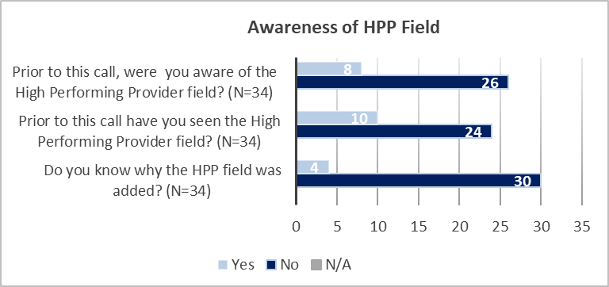
Product Effectiveness (PE) Evaluation & Key Findings
The HPP Team partnered with the PE Team to develop quantitative and qualitative measures to determine the functionality, usability and adoption of the HPP designation in PPMS.
Design/Process
The PE Team held 20-minute interviews with questions targeting functionality, usability, and adoption. A total of 34 staff in various positions were interviewed.
Findings
Next Steps/Solutions:
Partnered with the OCC Strategic Comms Team to bolster some of our communication/educational resources
Updated the FGB to include step-by-step instructions for locating the HPP designation in PPMS/HSRM
Collaborating with the Transformation Team to incorporate HPP content into the E2E Training
Partnering with the Trainings Team to hold office hours
Full functionality and usability of the HPP field could not be assessed due to the lack of awareness of the HPP field resulting in zero utilization of the HPP field by interviewees. Of the 34 interviewees, only 23% of participants (N=8) were aware of the HPP field prior to PE’s engagement, and only 12% of participants (N=4) were aware of why the HPP field was added.

Slide 11
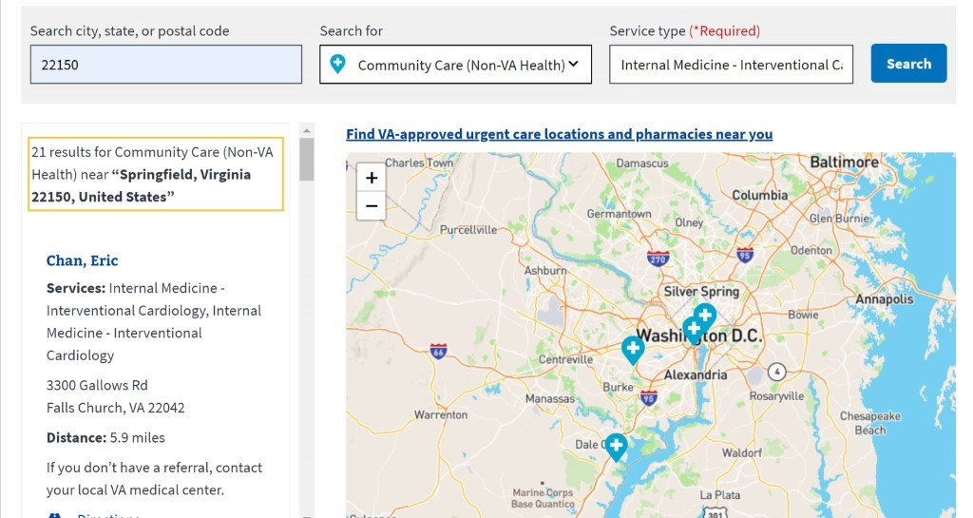

Provider Directory-Future State
The HPP Team received formal approval from VA leadership to place the HPP designation on VA.gov, the public-facing website in which Veterans can locate providers using the provider directory. VA.gov will only display Y (Yes) designations to indicate HPPs as a future state enhancement.
VA.gov Directory Legend
HPP: Y (Yes)
The website will display the definition of the Y designation
Veterans will have access to more information through education tools linked to a provider locator webpage
Note: This will be on the va.gov provider directory page as a future state enhancement

Slide 12
HPP Current Status
New naming convention in final stages of approval
Finalizing due diligence meetings with Quality team and PPMS per ELC
Change Request in process of submission to PPMS to assess designation information functionality
Cross collaboration with Community Provider Core Training Team

