Slide 1
Referral Coordination Initiative (RCI)
VETERANS HEALTH ADMINISTRATION
February 25, 2021

Slide 2


Referral Coordination Initiative
Understanding the Referral Coordination Initiative (RCI)
About RCI
RCI Goals
Referral Coordination Teams
Referral Coordination – Ideal State
RCI Data Tools
Additional RCI Resources

Slide 3
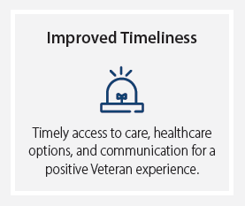

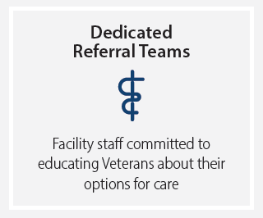
The Goal of Referral Coordination Initiative (RCI)

Slide 4

RCI Goals
Improved Timeliness
Timely access to convenient care in a welcoming environment, with appropriate healthcare options and communication that builds trust and a positive Veteran experience.
Decrease referral scheduling time to 3 days for internal/direct care and 7 days (aspirational) for community care
Key Metrics
Direct Care in VA: Three (3) days
Community Care (aspirational):
    FY21Q2 – 21 days
    FY21Q3 – 14 days
    FY21Q4 – 7 days
Notes:
*Average Days from File Entry Date (FED) to 1st Scheduled by 1st Scheduled Month (Internal and CC)​
(Kathy Benjamin is going to provide and example to illustrate what this means for audiences who aren’t well-versed in scheduling nomenclature.)

Slide 5

RCI Goals
Collaborative Journey
A collaborative health care journey between the Veteran and his or her care team to achieve desired health outcomes.
Improve Veteran satisfaction by ensuring Veterans understand their full range of care options for internal/direct and community care and are able to make an informed decision about where, when, and how they would like to receive their care
Key Metrics
Improve Veteran satisfaction
Increase agreement scores in V-Signal Surveys related to RCI

Slide 6

RCI Goals
Dedicated Referral Teams
Administrative and clinical staff who will be better positioned to listen and act on Veteran preferences.
Utilize internal/direct specialty care services and maximize value-added community care options by ensuring staff only refers Veterans into the community who are both eligible for community care and actively choose to receive care by community providers
Key Metrics
Timeliness to schedule Veteran appointments (internal and CC)
Percent of Veterans engaging with RCT
Referral patterns for internal/direct vs community care
VSignals data to monitor Veteran satisfaction

Slide 7
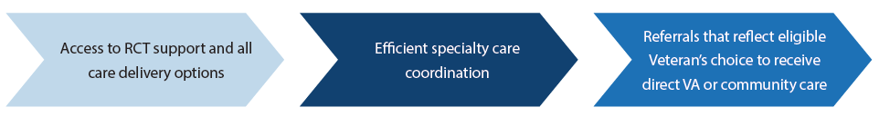
Referral Coordination Teams
Implement Referral Coordination Teams (RCT) to:
Serve as the liaison between referring providers and specialty care services
Remove administrative burden from referring providers
Provide support and comprehensive information about healthcare options within VA and if eligible, community care
Ensure Veteran preferences for healthcare are followed
Move all referrals from pending to scheduled in a timely manner

Slide 8


Referral Coordination Teams
To be successful, RCTs will:
Eliminate direct entry of community care referrals by referring providers
Establish a network of interfacility referral options between VAMCs to support facilities with limited or no on-site specialty care services
Streamline and expedite the appointment scheduling process for all referrals
Identify scheduling preferences for all Veterans who choose community care using the consult toolbox
Utilize RCI Clinical and Administrative staff model recommendations to support a dedicated RCT

Slide 9
RCI Process – Ideal State
RCTs will coordinate the referral process across Primary Care, Mental Health, and Specialty Medicine/Surgery Care services, improving the experience for each Veteran by:
  Explaining all options of care available including in-person, virtual care, and telephone
  Determining community care eligibility, educating them about these options, capturing their community care scheduling preferences and initiating the community care scheduling process when appropriate
  Utilizing clinical and administrative staff who have been cross trained in both in-house and community care processes to ultimately decrease the number of hand-offs, rework, and time to triage and schedule appointments
The aspirational goal for RCTs is to review 100% of referrals and schedule the Veteran’s appointment within three (3) days for VHA care with an aspirational goal of seven (7) days for community care.

Slide 10
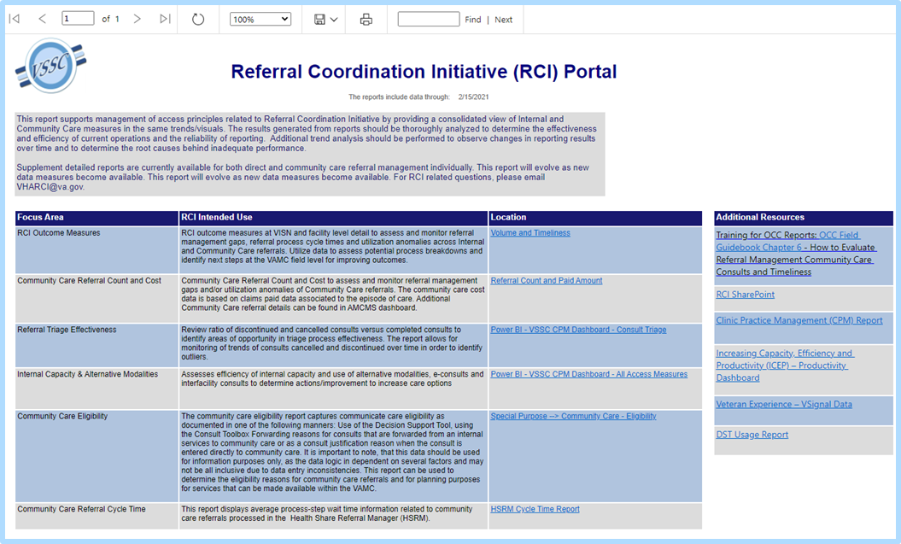
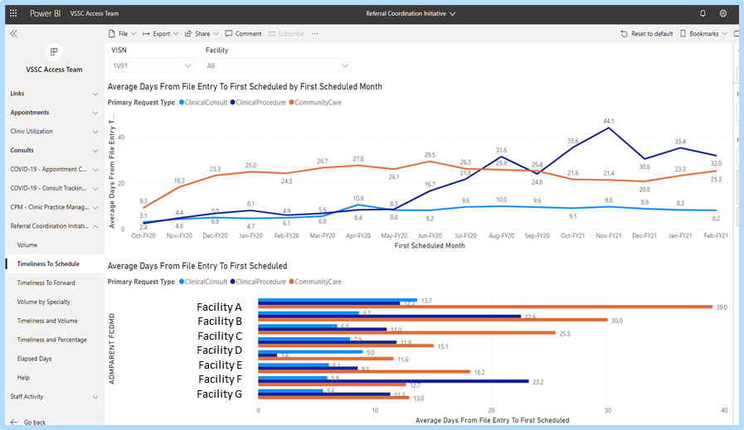
RCI Data Tools
Network Directors report on RCI progress on Health Operations Center calls to VHA leadership
ND reports focus on a consolidated dashboard view of internal/direct and community care measures
RCI Data Portal: Launching pad into RCI VSSC Dashboard and pre-existing related reports supporting management of referral management process
RCI VSSC Dashboard: Provide a consolidated view of RCI key performance indicators (KPIs) from both internal/direct and community care measures
Office Hours and additional training for these tools are available

Slide 11
RCI Data Tools
Intent: provide a consolidated view of internal/direct and community care measures related to RCI
  RCI Data Portal: Launching pad into RCI VSSC Dashboard and pre-existing related reports supporting management of referral coordination process
  RCI VSSC Dashboard: Provide a consolidated view of RCI key process indicators (KPIs) from both internal/direct and community care measures
  Supplement detailed reports are currently available for both internal/direct and community care referral management individually
The results generated from reports should be thoroughly analyzed to determine the effectiveness and efficiency of current operations and the reliability of reporting.
Additional trend analysis should be performed to observe changes in reporting results over time and to determine the root causes behind inadequate performance.
This report will evolve as new data measures are incorporated from various end users (i.e. RCI ELT, ND, VISN GPM, GPM, Admin/Clinical Leads)
Reports align with KPIs presented by ND’s on weekly RCI HOC
The VSSC Consult Cube Dashboard must be used in order to obtain SSN level data of the reports captured on the RCI VSSC Dashboard.

Slide 12
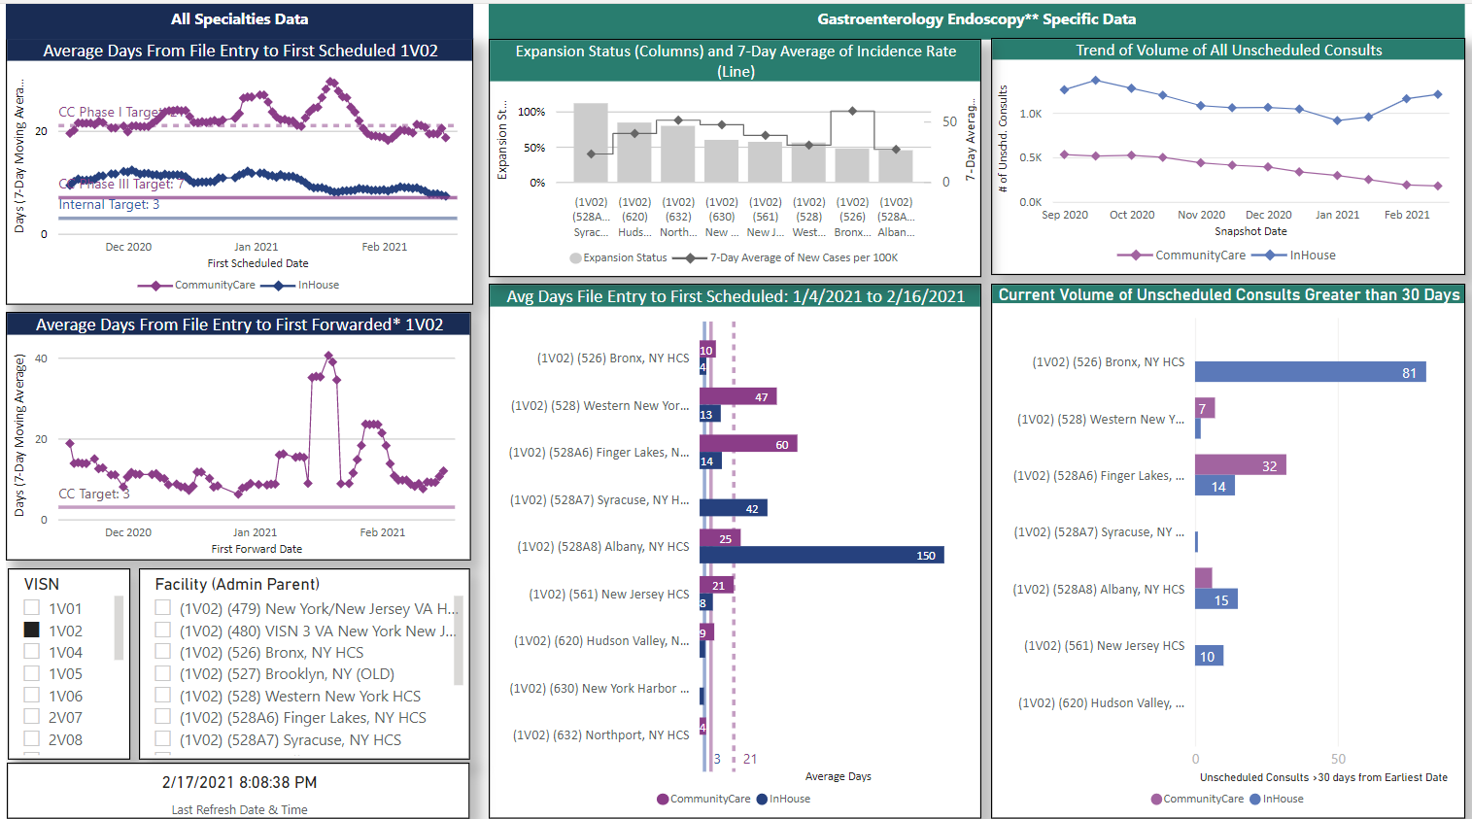
RCI & Specialty Specific - Example HOC Slide
A
D
F
B
E
Facility A
Facility B
Facility C
Facility D
Facility E
Facility F
Facility G
G
Facility A
Facility B
Facility C
Facility D
Facility E
Facility F
Facility G
C
<VISN comments here: (1) RCI progress, trends in data, accomplishments, barriers etc (2) If a VAMC is 0 for E or G, please explain here.>
*This metric does not include consults that are entered directly to community care
**Gastroenterology Endoscopy consults are identified as follows : Internal Consults are stopcode 321 only. Community Care GI Endoscopy and Other Procedures consults are identified by consult service names. A list of 227 consult service names have been categorized as such.
Data as of : 02/22/2021

Slide 13
Additional RCI Resources
RCI SharePoint page: VHA Referral Coordination Initiative
RCI Project team provides feedback to NDs on local RCI implementation progress and outcomes during weekly Health Operations Center call
RCI memo includes additional guidance and expectations (Coming Soon)
Updated RCI Guidebook (Coming Soon)
Internal/Staff and External/Veteran Communication Materials
RCI Implementation Checklist (Coming Soon)
RCI Weekly Meeting – Wed. 12 p.m. ET.
Contact the RCI Project Team at VHARCI@va.gov for additional support as needed

Slide 14

Questions
Pre-Decisional
Internal VA Use Only

Slide 15
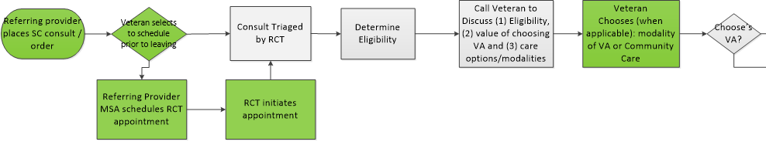
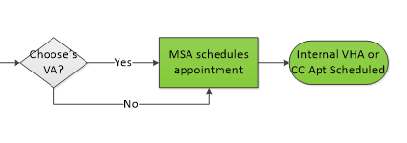
RCT Process Maps
VETERAN EXPERIENCE
RCT PROCESS MAP
Pre-Decisional
Internal VA Use Only

Slide 16
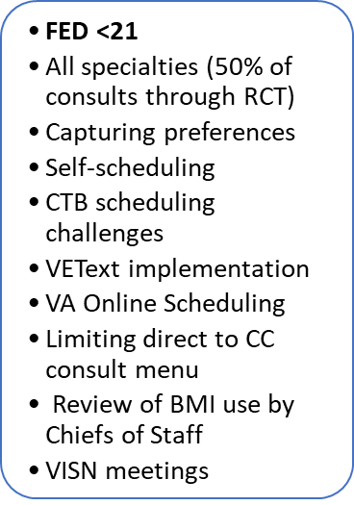
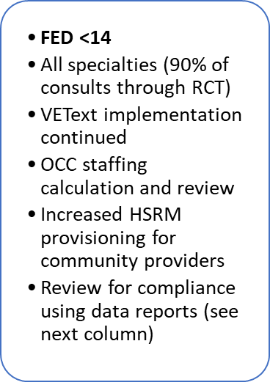
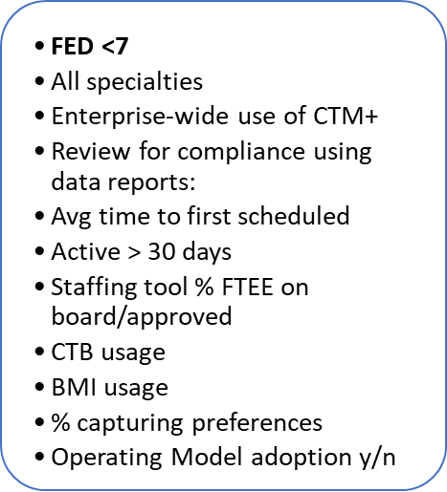
FY21 RCI Milestones
Completion of VISN specific supply/demand assessments
RCTs fully implemented across all specialties
50% of consults through RCTs
VISN-level partnerships fully implemented
75% of consults through RCTs
Scheduling Timeliness: VHA <=3 days; CC <=7 days
90% of consults through RCTs
January
February
April
June
OCC RCI FY21 Glidepath for Scheduling
January - March
April – June
June 1 and beyond
Pre-Decisional
Internal VA Use Only

Slide 17

Referral Coordination Team (RCT) - Composition
MOVE TO NOTES SECTION
The Referral Coordination Team (RCT) is comprised of clinical and administrative staff. The RCT serves as the care coordinators for both internal/direct and community care needs.
  Clinical RCT. Clinical RCTs should be a nurse. Sites may use MD/DO/NP/PA during the transition to RNs. They should be cross trained to triage both internal/direct and community care referrals.
    perform initial triage on all consults
    run the DST or determine community care eligibility through alternative means
    call every Veteran to review possible community care eligibilities and internal/direct care modality options
    document the conversation with the Veteran using the RCI Consult Toolbox (CTB) tab [in production]/
    Capture #RCT# comment on consult after clinical review
    complete a warm hand-off to the Administrative RCT to schedule the appointment
    Capture the Veterans community care scheduling preferences and forward the consult to community care using the Consult Toolbox, when applicable
  Administrative RCT. Administrative RCTs should be a Medical Support Assistant (MSA) scheduler or equivalent. They should be cross trained to schedule both internal/direct and community care appointments.
    accept the warm hand-off from the Clinical RCT if appliable or call every Veteran to schedule both internal/direct or community care appointments per VHA scheduling directives
    Capture #RCT# comment on consult after clinical review (if clinical member on the team did not capture, but clinical review was completed)
    Capture the Veterans community care scheduling preferences and forward the consult to community care using the Consult Toolbox, when applicable
Make this visual

Slide 18
VAMCs with Limited or No On-Site Specialty Care
All VAMCs are required to implement RCI and put RCT in place.
VAMCs with limited or no on-site specialty care services should work with VISN and VAMC leadership to develop a VISN-level inventory and appropriate service level agreements between VAMCs that are able to provide e-consult reviews and/or in-person or virtual care appointments for Veterans as an alternative care option.
VAMCs are also encouraged to offer the Veteran an appointment with the Clinical Resource Hub (CRH) within their VISN as an alternative care option to community care when care is unable to be delivered via service level agreement.

Slide 19
Ideal RCI process for limited or no-on-site specialty care
During the Veteran’s initial visit, the referring providers will inform the Veteran that the RCT will contact them within 3 days to review all potential eligibilities and care options for their referral(s) and coordinate appropriate internal/direct or community care appointments.
VAMCs must decide if they will utilize an on-site RCT at the referral originating facility or a partnering RCT located remotely or at another VAMC
  If the RCT reviewing the consult is located at the originating VAMC:
    The referring provider enters an e-consult or internal/direct consult.
  If the RCT reviewing the consult is located remotely or at another VAMC:
    The referring provider will enter an e-consult or interfacility consult
The Veteran will have the option to schedule an RCT appointment prior to leaving the referring provider’s office.
The RCT located at the originating facility or the partnering facility will follow the same process outline for the RCT.

