Slide 1
David Atkins, MD, MPH
COVID-19 ANALYTICS AND IMPACTS

Slide 2
Health Services Research on the Impact of COVID
(Points of Contact follow Research Areas)
Rapid Synthesis of Emerging Evidence – Nicole Floyd
Observational studies of medication treatments – Alexandra Neuhaus-Follini
Long-Term COVID Outcomes – Alexandra Neuhaus-Follini
Rapid response projects – Emily Evans, Maciej Gonek
Disparities in COVID Outcomes – Naomi Tomoyasu, Alexandra N-F
Modeling Risk of Infection and Poor Outcomes – Miho Tanaka
COVID impacts on Veterans in Long Term Care – Nsini Umoh Improving Data Sources for COVID Research – Scott Duvall
IN DEVELOPMENT – Impacts of the Pandemic on Care and Outcomes for Non-COVID Conditions – Stephanie Guerra
Vaccine Attitudes and Implementation – Miho Tanaka, Maciej Gonek

Slide 3

QUERI Contributes to VA’s Fight Against COVID-19
Built on 20+ years of experience in rapid deployment of effective practices (e.g., rapid HIV testing toolkit, tele-mental health collaborative care)
National COVID-19 survey led by QUERI PM Melissa Braganza identified best practices to rapidly pivot QI projects to virtual care, data collection
First VA COVID-19 Drive-Thru testing site: “Swab Squad” (Denver QUERI)
Tele-critical care learning communities in partnership with Offices of Rural Health, Connected Care (Virtual Specialty Care QUERI, Seattle, Iowa)
Virtual implementation strategy and leadership training support for providers pivoting to virtual care (Behavioral Health QUERI)
Scale up and spread Veteran Advanced Care Planning Gold Status Practice Shark Tank, in partnership with Diffusion of Excellence
For more information, visit: https://www.queri.research.va.gov/qnews/may20/default.cfm

Slide 4
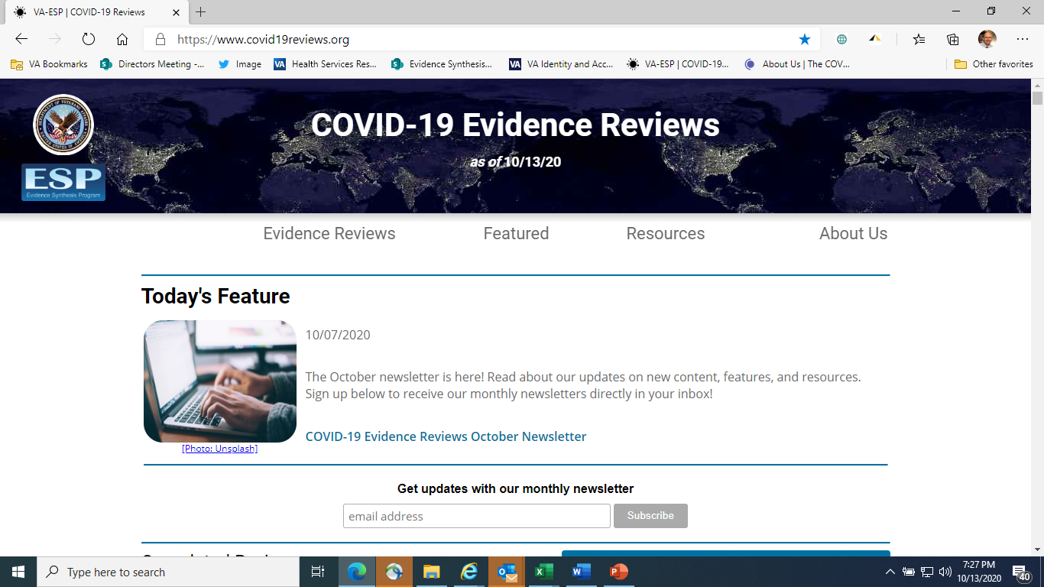
Evidence Synthesis Program (ESP)
Resource for Clinical and Operational Leadership to Support Decision-making for COVID-19
Ultra-Rapid Reviews & Living Reviews
  Within 7-10 days of request of VA partners
  8 completed (2 living reviews)
    COVID-19: Intensive care unit length of stay and ventilation days
Critical Appraisal of New Research
  Critical appraisal of individual high-priority studies, including pre-prints
  6 completed:
    PREPRINT REVIEW: Outcomes of hydroxychloroquine usage in COVID
COVID-19 Evidence Review Website
  Developed in cooperation with WHO
  Pulls from 15 international sources
  Over 500 new reviews/protocols per month
Please let us know if you’d like to receive email notifications for reports in progress: covid19reviews@gmail.com

Slide 5
COVID HSR&D Research Rapid Response Initiative
Can we work quickly to generate insights on a new problem?
9-month funding for new projects or supplements (concluding February – April 2021)
Reviewed 200 proposals over 2 rounds, funded 21 new projects & 5 project mods
Examine wide range of outcomes related to COVID, pandemic response
  Mental health impacts
  Direct clinical impacts (CKD, long-term effects, CLCs)
  Disruptions in care (Chronic disease, CVD)
  Health system (Nurse staffing, Occ Health planning, Restarting care)
Reviewing mid-project progress (partnerships, early insights)
Lay groundwork for longer-term studies (SMRB or new initiatives)

Slide 6
Studying COVID-19 Impacts on Mental Health
(20 projects & project mods funded by HSRD, RRD and CSRD)
Populations at Risk
General Veteran Population
Veterans with MH Conditions (MDD, PTSD, Substance Use)
Other Vulnerable Populations (Aging, Homeless, Residential, Rural)
Clinical & Behavioral Outcomes*
Activities
Functioning
Family relationships
Mental Health Symptoms
Physical Health
Substance Use
*Potential relationships (and effects) among variables within this set.
C
COVID-19-related stressors
COVID-19 Infection
Local COVID severity
Public Health Response
Restrictions (schools daycares, living facilities, business, travel)
Shelter in Place Measures
Social Distancing
Intermediate Outcomes*
Basic Needs (e.g., food, housing, income)
Medical Care (access, utilization, adherence)
Social Support (access to social services, community support & integration, social connectedness)
*Potential mediators or moderators of clinical/behavioral outcomes
Interventions to Address Mental Health
Both COVID-19 and
non-COVID-19 specific
Interventions to Address Medical, Social, and Economic Resource Needs

Slide 7
Medication Safety and Effectiveness Collaboratory
Can we use VA EHR data for insights into effective COVID Rx?
Grew out of work with FDA Evidence Accelerator efforts
Initial aim -- identify good candidates for definitive drug trials
Current emphasis -- develop “real-world evidence” to supplement evidence from RCTs
  Hydroxychloroquine
  Anti-coagulants
  Remdesivir
  Steroids
Data and Methods Workgroup to improve methods for COVID-19 observational studies
Prioritization group to identify new candidate topics

Slide 8
COVID-19 Observational Research Collaboratory (CORC)
Including Study of Long-Term Outcomes
Will take over all activities currently under the umbrella of the Medication Safety and Effectiveness Collaboratory
PIs will lead an observational study focused on long-term outcomes, which will complement ongoing work by EPICCC
Concept papers were due on 12/2

Slide 9
Impacts of Pandemic on Non-COVID Care and Outcomes
What conditions have been most affected by disrupted care?
Held planning meeting on November 20th with group of ~50 operations and program partners and researchers
  mental health, acute care, and chronic/preventive care
Goals of meeting
  Share information between program and research leads on how pandemic is disrupting care.
  Decide on most important questions where research can help
  Discuss possible comparisons for isolating impacts of the pandemic and underlying causes and ways to mitigate them
HSR&D staff determining next steps, stay tuned

Slide 10
Racial/ethnic disparities in COVID-19 outcomes
Rentsch et al. (PLoS Med): https://journals.plos.org/plosmedicine/article?id=10.1371/journal.pmed.1003379
  Black and Hispanic Veterans more likely to test positive for COVID-19 than non-Hispanic White Veterans
  No racial/ethnic disparities in 30-day mortality
Ioannou et al. (JAMA Netw Open): https://jamanetwork.com/journals/jamanetworkopen/fullarticle/2770946
  Black Veterans more to require mechanical ventilation than non-Hispanic White Veterans
  No racial/ethnic disparities in case fatality rate
Mackey et al. (Annals) – https://www.acpjournals.org/doi/10.7326/M20-6306
  Systematic review
  Main driver of racial/ethnic disparities in COVID-19 outcomes is exposure (e.g., status as a frontline worker)

Slide 11
Implementation of COVID-19 Vaccination Efforts
Can research help improve delivery and uptake of COVID vaccine?
Questions
What are VA healthcare workers’ and Veterans’ attitudes toward COVID-19 vaccines?
  How do these change over time?
  How do these vary over specific subgroups (eg. Racial/ethnic groups)
What is effective messaging to promote Vaccine uptake?
What factors affect implementation?
Partners
National Center for Health Promotion and Disease Prevention (NCP)
Pharmacy Benefits Management (PBM)
Office of Health Equity (OHE)
Mechanisms
QUERI: 3-6 month period, begin January
HSRD Solicitation 2 years
  RFA released mid-December
  Fund projects by spring

Slide 12
QUERI Rapid Response Teams (RRTs)
Time-sensitive Evaluation of COVID-19 Vaccine Implementation
New initiative at the behest of VA national leaders to have existing QUERI Centers take on 3-6 month time-sensitive projects
3 RRTs commissioned 12/20 to respond to time-sensitive quality improvement & evaluation needs for Vaccine IPT, NCP
The “QUERI RRT3”
Bedford QUERI (Rani Elwy)
Vaccine Mitigation Strategies
Hines QUERI (Charlesnika Evans)
Veteran perspectives on vaccine
Durham QUERI (Nicki Hastings)
Employee Perspectives on vaccine
“Learn quickly, (don’t be afraid to) fail quickly, and apply lessons to move forward quickly” – Carolyn Clancy

Slide 13
COVID data modeling workgroup - Modeling Risk of Infection and Poor Outcomes
Objectives of the workgroup:
  Create a venue for ORD investigators to share and collaborate on modeling projects
  Discuss optimal use-case for modeling to improve clinical decisions and care and steps to get models into practice
  Help identify topics for prioritized work or funding.
Operational partners: National Center for Health Promotion and Disease Prevention, VA Emergency Medicine, Office of Innovation Ecosystem, Office of Health Equity, and Office of Healthcare Informatics
Achievements:
  Model estimating risk of COVID-related death among 9 million Veterans potentially informing vaccination allocation strategies
  AI Model predicting a 30-day mortality among Veteran enrollees tested positive with COVID
  Model predicting 30 day mortality of COVID infected patients could be used for prioritizing treatments or triaging follow-up care
Notes:
One of the outcomes of ORD’s Mini Scientific Symposium: Individual Risk Prediction for COVID-19, held on June 19, 2020.
Operational partners: National Center for Health Promotion and Disease Prevention, VA Emergency Medicine, Office of Innovation Ecosystem, Office of Health Equity, and Office of Healthcare Informatics
Membership: George Ioannou, Vincent Marconi, Gil Alterovitz, Matt Samore, Timothy Hofer, Jonathon Sugimoto, Dr. David Arreola, Dr. Raymond Chung, Kate Cillessen, Kristin Watt, Melissa Knox, Michelle Wong, Robert Bonomo, Seth Hurley, Thomas Osbourne, Vincent Fan, Zachary Veigullis, Dr. David Atkins, Jody Garber, Janeen Smith, David Massaro, Kyung Lee,, Casey Okamoto, Franz Macedo, Kristen Berry, Christos Makridis, Jonathon Sugimoto, David Arreola,

Slide 14

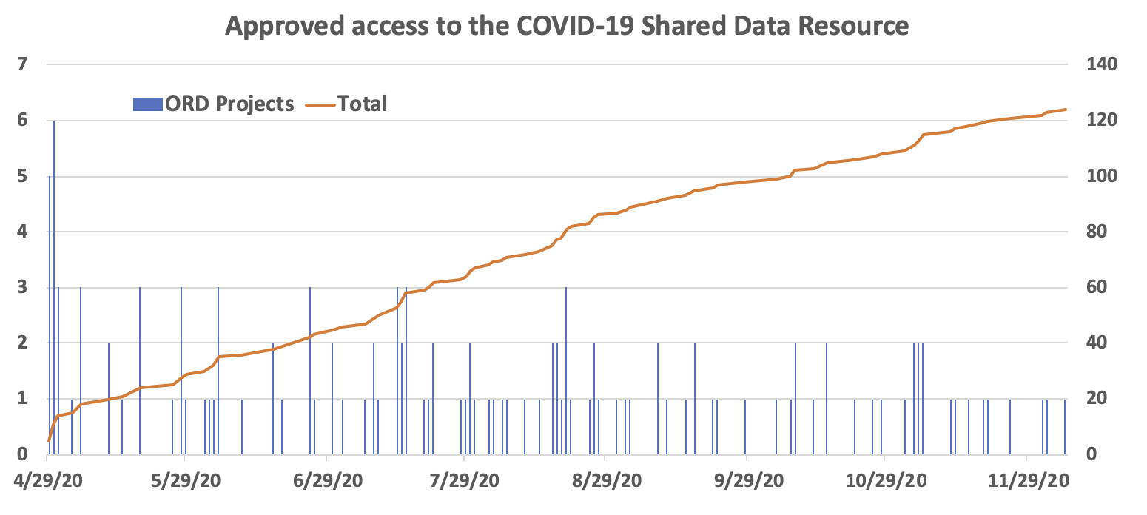
VA COVID-19 Shared Data Resource
VINCI’s newest data domain available to VA researchers and operational partners
Contains information on all patients who:
  received a COVID-19 laboratory test (positive or negative) within VA
  tested positive outside VA and information pertaining to the positive test was recorded in VA clinical notes
347 data elements/phenotypes as of 12/7/2020 related to:
  Pre-existing conditions
  Sociodemographic factors
  Pharmacological and non-pharmacological interventions
  Patient outcomes
  Community data
124 ORD research studies with approved access to the Shared Data Resource as of 12/7/2020

