Slide 1


VA Health Services Research & Development Service
State of the Art Conference
Opening Plenary Session
May 18, 2022

Slide 2
Opening Plenary Agenda
Defining Virtual Care
Why Virtual Care (VC)
Where We’ve Been
Access → Engagement → Outcomes
Operational and Veteran Perspectives
SOTA Goals & Products
Charge to the Workgroups

Slide 3
Defining Virtual Care
Drawing on the Office of Connected Care’s Strategic Plan:
We use the term “virtual care technologies” to refer to technologies intended to enhance the accessibility, capacity, quality, and experience of VA health care for Veterans, their families, and their caregivers, wherever they are located.

Slide 4
Why Virtual Care is a Priority for VHA
Potential to address some disparities in care; but also exacerbate others
  Growing digital divide
Variation in engagement with VC within the Veteran population
  Need to understand why and how to enhance engagement if we hope to realize the potential of VC
Proliferation of VC technologies in and outside of VA
  Need to know what works and what doesn’t for who, and why – in order to use VA resources optimally and advance our mission
Notes:
First bullet: Opportunity to discuss threatened access

Slide 5
Virtual Care Research in VA
Portfolio review data gathered directly from public HSR&D database
Data abstracted from project descriptions
369 HSR&D funded projects identified (2011-2020)
Additional projects continue to be counted and abstracted
Grant Type/ Funding Mechanism | Response Frequency: Percentage (N=369)
IIR | 37%
PPO | 14%
RRP | 13%
CDA | 9%
SDR | 5%
CRE | 4%
Other | 18%

Slide 6
Virtual Care Research in VA
*More than one Care Type could be selected for a project
Notes:
Majority of VC work conducted on mental and behavioral health aligns with expectations
180 projects were categorized as “Health Systems” (either alone or in conjunction with another type)

Slide 7
Virtual Care Research in VA
*More than one VC Category could be selected for a project
Notes:
In recent years, total number and proportion of synchronous (video and telephone) telehealth-focused projects have grown, significantly outpacing others

Slide 8
Virtual Care Research in VA
For HSR&D projects with clinical trials (n=99), primary outcome field was abstracted and categorized
Only one outcome category was selected; categories were inductively developed
Majority of work primarily studied health-related outcomes (vs. utilization, cost, access, or patient centeredness)

Slide 9
SOTA Process—Where We’ve Been
Co-chairs convened planning committee
  refined key workgroup questions
  identified subject matter experts to participate in workgroups
  selected pre-conference readings to address SOTA objectives
  created evidence briefs based on review of research
Three workgroups and leads developed questions/readings:
  Access (Donna Zulman, Ursula Myers, Charlie Wray)
  Engagement (Tim Hogan, Jenice Guzman-Clark, Taona Haderlein)
  Outcomes (Scott Sherman, Samantha Connolly, Jeydith Gutierrez)

Slide 10
Continuum of access, engagement, & outcomes
Veteran gains and maintains access to VC technologies
Has/is provided Internet enabled device
Has/is directed to reliable, affordable broadband
Receives baseline digital literacy training if needed
Ongoing navigation
Veteran adopts VC technologies and stays engaged
Initial decision to try VC tool/technology
Support available to troubleshoot issues
Clinical teams engaged in VC use/data sharing
Positive reinforcement
Veteran sees improved outcomes
Better health outcomes
Increased access to care/ reduced wait times
Time/cost savings (convenience)
Increased self-efficacy
Feeds back to engagement
Notes:
Broader set of outcomes
Annie usage – patient engagement “the whole journey” through finishing the protocol
More virtualized facilities – divide formed by some places doing more. How can we use this to make sure this is something veterans aren’t getting with variability
Can’t vs Don’t use VC
Veteran and Care team is critical
Providers don’t adopt because of lack of evidence base, VC needs to be woven into workflow – what are incentives?

Slide 11
Virtual Care Perspectives
Opportunities, Challenges, and Priorities
  Leonie Heyworth, MD, MPH; Nancy Wilck
Veteran Experience
  Rebecca Keller, MBA, OTF, Colonel USAF (ret)
Notes:
Before handing off – mention dinner plans taped outside general session, people can sign up during first break, during lunch, or second break

Slide 12

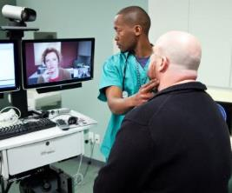



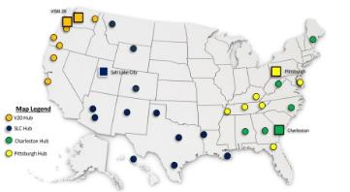
Telehealth Approach: From Anywhere to Anywhere
Where VA Connected Care Occurs
Home/Community
Clinic
Hospital
Portal / Secure Messaging
Home Telehealth / Remote Monitoring
VA Video Connect
mHealth - Apps, Annie
Telephone Care
Tele-Urgent Care
And more…
Video Telehealth
-Primary Care
-Mental Health
-50+ specialties
Store and Forward Telehealth
Provider Connect
TeleICU
TeleStroke
TeleNephrology
More …
How VA Implements Connected Care
Local
Regional
National
Goal: Connected Care Integration into all routine operations
Clinical Resource Hubs
TeleMental Health
TelePrimary Care
TeleDermatology
TeleRehabiitation
TeleSleep
Expert TeleConsultation
  TeleGenomics
  Specialty Mental Health
TeleEmergencyManagement
TeleICU, TeleStroke, etc.

Slide 13
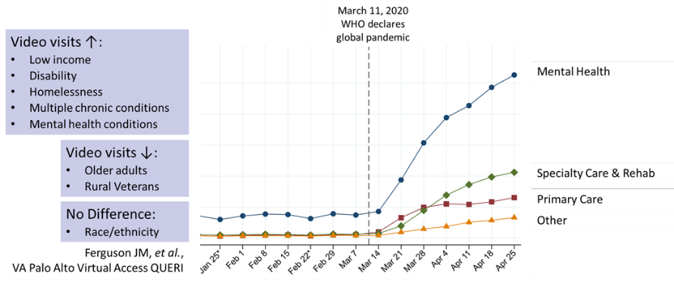
Where We’ve Been: Early Pandemic

Slide 14
Growth in Connected Care Services

Slide 15
Relentless Focus on Patient Experience

Slide 16
Challenges in Virtual Care - Patients
  Little awareness of virtual care tools other than My HealtheVet and VVC
  Most patients unlikely to use tools unless recommended by their provider or another trusted source
  Lack of savviness with technology presents a barrier to communication and access
    e.g., many Veterans own a smartphone but use them only for phone calls; two-factor authentication is extremely challenging; broadband or Wi-Fi not always available

Slide 17

Challenges in Virtual Care - Providers
    Lack of time to learn about tools – there are so many!
    Virtual care tools typically provide additional data rather than insights
    Uncertain about tools’ evidence base, privacy and security
    Mismatch between existing workflows and virtual care tools (spread across multiple apps/platforms)
    Uncertain how to determine patient readiness to use virtual care

Slide 18

Where We’re Going: Ideal Health Care Platform
Goal: simplify and consolidate offerings with initial focus on patient engagement
Patients are eager to utilize a single hub for all VA healthcare apps to increase engagement in self-monitoring their health and patient-provider relationships.
Patients want ability to assign specific data access rights to granular data to friends/family members/caregivers/providers

Slide 19
Ideal Connected Care Platform
Features that would help drive patient engagement:
Integration between the VA apps – ability for the apps to “talk to each other”
Shared experiences – e.g.,. Patients Like Me
Personalized content and elimination of redundant data entries
Reminders and coaching – reminders for upcoming appointments or prompts to submit health data – can be virtual assistant/coach but want ability to escalate to a ‘real person’
Downloadable app from the App/Google Play Stores
Ability to flag events in tracked data to discuss at next provider interaction
Gamification (goals, challenges, rewards, grading system) to encourage continued engagement with the platform
Ability to record behavioral health and SDOH concerns
Confirmation that provider is reviewing data and making appropriate adjustments to care plan

Slide 20

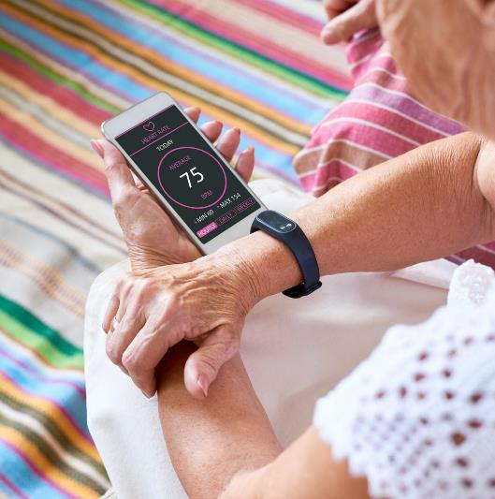

Patient-Generated Health Data (PGHD)
Available to VA staff through the Virtual Care Manager app
Health-related data that is gathered outside of a clinical setting.
Veterans can share information such as diet, mood, sleep, and weight to gather data such as blood pressure, glucose levels, and heart rate.
  Wearable devices and sensors (FitBit, Apple Watch, glucometers)
  Pen and paper
  Apps (Share My Health Data)
  My HealtheVet

Slide 21
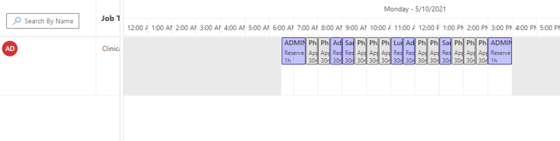
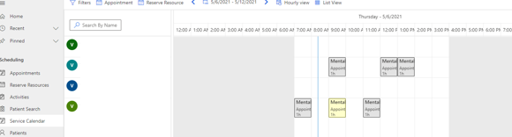
Enhanced Telehealth Scheduling
VA is integrating video-to-home scheduling in front line scheduler applications and establish a cross-facility scheduling system for telehealth that works between Vista and Cerner systems.

Slide 22



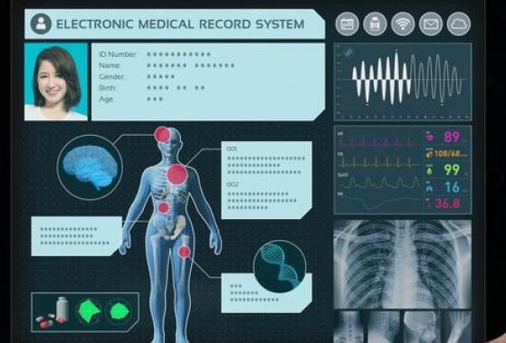


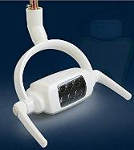
Maximizing Remote Care
EMR
Phase 1
Phase 2
Phase 3

Slide 23
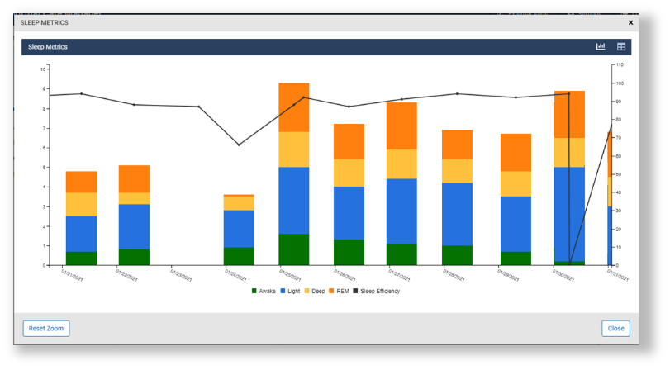

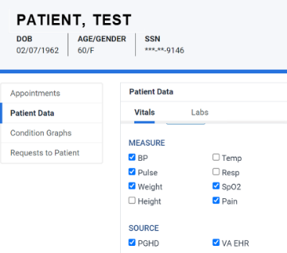
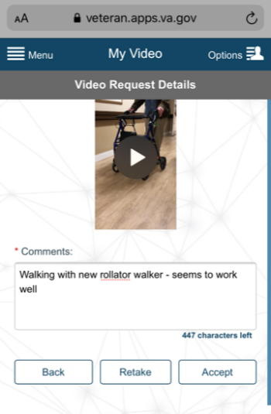
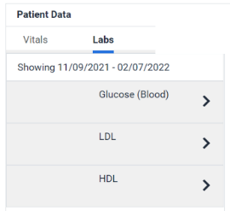
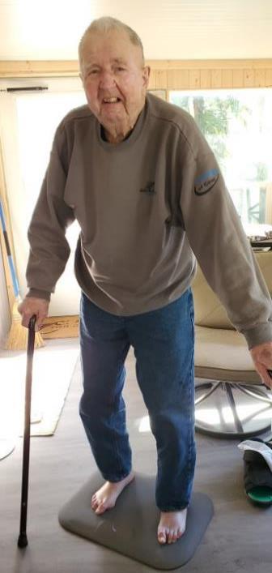

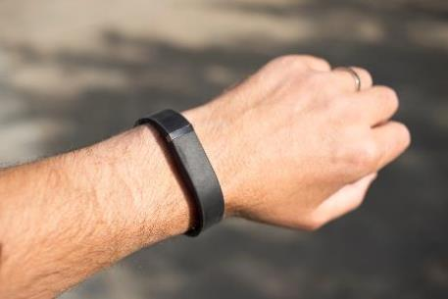
Making Virtual Care Part of the Clinician’s Workflow

Slide 24
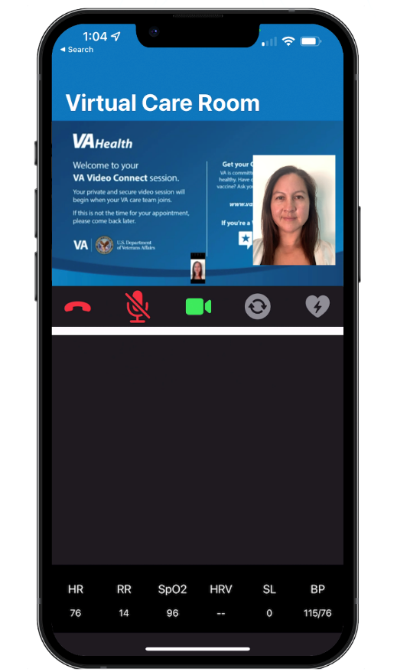


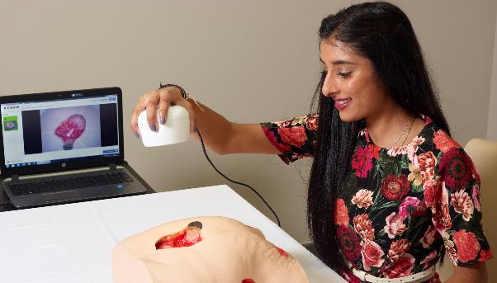
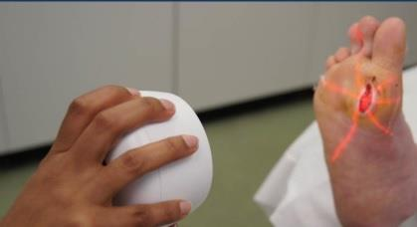
Objective Data Expands Possibilities

Slide 25
Research – Operations – Cross Program Offices
Tele PreOp
Evaluated safety and efficiency of the different pre-anesthesia evaluation modalities in general, and also for the most common outpatient surgery (cataract surgery).
570,489 pre-anesthesia evaluations conducted at the VA between Jan 2016 and July 2021
8.1% (n=46,071) by telephone, 2.2% (n=12,565) by VVC, with VVC increasing to 3.5% of total visits (n= 3441) during the COVID era (March 2020-July 2021)
Findings:
  Tele Care (VVC + Telephone) had lower 30-day mortality rates and lower 7-day and 30-day readmission rates than face-to-face pre-anesthesia evaluations
  Tele Care (VVC + Telephone) had slightly higher rates of date of surgery cancellation and testing rates than face-to-face pre-anesthesia evaluations
Contactless Vitals
Aim 1: Identify providers’ attitudes regarding usefulness, ease of use, reliability, and intention to use VVC Vitals;
Aim 2: Identify patients’ attitudes regarding usefulness, ease of use, reliability, and acceptability of VVC Vitals;
Aim 3: Describe findings regarding provider and patient usability, acceptability, and the feasibility of implementation in routing VA clinical settings.

Slide 26
New Initiatives
Common Themes/Findings:
Awareness and Interest in Video
Veteran awareness of video as an option​
Veteran interest in telehealth ​
Perceptions of Video Quality and Suitability​
Veteran perceptions about quality of care by telehealth ​
Staff perceptions about quality and suitability of care by telehealth​
Scheduling
Veteran awareness of how to schedule a video visit
Staff reported challenges with the number of scheduling grids and platforms
Veteran Training
Digital comfort and proficiency ​
Nervousness and difficulty with using video telehealth​
Inconsistent onboarding​
Need for education, training and technical support
Technology and Infrastructure
Lack of adequate broadband access for Veterans
Affordability of internet/devices/ equipment​
Poor audio/video quality, dropped connections​​
Supporting VA Staff
Issues with use and managing technical difficulties in real time ​
Need for hands on training and technical support
Issues with connectivity at VA

Slide 27

All Politics Are Local
What is the value of virtual care?
Access
Time
Team
Turf
Workload
Experiences
Evidence
Can I change now?
Funding
Feedback
Leadership
Provider/Patient Preferences
Why change now?
Access
↑ Apprehension
Metric
Keeping with the Competition
Funding
Provider/Patient Preferences
New Evidence
New Tool
Training
Recognition of Evolution

Slide 28


The Virtual Healthcare System
Where We Were
Where We’re Going

Slide 29

Patient Experience Video

Slide 30
HSR&D Priorities & ORD Alignment (David Atkins)
ORD is undergoing a reorganization to align decision-making with priority areas rather than research services.
The aim of this move follows the aims of the Virtual Care CORE
  Align and coordinate with the needs of our VHA partners
  Look across work being done in an area regardless of funding service or source
  Identify some priority goals and align funding to meet them
  Address other enterprise issues (e.g. data sources, etc) to advance research
This may create opportunities for new initiatives in this space

Slide 31
Virtual Care SOTA Goals
The primary goal of the SOTA is to inform policy and clinical operations and generate a research agenda focused on opportunities to:
  Address VC access disparities
  Enhance Veteran engagement with VC
  Define and improve outcomes influenced by VC
As you consider potential research priorities, think about:
  Is the barrier to improvement a knowledge problem (vs. an execution problem)?
  Is better information likely to change practice (or is the barrier resources)?
  How will qualitative and quantitative research tools advance our understanding?
  Is this a unique opportunity for VA to study?

Slide 32
Virtual Care SOTA Goals (cont)
In order to create a research agenda focused on VA Virtual Care we will:
Identify areas with sufficient evidence such that further research is not a priority
Identify and prioritize research questions where there is insufficient evidence to guide practice and clinical policy
  Strive for consensus where possible
  Consider priorities that may be relevant across technologies and clinical contexts
Identify issues or new developments on the horizon that may have implications for future research

Slide 33
SOTA Products
VC research agenda
  Developed by HSR&D, based on findings of workgroups
  Should be linked to strong evidence or other clear rationales
  Will be briefed to VA leadership and operational offices
  Can inform program announcements or new solicitations
Virtual Care journal supplement in Journal of General Internal Medicine (JGIM) (in discussion)
Cyberseminars
Other?

Slide 34
Charge to the Workgroups
Day 1
Workgroup leads facilitate discussion to address key questions
  Use a collaborative process to mine, align, and refine ideas
  Use workgroup specific questions to guide you
  Refer to specific evidence to support statements
Workgroup comes to consensus on priority research agenda and implementation strategies
Develop summary of workgroup deliberations, workgroup leads finalize in PowerPoint
Day 2
Workgroup summaries presented to all SOTA participants
Opportunity for clarifying questions and prioritization of summaries
Facilitated full group discussion of next steps

