Slide 1
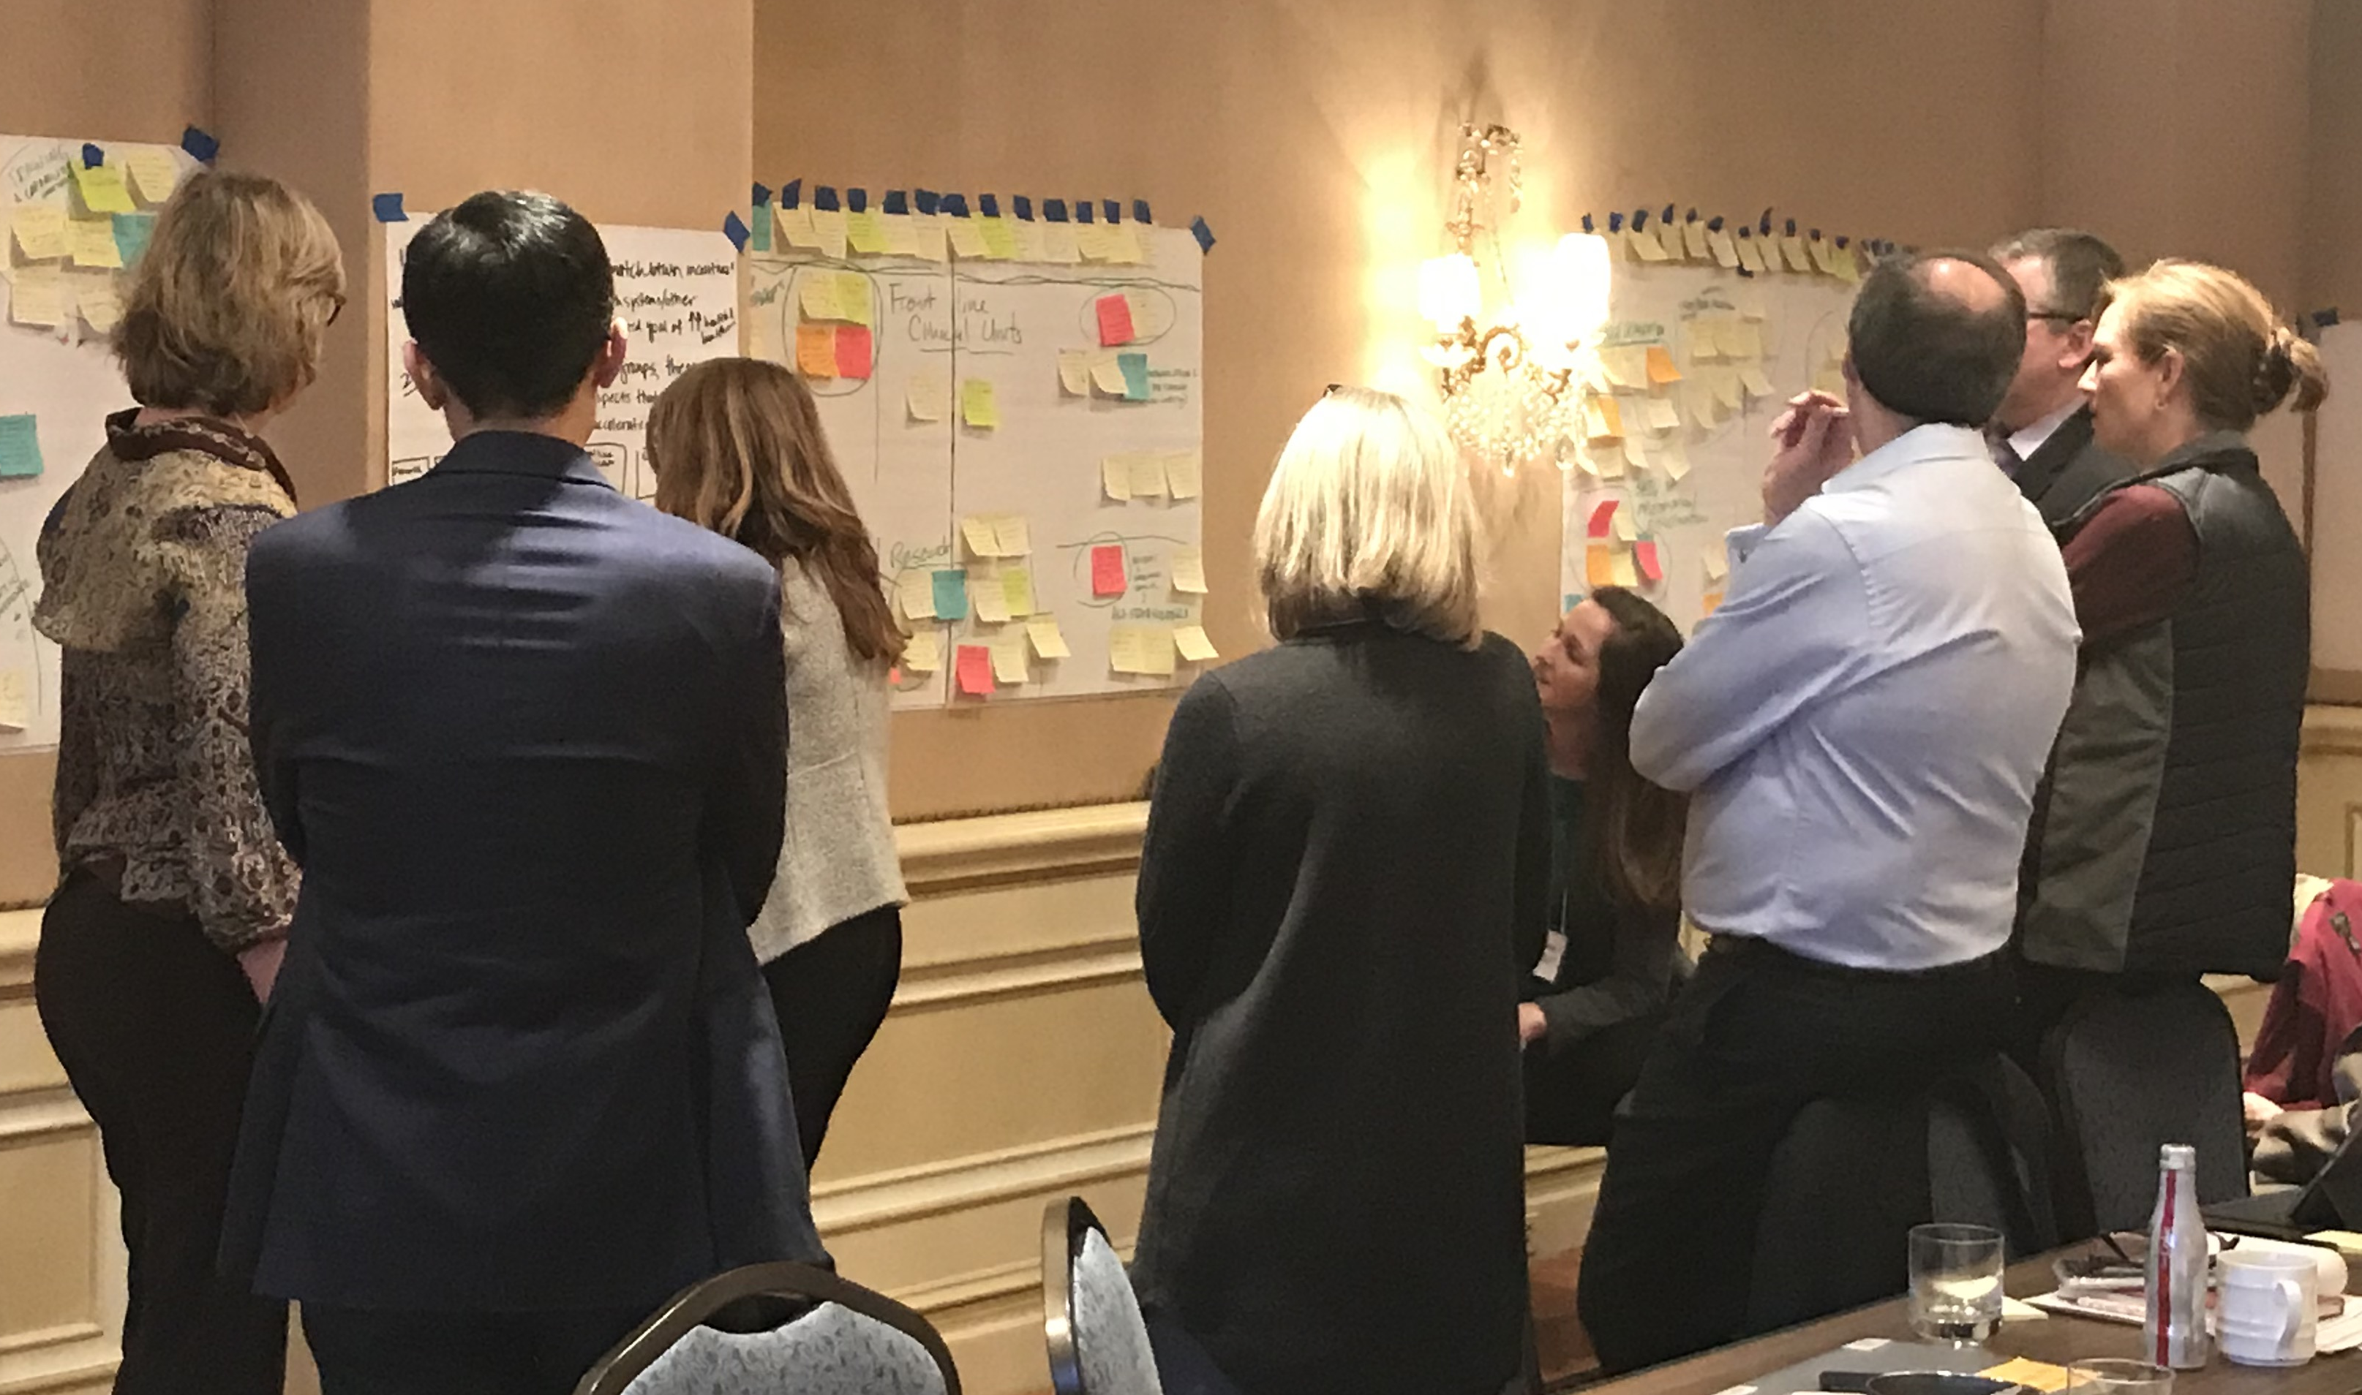
Accelerating Implementation of Embedded Research Output
Workgroup E

Slide 2
Members
Laura Damschroder
Christian Helfrich
NithyaPriya Ramalingam
A. Rani Elwy
Adam Sharp
Amy Huebschmann
Amy Kilbourne
Benjamin Broder
Benson Hsu
Cara Lewis
Diana Buist
George T. Blike
Heather Limper
Jane Brock
Karen Crotty
Laura Seeff
M. Rashad Massoud
Maureen Fagan
Michael Ho
Paula Lozano
Ralph Gonzales
Sarah Greene
Katherine Wilemon
Elizabeth A McGlynn
Andrew Knighton
Lee A Fleisher

Slide 3
Vision for Embedded Science
Everyone is best friends, we maximize learning for everyone, and implement evidence-based practices FAST and perfectly every time
High ROI for the health system
Researchers make a difference in the world
Funders fund programs that truly disrupt and innovate health care
Patients and communities are partners with health systems
Better health for patients and communities is the goal

Slide 4
Chaos (Storming: a normal team process)
Notes:
What is embedded research? Literature has poor, incomplete definitions
What is the evidence supporting embedded research?

Slide 5
Pre-Conditions
Highest performing health systems ALL have models of embedded research
System feels level of urgency: disrupt or die
C-Suite → Middle managers → frontline
External forces e.g., Big Tech poaching
System leaders have incentive to *evaluate*
System leaders value evidence
Include in performance evaluations
Established definition of “embedded research”
Horizontal integration
Alignment of incentives for system and researcher
Metrics to measure success of embedded research
Training Available
Notes:
e.g., KP, Intermountain, VA, Geisinger

Slide 6
Current state (gaps, opportunities to improve)
We don’t understand what is working, where & why
Misalignment between system priorities and research foci
ROI v R01
Established methods and approach to embedded research have not been translated into system operations
No one knows what embedded research is
Pace and efficiency of translating EBI is slow and clunky
Learning repository?

Slide 7
Recommendations for Researchers
Communicate the Value Proposition of embedded research to trainees, academic leaders, system leaders, payers and patients …
Define the role of the embedded researcher (and program)
Develop pitch for rigor while still moving quickly
Impact on quality, cost and patient/family experience
Our research should check all 4 boxes:
Rapid
Relevant
Relationship-driven
Rigorous
Notes:
. Define the role of the embedded researcher (and program): what do you bring in terms of capabilities (e.g., data analysis) and what won't you be able to do (e.g., data acquisition)?
b. Alternative research designs: hybrid trials, stepped-wedge, interrupted time series
i. Help explain in simple language what they are, how they can make it possible to do more rigorous evaluations while still moving quickly

Slide 8
Recommendations for research funders
Align funding for embedded research w/ health systems' priorities
Makes it gravy for health systems to engage embedded researchers--they were going to do it anyway
Create and prioritize new streams of funding
Rapid submission and review (off cycle)
Create study sections and train reviewers
Fund curated embedded-research learning repository

Slide 9
Recommendations for health system leaders
Put implementation science structures in place to complement QI
Ensure health system have robust quality capabilities (Project management, HIT, data analytics, improvement advisors)
Get embedded researchers involved from start to finish (access to data)
System for QI determination & publication of non-human subjects research

Slide 10
Next Steps
Complete analysis & interpretation
Communication and messaging
Lay Media
Washington Post Article
System Leaders – Policy-makers
NEJM @Catalyst
HBR/Blog
Health Affairs
Tweets
Blogs
Highlight multi-perspective insights and recommendations
Health System
Researchers
Patients
Funders

Slide 11
An amazing multi-perspective team

